Slide 1
INDIAN WATER RIGHTS SETTLEMENTS
WSWC/NARF Symposium
August 25-27, 2015
Pamela Williams, Director
Secretary’s Indian Water Rights Office
Letty Belin, Senior Counselor to
Deputy Secretary of the Interior

Slide 2
INDIAN WATER RIGHTS SETTLEMENTS How They Work
Pamela Williams, Director
Secretary’s Indian Water Rights Office

Slide 3
Indian Water Settlements
History and legal underpinnings
Existing Indian water settlements
Settlement elements and benefits
The Federal settlement process
Federal legislation and costs

Slide 4
Historic Background
Basis of Indian water rights is the Federal reserved water rights doctrine established in United States v. Winters in 1908
establishment of a reservation impliedly reserves the amount of water necessary to accomplish the purposes of the reservation (homeland purpose)
past, present, and future uses included
rights are not lost by non-use
governed by Federal and not state law
held in trust by the Federal Government

Slide 5
Historic Background (cont’d)
Despite the Winters decision, Indian water rights were largely left undeveloped and unprotected in the decades after 1908
By contrast, Federal policy and expenditures supported extensive development of water resources to benefit non-Indian communities across the West

Slide 6
Early Efforts to Establish Indian Water Rights
Winters rights were a cloud over western non-Indian water rights
The push to quantify Winters rights began in the 1960s
Disputes over the applicability of the McCarran Act to Indian reserved water rights created a rush to litigate but the results were disappointing

Slide 7
Settlement Era Begins
In the 1970s, tribes, states, local parties, and the Federal Government began questioning the utility of litigation as the way to resolve Indian water rights disputes
Negotiated settlements, rather than protracted litigation, became the preferred approach to resolving Indian water rights conflicts

Slide 8
Completed Settlements
Department of the Interior (DOI) has completed 33 Indian water rights settlements since 1978
Congressionally Approved → 29
Administratively Approved by DOI & Department of Justice (DOJ) → 4

Slide 9
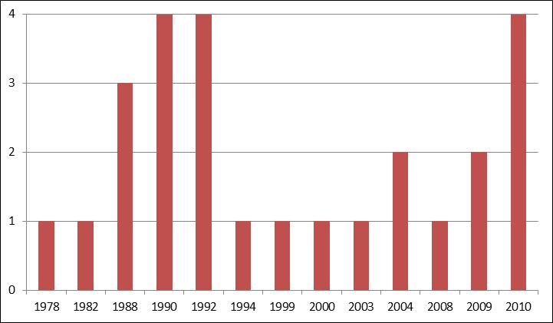
Number of Indian Water Rights Settlements by Year of Federal Legislation

Slide 10
Indian Water Rights Settlements with Federal Legislation, by State

Slide 11
Active Indian Water Rights Settlement Negotiations by State

Slide 12
Settlement Negotiations
Settlement negotiations frequently evolve from litigation but can also occur without litigation
DOI provides technical and other assistance to the tribes
Settlement agreements vary from multi-party agreements to compacts among the state, tribe, and Federal Government
When agreement is reached, parties typically seek Federal approval in the form of Federal legislation

Slide 13
Benefits of Settlements
Wet Water
Provide “wet water” to tribes; litigation provides “paper water”
Win-Win
Provide water to tribes while protecting existing non-Indian water users
Local Solutions
Allow parties to develop and implement creative solutions to water use problems based on local knowledge and values

Slide 14
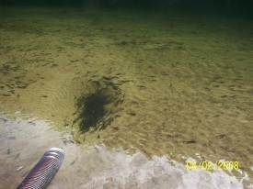
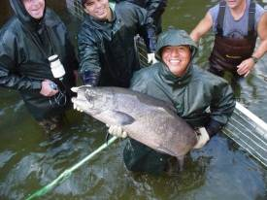
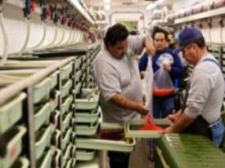
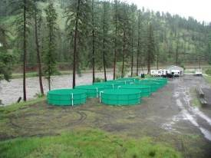
Nez Perce Tribal Hatchery

Slide 15
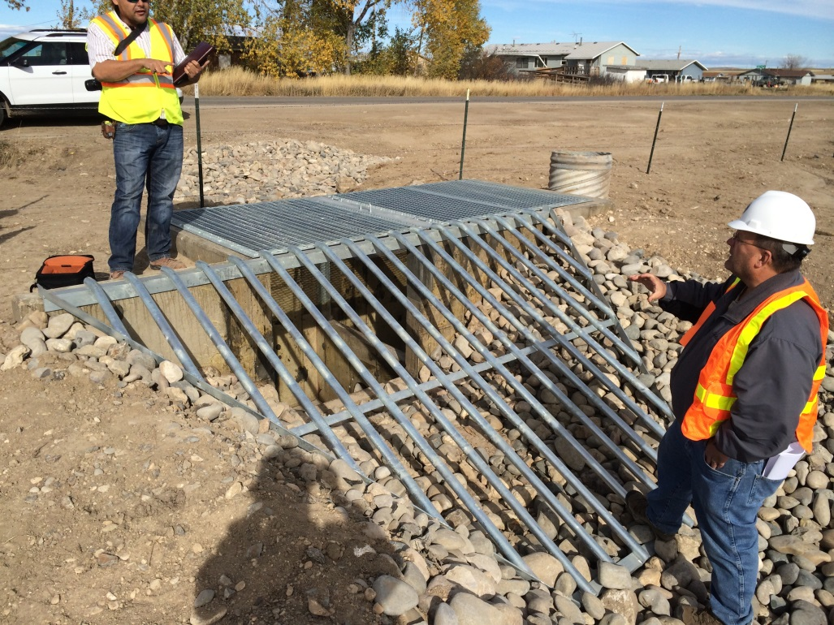
Crow Irrigation Project

Slide 16
Benefits of Settlements (cont.)
Certainty and Economic Development
Provide certainty to tribes and neighboring communities, support economic development for tribes, and replace historic tension with cooperation
Trust Responsibility
Consistent with the Federal trust responsibility and Federal policy of promoting Indian self-determination and economic self-sufficiency

Slide 17
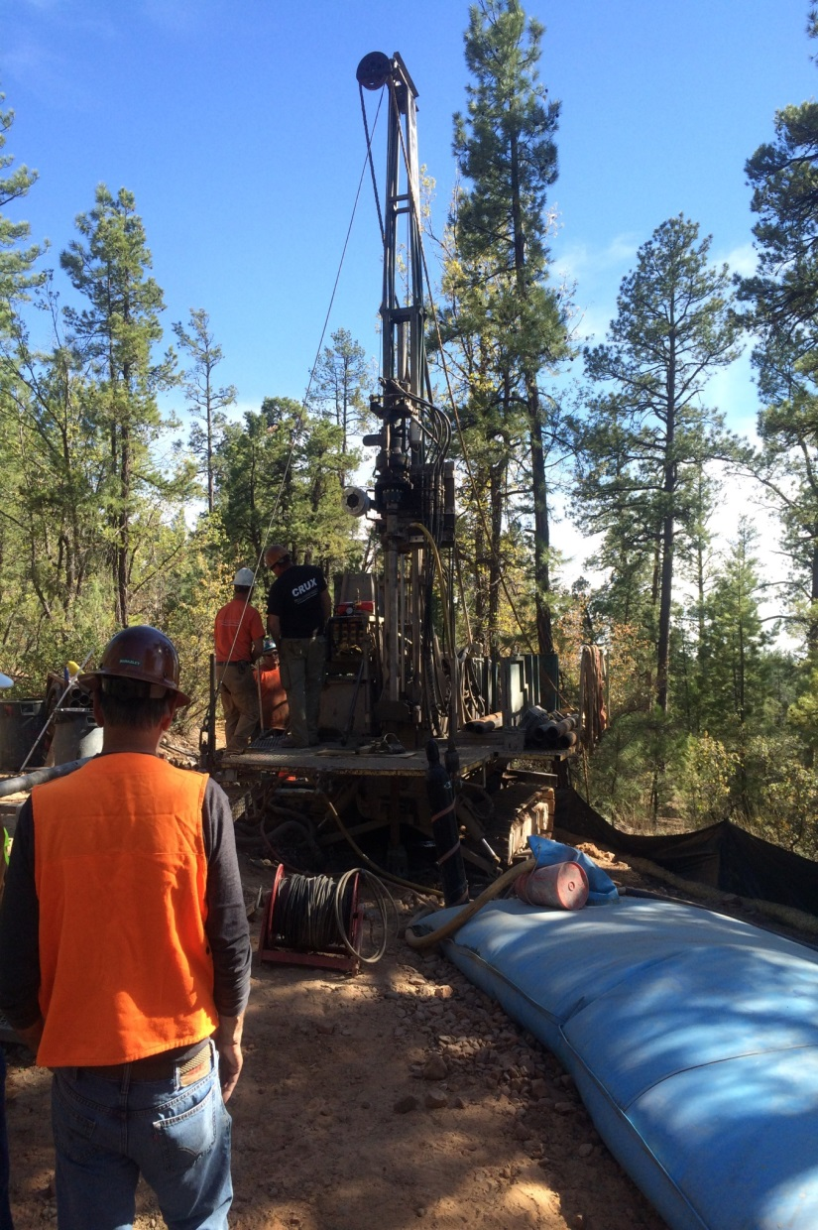
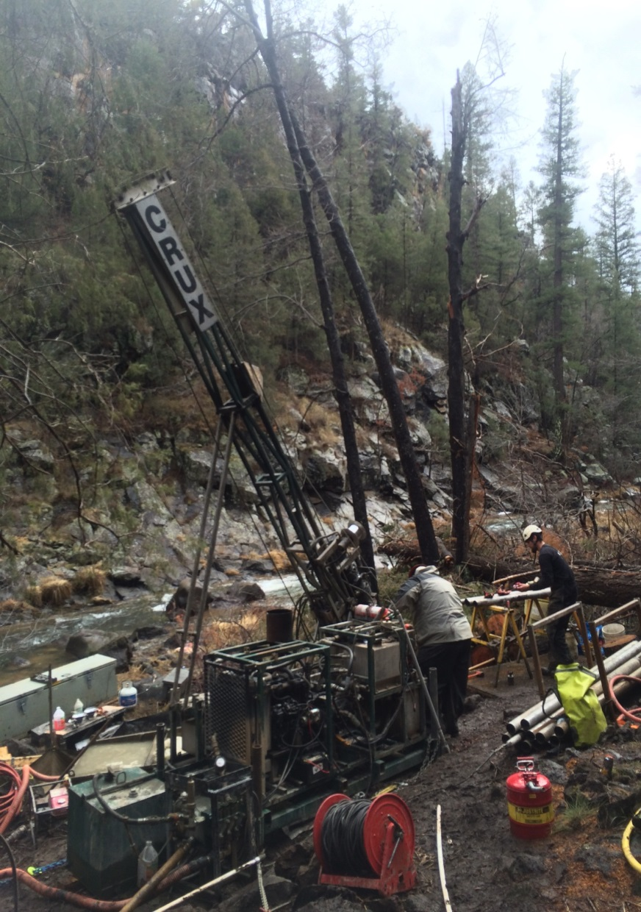
White Mountain Apache Tribe

Slide 18
Federal Settlement Process
The Working Group on Indian Water Settlements
Established by the Department of the Interior in 1989
Comprised of all Assistant Secretaries and the Solicitor
Responsible for making recommendations to the Secretary of the Interior regarding water settlements and settlement policies

Slide 19
Federal Settlement Process (cont.)
Presided over by a Chairman who is usually a counselor to the Secretary or Deputy Secretary
Secretary’s Indian Water Rights Office (SIWRO), under the direction of the Chairman of the Working Group, coordinates and assists with Indian water rights settlements and interfaces with settlement teams in the field
Upon direction from the Working Group, SIWRO establishes Federal teams to lead settlement negotiations and implementation

Slide 20
Federal Settlement Process (cont.)
Teams are comprised of representatives from:
Bureau of Indian Affairs
Bureau of Reclamation
Solicitor’s Office
Fish and Wildlife Service
Department of Justice
Other Federal agencies (within or outside the DOI) with significant interests in the settlement
Currently the DOI has 41 teams in the field:
19 Negotiation Teams , 20 Implementation Teams, and 2 Assessment Teams

Slide 21
Criteria and Procedures
The Criteria & Procedures for Participation of Federal Government in Negotiating for Settlement of Indian Water Rights Claims, 55 Fed. Reg. 9223-9225, Mar. 12, 1990
Provide guidelines for Administration’s participation in settlements
Include factors to be considered in deciding Federal contribution to settlement cost share
Require non-Federal cost sharing
Flexible enough to adapt to the unique circumstances of each negotiation
Followed by every Administration since 1990, but with differing interpretations

Slide 22
Criteria and Procedures (cont’d)
Four-Phase Settlement Procedure
Phase I – Fact Finding
Phase II – Assessments and Recommendations
Phase III – Briefings and Negotiation Positions
Phase IV – Negotiation Towards Settlement
Notes:
On Phase IV changed it from “Negotiation” to “Negotiation Towards Settlement”

Slide 23
Criteria and Procedures (cont’d)
Phase I – Fact Finding
Develop information necessary to support settlement; identify parties and their positions; evaluate claims; describe geography of the reservation and drainage basin; and analyze contracts, statutes, regulations, legal precedent, and history of reservation water use
Phase II – Assessments and Recommendations
Assess costs presuming settlement and cost of settlement to all the parties; analyze value of tribal water claim; and recommend a negotiating position

Slide 24
Criteria and Procedures (cont.)
Phase III – Briefings and Negotiation Positions
Working Group establishes Federal negotiating position, including Federal funding strategy and positions on major issues
Phase IV – Negotiations Towards Settlement
commence; Office of Management & Budget (OMB) and DOJ are briefed periodically; negotiating position revised if appropriate
Notes:
On Phase IV changed it from “Negotiation” to “Negotiation Towards Settlement”

Slide 25
Federal Settlement Legislation
Basic parameters of the settlement and legislation approved by Working Group and OMB
Legislation drafted and introduced
Hearings scheduled
DOI prepares initial draft testimony which is then reviewed and revised through the OMB clearance process before being submitted to Congress

Slide 26
Federal Costs of Settlements
Federal funding required by Indian water settlements has significantly increased over time
Roughly a billion dollars expended between mid 1980s and 2002.

Slide 27
THE OBAMA ADMINISTRATION’S APPROACH TO INDIAN WATER SETTLEMENTS
Letty Belin
Senior Counselor to the Deputy Secretary

Slide 28
Obama Administration Support for Indian Water Rights Settlements
“The Administration is proud of its record on Indian water rights settlements, and we continue to be committed to settlements as an important way to address the water needs of Native American communities. Indian water rights settlements are consistent with the general Federal trust responsibility to American Indians and with Federal policy promoting tribal sovereignty, self-determination, and economic self-sufficiency.”
Michael Connor, Deputy Secretary, U.S. Department of the Interior, May 20, 2015

Slide 29
Administration Priorities
2009-2017: Prioritize Indian water settlements
Federal trust responsibility – we must fulfill our legal obligation to protect Indian water rights
Permanent access to a clean and reliable water supply is fundamental to economic security and prosperity in Indian Country.
Settlements benefit both tribes and non-Indians by providing certainty in water supplies and resolving longstanding disputes and litigation

Slide 30
Administration Priorities (cont’d)
2009-2010:
Support water settlements with reasonable federal funding contributions
Complete negotiations on and enact 6 new settlements
Enact new settlement funding mechanisms

Slide 31
Administration Priorities (cont’d)
2011-2015 (no settlements because they are considered “earmarks”):
Fund and implement existing settlements
Increase funding of Reclamation and BIA water settlement assistance programs for tribes
Increase settlement implementation funding

Slide 32
Administration Priorities (cont’d)
Design and deploy additional Reclamation technical assistance tools to aid tribes in early stages to develop viable settlement proposals (e.g., DECATs, Value Planning)
Review DOI settlement program; identify and implement improvements

Slide 33
Administration Priorities (cont’d)
2015-17:
New Opportunities in Congress?
Bishop letter signals Indian water settlements that comply with Criteria and Procedures might not be considered earmarks and therefore could be enacted
More settlements are either ready for Congressional action or nearly ready (e.g., Klamath, Pechanga, Blackfeet)
Institutionalize revised and expanded SIWRO/DOI Settlement Program
Ensure adequate funding to implement existing settlements

Slide 34
Settlement Funding
Indian Water Settlements in 2009 Omnibus Public Lands Management Act (P.L. 111-11)
Navajo San Juan Settlement (Federal cost of about $1 billion)
Shoshone-Paiute Tribes of the Duck Valley Reservation (Federal cost approx. $65 million)

Slide 35
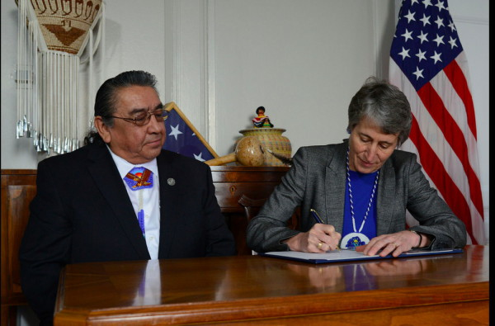
Duck Valley
Signing of final Duck Valley Settlement Agreement – Shoshone-Paiute Chairman Manning and Secretary Jewell -- February 27, 2015

Slide 36
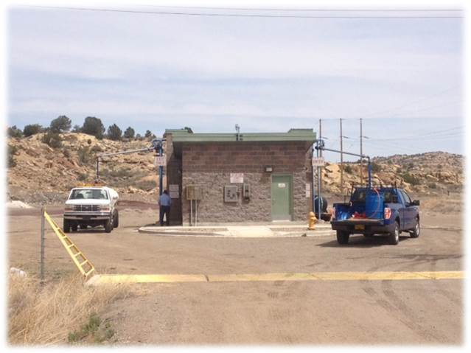
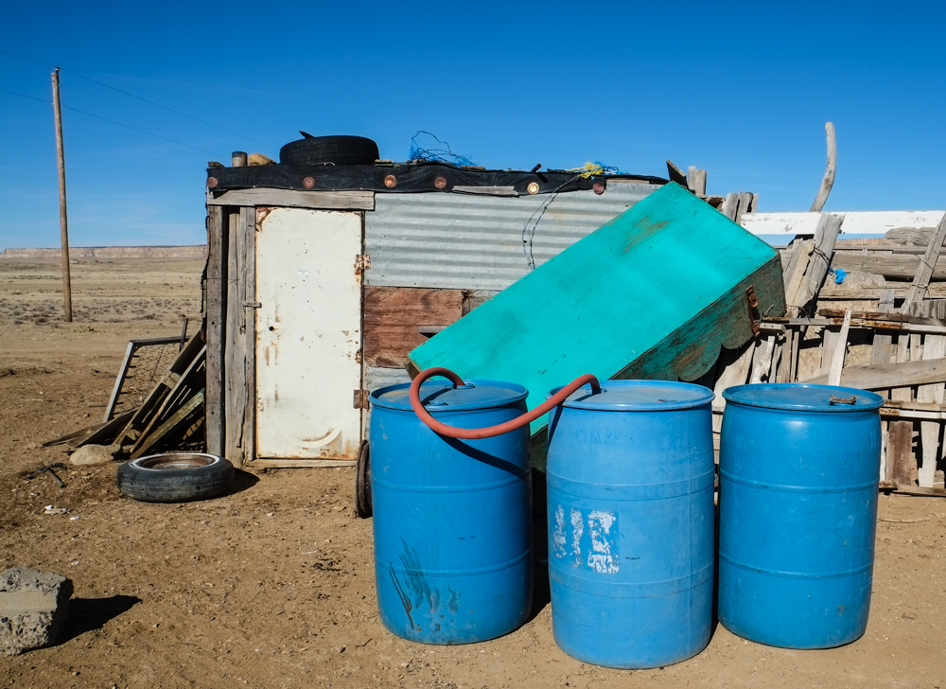
Navajo-San Juan (Gallup Pipeline)

Slide 37
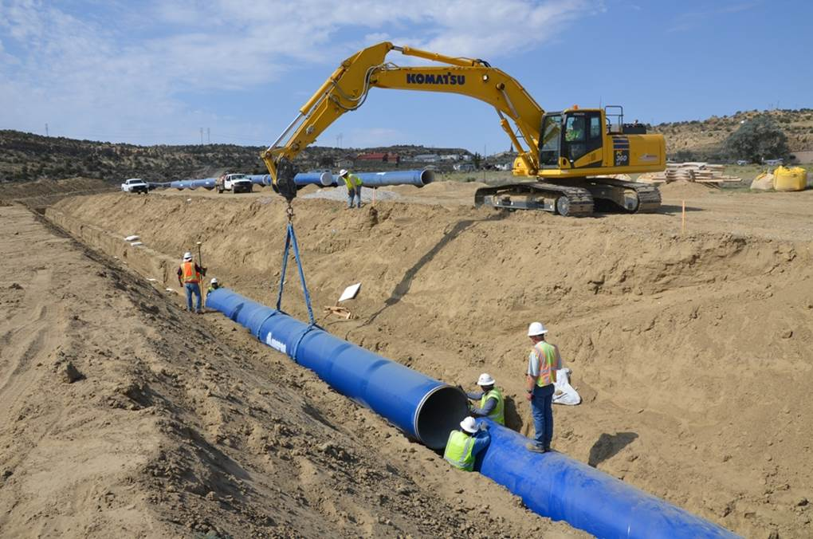
Navajo- Gallup Pipe-Laying
About 2/3 of the 324 direct jobs from Project are held by Navajo tribal members

Slide 38
Settlement Funding (cont’d)
2009 Act Established Reclamation Water Settlement Fund
$120 million for each of 10 years beginning in 2020 (total of $1.2 billion)
Includes funding limits and priorities

Slide 39
Settlement Funding (cont’d)
2010 Claims Settlement Act (P.L. 111-291)
Approximately $1 B federal funding authorized for 4 settlements (Crow, and White Mountain Apache Tribes, and Taos, Pojoaque, Nambe, San Ildefonso, and Tesuque Pueblos)
$650 M of the $1 B is provided in mandatory funding; the remainder must come from Reclamation and BIA budgets and/or 2009 Reclamation Water Settlements Fund

Slide 40
Settlement Funding (cont’d)
2010 Claims Settlement Act (cont’d)
An additional $180 M in mandatory funding is provided for the Navajo-San Juan settlement
In total, over $830 M in mandatory funding for Indian water settlements provided

Slide 41
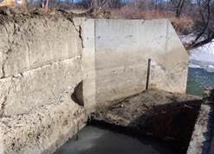
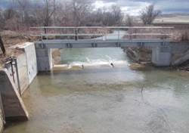
Crow Implementation
Lodge Grass Canal No. 1 Headworks rehabilitation project -- completed by Crow Tribe during the winter of 2012 and 2013.
Before
After

Slide 42
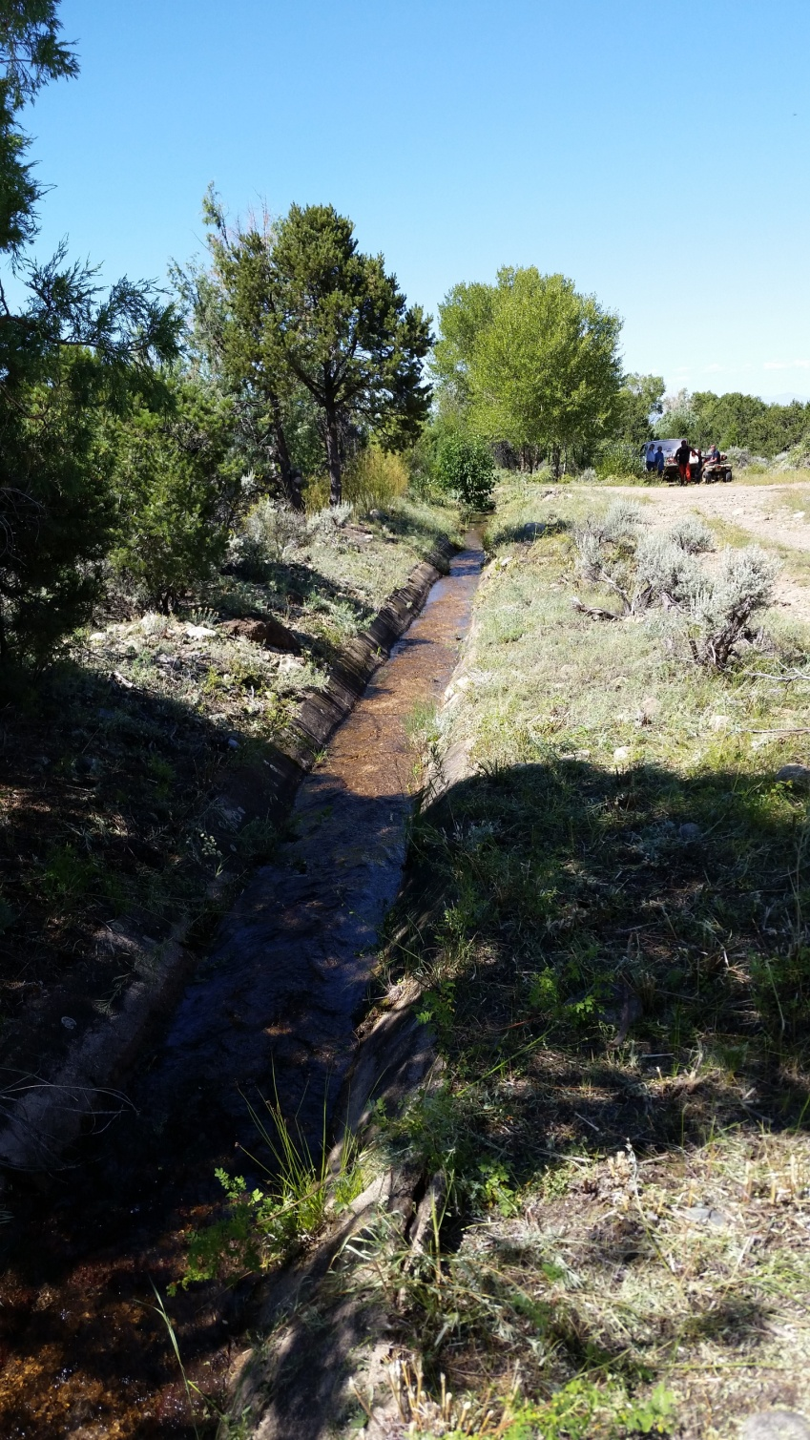
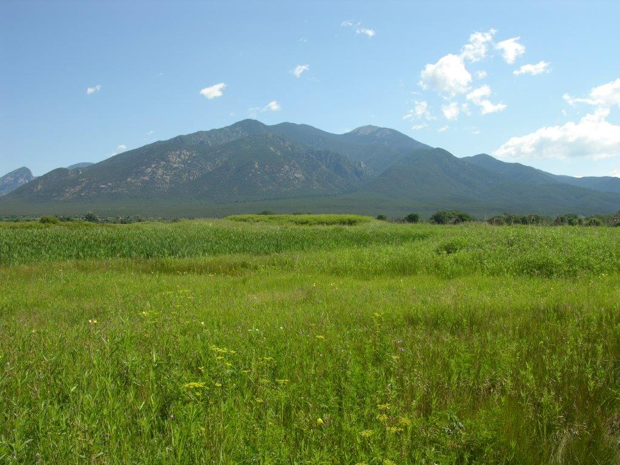
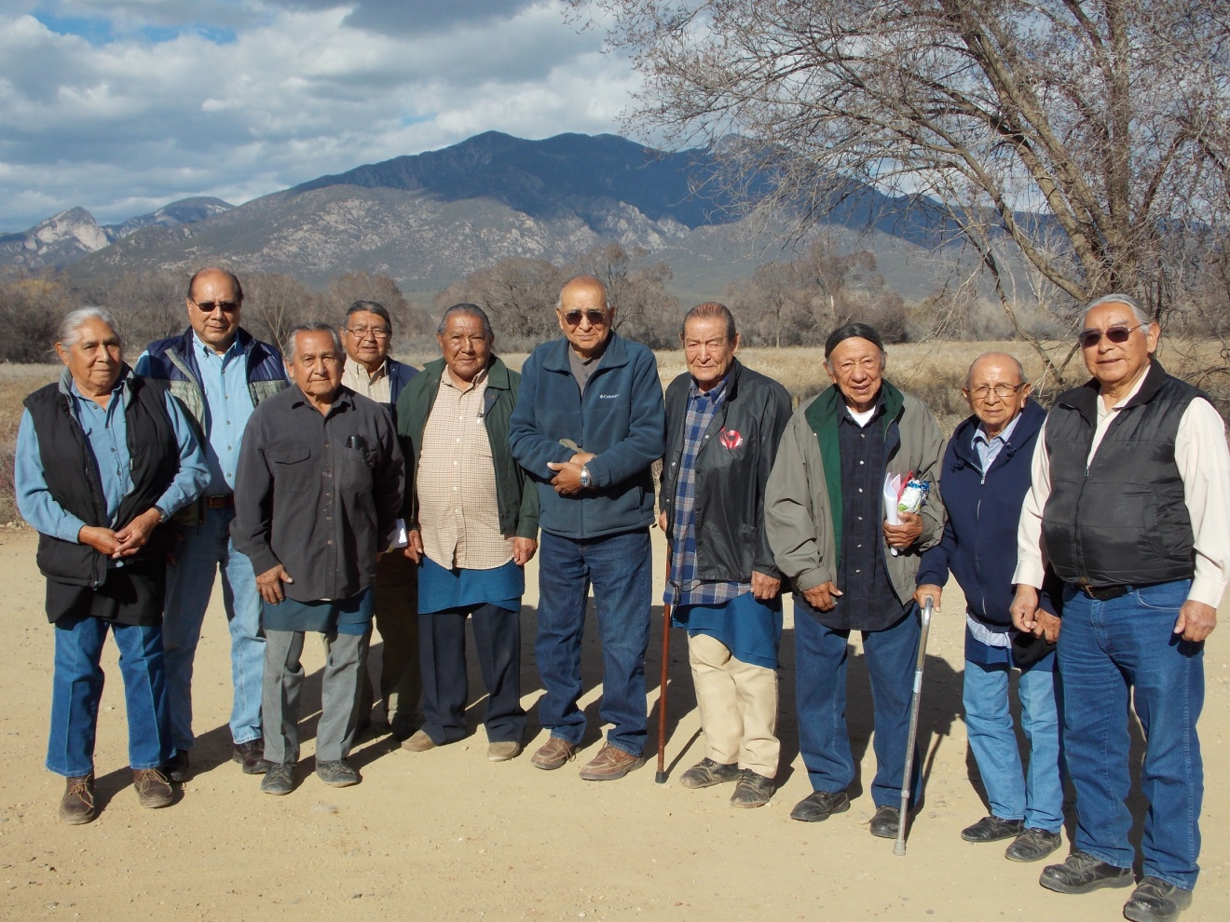
Taos Implementation

Slide 43
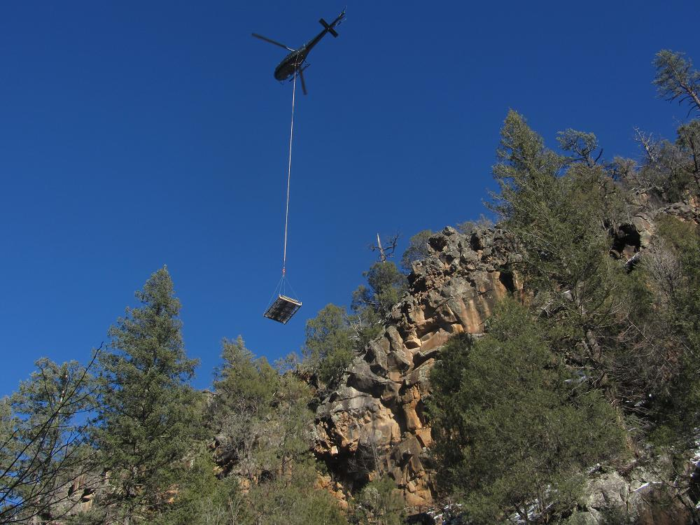
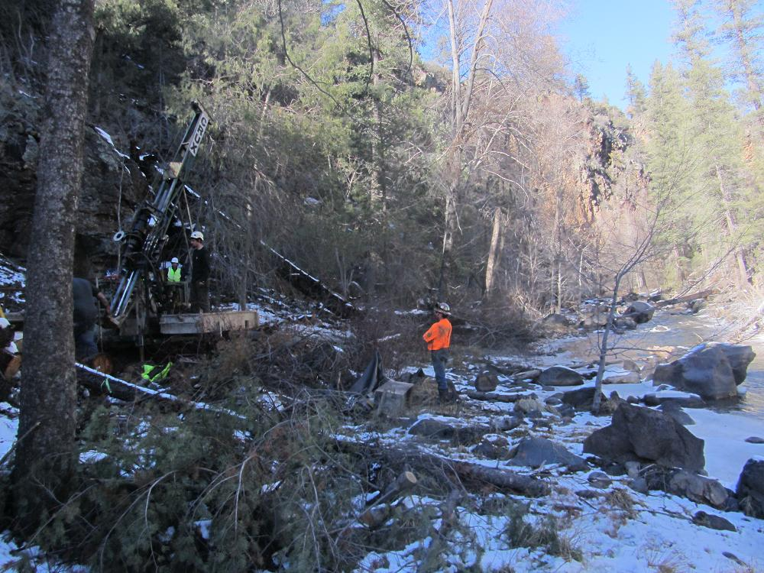
White Mountain Implementation
Pre-Construction Technical Work

Slide 44
DOI Budgets
Increased settlement implementation funding
Increased funding for Reclamation and BIA technical assistance to tribes
Increased funding for SIWRO

Slide 45
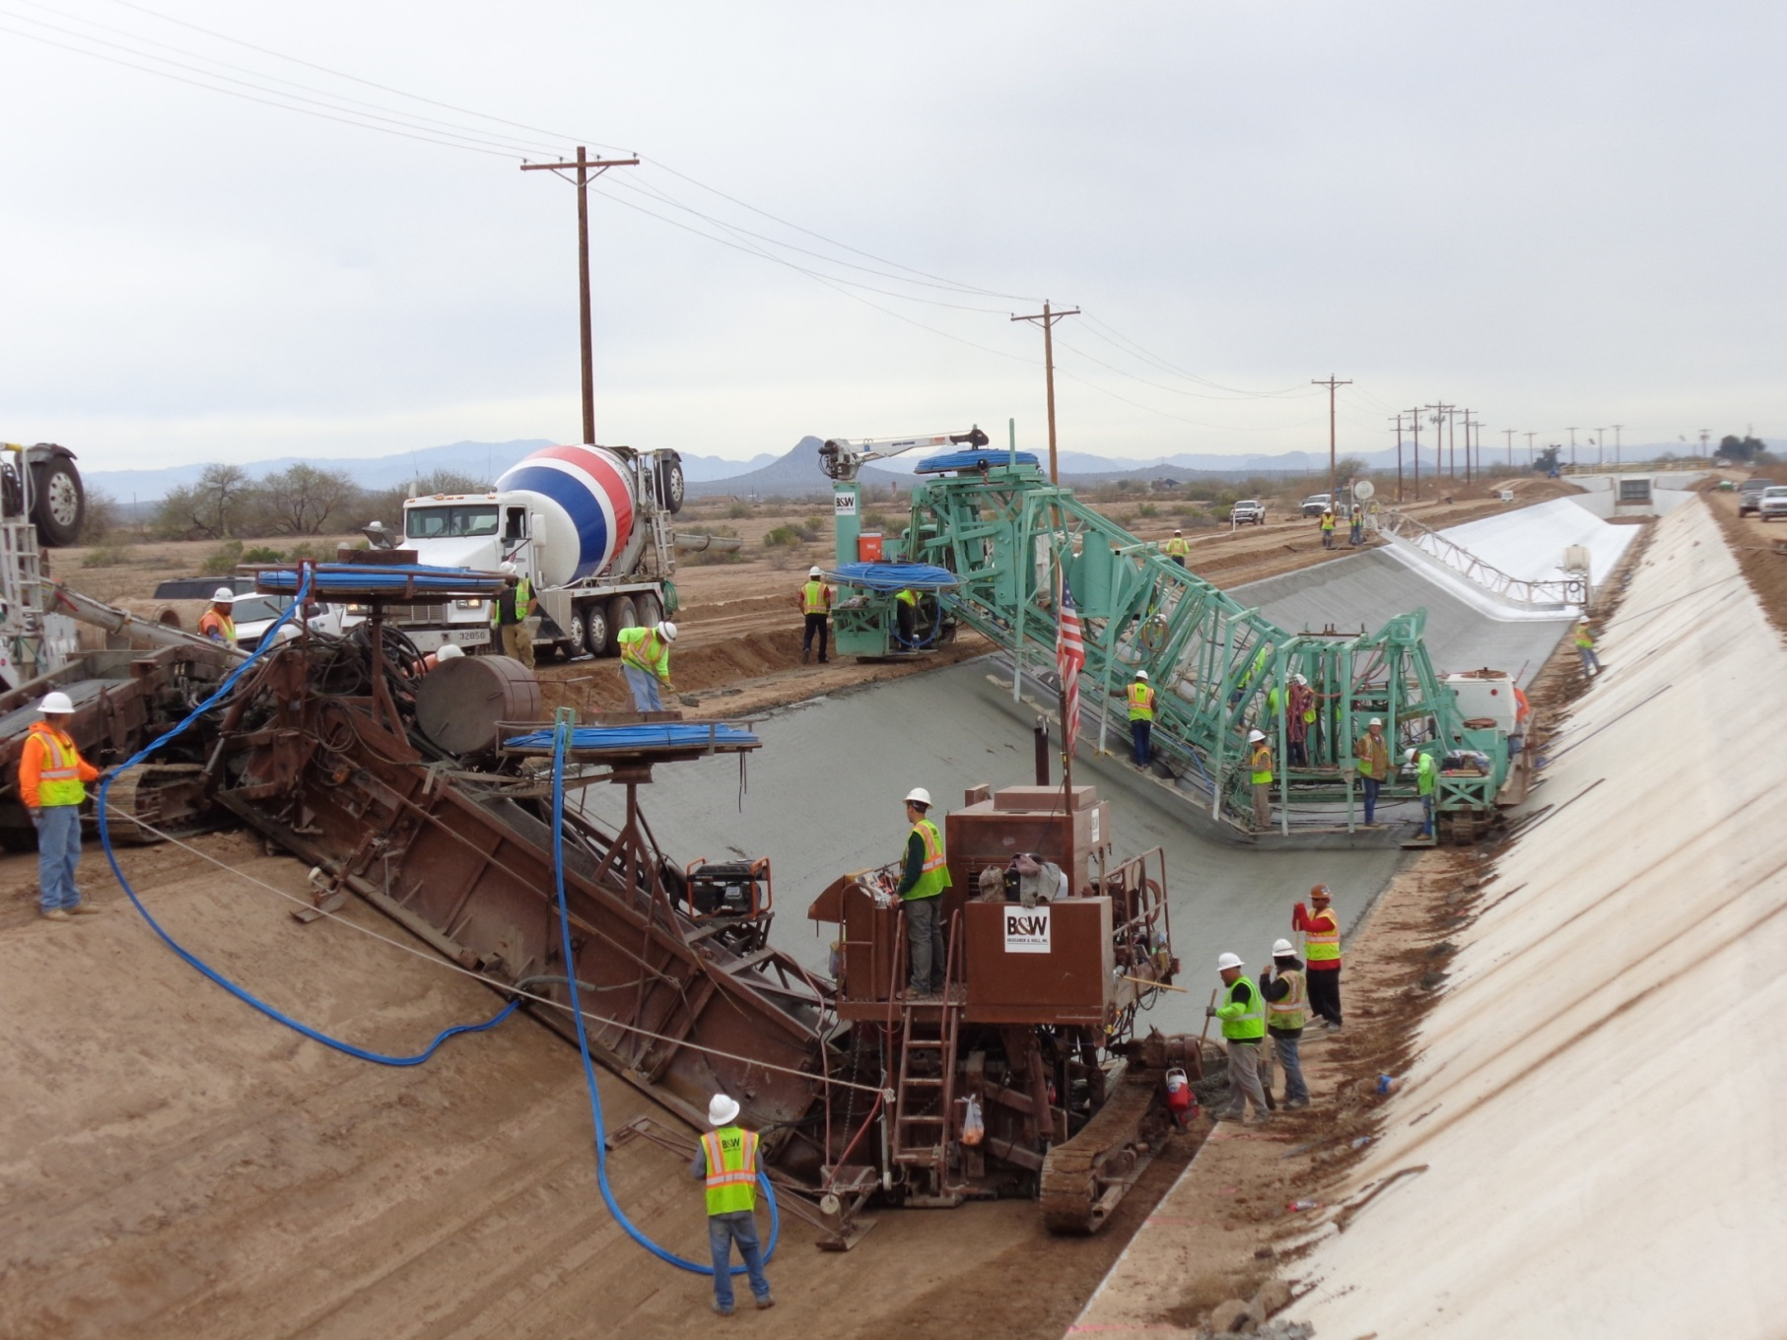
Gila River: Pima- Maricopa Irrigation Project

Slide 46
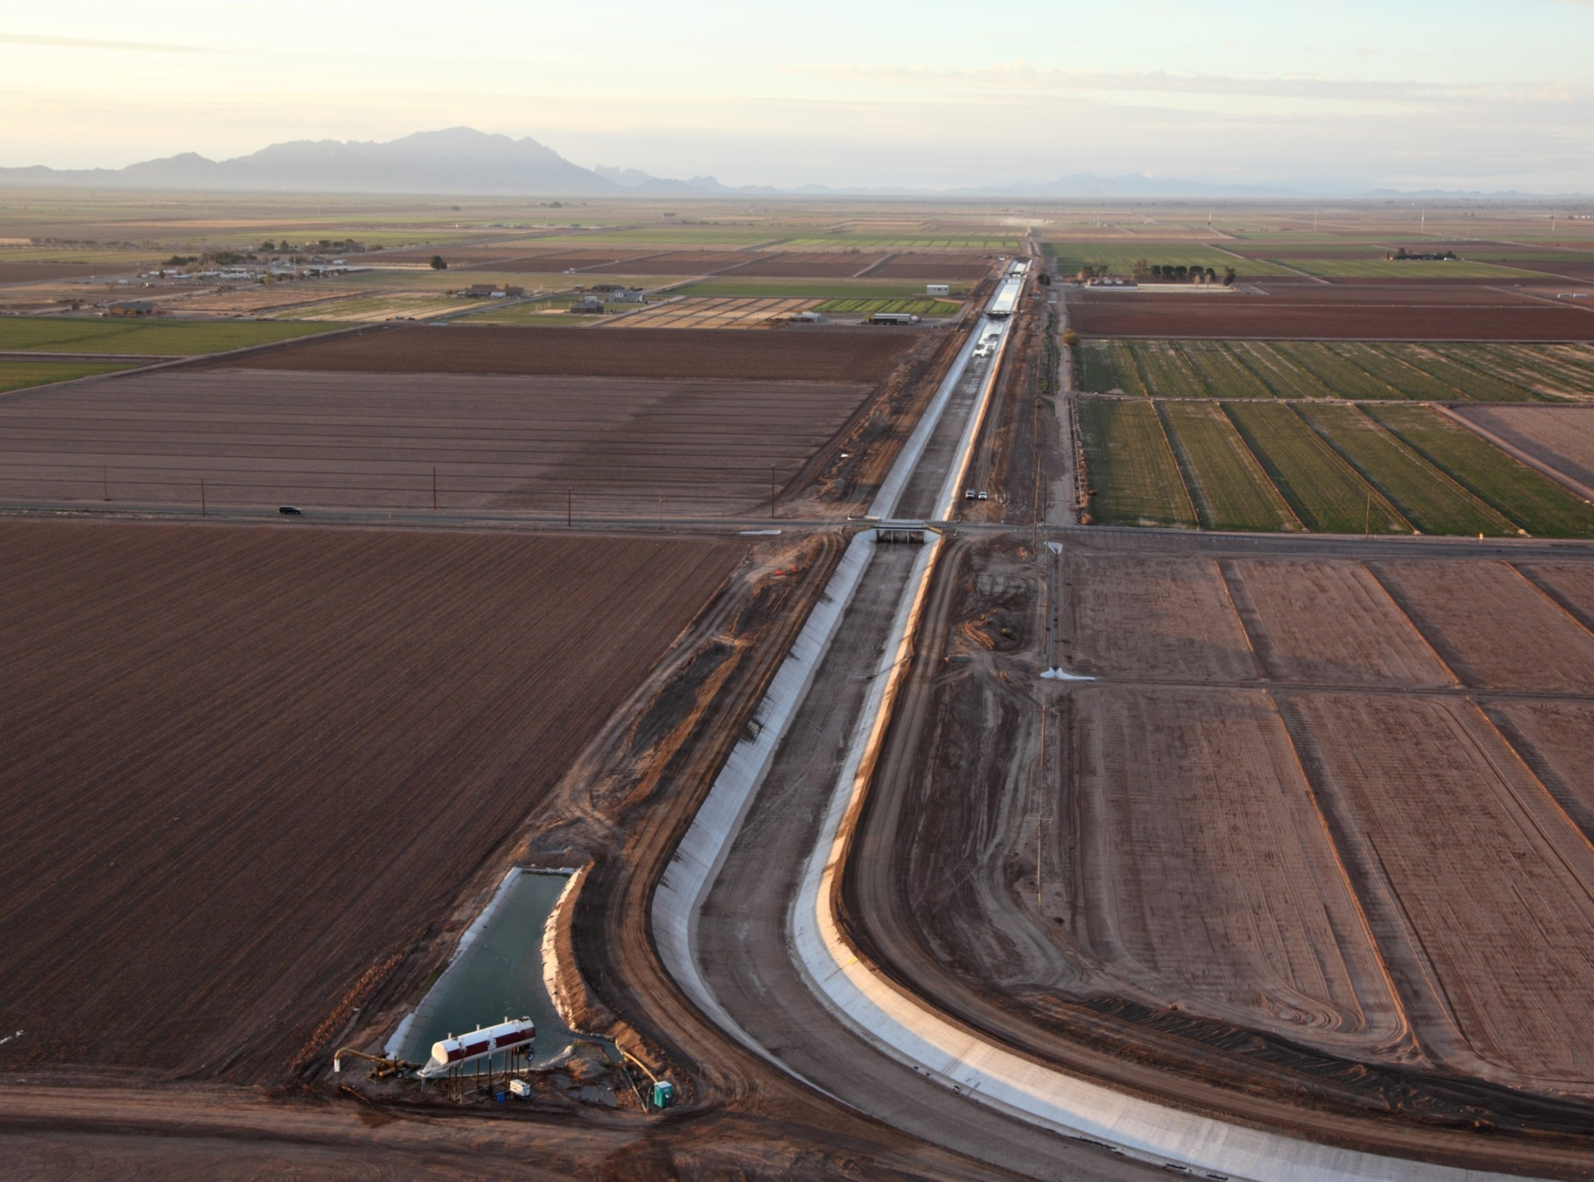
Pima Canal (cont’d)

Slide 47
Total Annual Discretionary DOI Settlement Implementation Funding (nominal $)

Slide 48
BOR/BIA Funding for Indian Water Settlement Negotiations
$ in Thousands

Slide 49
DOI Funding
FY 2014 FY 2015 FY 2016 (requested)
SIWRO $866,000 $868,000 $1,368,000
Reclamation $3,164,000 $3,841,000 $5,869,000
BIA $16,315,000 $16,335,000 $30,391,000
TOTAL $20,345,000 $21,044,000 $37,628,000
Increase from FY 2015 to 2016 request = 79%

Slide 50
Obama Administration Indian Trust Litigation Settlements
2010 Cobell settlement (mismanagement of trust land assets): $3.4 billion ($1.4 billion to individuals; $2 billion to tribes to acquire fractionated allotted lands on approximately 150 reservations)
2010 Keepseagle settlement (discrimination by USDA against Indian farmers): $760 million
2009-2015 tribal breach of trust claims settlements: to date $2.63 billion obligated to 83 tribes

Slide 51
Obama Administration Water Settlements Funding
2009 Omnibus Lands Public Land Management Act (Navajo, Shoshone-Paiute Tribes of Duck Valley): approximately $1 billion; in addition to $1.2 billion Reclamation Water Settlements Fund
2010 Claims Resolution Act settlements ( Crow, Nambe, Pojoaque, San Ildefonso,Taos, Tesuque, White Mountain Apache): approximately $1 billion

Slide 52
Total Federal Dollars to Indian Country from Settled Legal Claims During Obama Administration
Water Settlements: $3.2 billion
Claims regarding other trust assets:
$6.8 billion
TOTAL: $10 billion to Indian Country

Slide 53
Indian Water Settlement Initiative
Interior consulted with Indian tribes in October and November 2014 and is preparing the comments received from tribes for posting on its website
http://www.doi.gov//siwro/index.cfm
DOI’s Working Group developed proposals to increase capacity of DOI Indian water settlement program
FY 2016 Budget request reflects these proposals

Slide 54
Indian Water Rights Initiative
The Department’s proposals to improve Indian water rights settlement program
Increase SIWRO staffing
Better intra-DOI coordination on budgeting and staffing
More training of team members
More analytics to support settlements

Slide 55
Current Status of Federal Indian Water Rights Settlements
Four settlements currently pending in Congress:
Montana: S. 1125 Blackfeet Tribe: Legislation pending, U.S. negotiating with Tribe and State.
Oregon: S. 133 Klamath Basin Water Recovery and Economic Restoration Act of 2015 (Klamath, Karuk, and Yurok Tribes
California: S. 1983 Pechanga Band of Luiseño Mission Indians Water Rights Settlement; San Luis Rey: technical amendment to 1988 Settlement Act

Slide 56
Congressional Support of Indian
Water Rights Settlements
Congressman Rob Bishop, Chairman, House Natural Resources Committee sends February 2015 letter to DOJ and Interior regarding acceptable process for Committee consideration of Indian water settlement legislation:
Compliance with Criteria and Procedures, (especially #s 4 and 5)
Administration support of settlement
Written support of legislation from Interior and DOJ
List of claims being settled

Slide 57
Future Challenges
There are 277 federally recognized tribes in the West (excluding Alaska), and we are seeing increased interest in Indian water rights settlements east of the 100th Meridian.
Many of these tribes are in need of clean, reliable drinking water; repairs to dilapidated irrigation projects; and the development of other water infrastructure necessary to bring reliable water supplies and economic development to reservations.

Slide 58
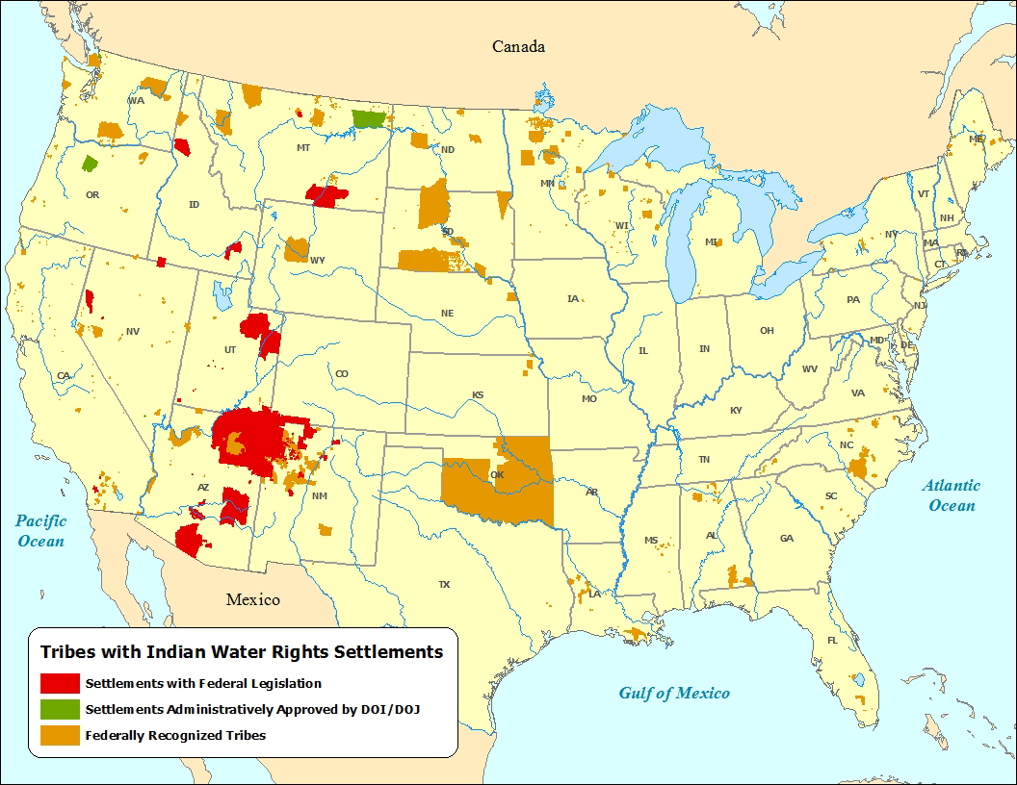
Notes:
Insert map from Colorado River Basin Study or 2009 Climate Change report

Slide 59
Future Challenges (cont’d)
Currently pending litigation relates to water rights of about 50 Indian tribes in 12 states
Many more requests for federal litigation assistance are pending

Slide 60
Future Challenges (cont’d)
Climate change (especially in Southwest) and population increases exacerbate urgency of addressing Indian water rights claims and ensuring tribes have clean, reliable water sources

Slide 61
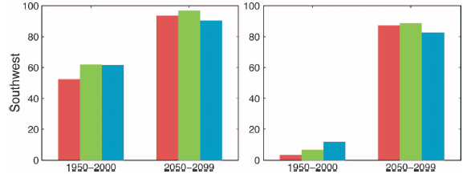
Decadal (11 yr) Drought Risk Multidecadal (35 yr) Drought Risk
Notes:
PDSI (Palmer Drought Severity Index) is a locally normalized index of soil moisture availability calculated from the balance of moisture supply (precipitation) and demand (evapotranspiration)
SM-30cm is integrated soil moisture from the surface to ~30cm
SM-2m is integrated soil moisture from the surface to ~2m

Slide 62
Final Thoughts
Continued growth and prosperity of the West depends on certainty of water supply; the pressure to secure water rights will continue
Litigation is risky. Supreme Court cases since Arizona v. California in 1963 have generally been negative towards Indian water rights.
U.S. v. New Mexico, 438 U.S. 697 (1978); Nevada v. U.S. ,463 U.S. 110 (1983); Arizona v. California III, 460 U.S. 605 (1983); Wyoming v. U.S., 492 U.S. 406 (1989)

Slide 63
Final Thoughts (cont’d)
Federal trust responsibility – we must fulfill our legal obligation to protect Indian water rights
Permanent access to a clean and reliable water supply is fundamental to economic security and prosperity in Indian Country.
Settlements benefit both tribes and non-Indians by providing certainty in water supplies and resolving longstanding disputes and litigation

