Slide 1
Identifying Parties & Issues and How Negotiations bind larger groups
Chairman Temet aguilar, pauma &Yuima/alternate Director,
San Luis rey Indian Water authority

Slide 2
The parties & Issues
Since the late 1800s, the San Luis Rey River Basin of northern San Diego County has been home to the reservations of our five Indian bands: La Jolla, Pala, Pauma, Rincon and San Pasqual Bands of Mission Indians.

Slide 3

Uncle Henry Rodriguez, La Jolla Band
remembers when the basin was lush. "I look back to what it was like when I was young, around eight or nine years old. It was full of vegetation, clean water and wildlife. Everything looked green. There were dry years, we know that, but there was enough to give us a good life."

Slide 4
History
All that changed, however, when settlers in the region used state law and federal authority to divert the waters of the San Luis Rey River into the Escondido Canal. From the 1890s to early 1900s, settlers secured water rights through federal legislation and agreements. The Escondido Canal diverted enough water to serve more than 67,000 people each year in the growing non-Indian communities of Escondido and Vista.

Slide 5
History
Since the diversion of San Luis Rey River water, the basin has dried up. For more than 75 years, the Indian Bands have lived with scarce water supplies and all the economic hardships caused by lack of water.

Slide 6
The Valley Roadrunner, January 21, 2004 opinion by Leo D. Calac, rincon
An editorial in the San Diego Union dated September 7, 1873 said it all about the attitude toward finding a home for the Indians. It stated: "The land is for the people who can cultivate it and become producers, adding to the prosperity of the commonwealth, and the Indians must go.“

Slide 7
[Looking] back one more time into history and see what the State did to the Indian. When the U.S. defeated Mexico and the Treaty of Guadalupe Hidalgo in 1848 was drawn up, the Indian occupants of the land were to be reimbursed for the land on which they lived. Did this happen? No, gold was discovered in California and those treaties were pigeonholed for almost 100 years before the California legislature would be forced to bring them out and the Indian allowed to sue.

Slide 8
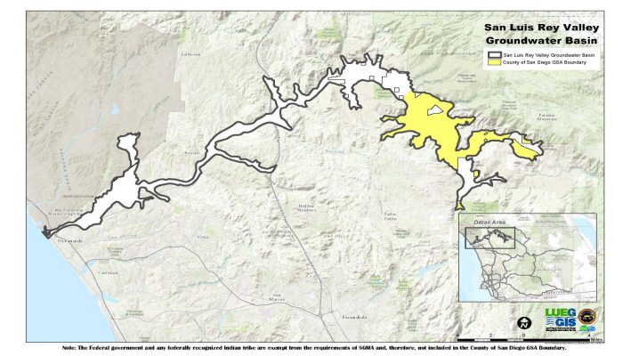
The basin

Slide 9
The Dispute
Since before the turn of the 20th Century, the Cities of Escondido and Vista (or their predecessors) have taken an average annual diversion of approximately 16,000 acre-feet of water from the San Luis Rey River, to which the Indian Bands claim senior rights based on the reserved rights or " Winters " doctrine (Winters v. United States). Under Winters, Indian reservations have a right to all the water they need as of the date they were created, regardless of when, or if, the water is first put to use.

Slide 10
The litigation
In 1969, the Indian Bands sued the City of Escondido and the Vista Irrigation District. The suit charged that US law protecting Indian reservation water rights was violated and that the Secretary of the Interior exceeded his authority in reaching water agreements on behalf of the Indian Bands. A series of hearings in 1980 on the Indian Bands' and the United States' motions for partial summary judgment upheld that position.

Slide 11
Robert S. Pelcyger, Special Counsel —
May, 2004
Under the San Luis Rey Indian Water Settlement Act, the federal government is required to provide 16,000 acre feet of water for use on the 5 Indian reservations (La Jolla, Rincon, San Pasqual, Pauma and Pala), the City of Escondido and the Vista Irrigation District. The source of that water is the savings produced by projects to line portions of two large earthen canals that convey water from the Colorado River to the Imperial and Coachella Valleys in Southern California, where it is used primarily for irrigation.

Slide 12
The Three Agreements
Three agreements are needed to make this Colorado River water available for the 5 reservations and for the San Luis Rey settlement. All three agreements were signed by the United States, the five Indian Bands, the San Luis Rey Indian Water Authority, the City of Escondido, the Vista Irrigation District, and other essential parties on October 10, 2003 in Los Angeles. After that they were formally celebrated in ceremonies in Las Vegas on December 10-12, 2003.

Slide 13
The Allocation Agreement
The first document, known as the Allocation Agreement, provides for the division of the water saved by lining portions of the All-American Canal and its Coachella Branch. The San Luis Rey Settlement Parties annually receive 16,000 acre feet of that conserved water. Most of the remaining conserved water, approximately 77,000 acre feet per year, is allocated to the San Diego County Water Authority. The San Luis Rey Settlement Parties are entitled to the first 16,000 acre feet conserved by the two projects for as long as the projects save water.

Slide 14
Water Delivery Agreement with Metropolitan Water District of Southern California
Under the Water Delivery Agreement, the federal government furnishes the water conserved by the two lining projects to Metropolitan on the Colorado River at Lake Havasu. Metropolitan agrees to furnish an equivalent amount at the terminus of its facilities in northern San Diego County, just north of the San Luis Rey River. Metropolitan gets paid for the use of its facilities at a heavily discounted rate that increases annually at the low inflation rate of 1.5%. The Bands have the right to build facilities to divert their treated or untreated water from Metropolitan's pipelines for use on their reservations.

Slide 15
Water Conveyance Agreement with San Diego County Water Authority
Under the Water Conveyance Agreement, the federal government, the 5 Bands and Escondido and Vista are able to use SDCWA's facilities to deliver their water to the 5 reservations and to Escondido's and Vista's service areas. SDCWA also gets paid for the use of its facilities at discounted rates that increase annually at the low inflation rate of 1.5%. The Bands have the right to build facilities to divert their treated or untreated water from SDCWA's pipelines for use on their reservations. Alternatively, Bands may negotiate with other water districts for the use of their existing facilities to convey their water to their reservations.

Slide 16
Thank you for your Time
Temet Aguilar

