Slide 1
David Barfield, Chief Engineer Division of Water Resources Kansas Department of Agriculture
Kansas Experience in Technical Negotiations for Tribal Water Right Settlements
Symposium on the Settlement of Indian Reserved Water Rights Claims, Great Falls, Montana
August 8, 2017

Slide 2
Background & History
Kickapoo Tribe Water Right Settlement
Notes:
BURKE

Slide 3
Kansas surface water supplies

Slide 4
Location

Slide 5
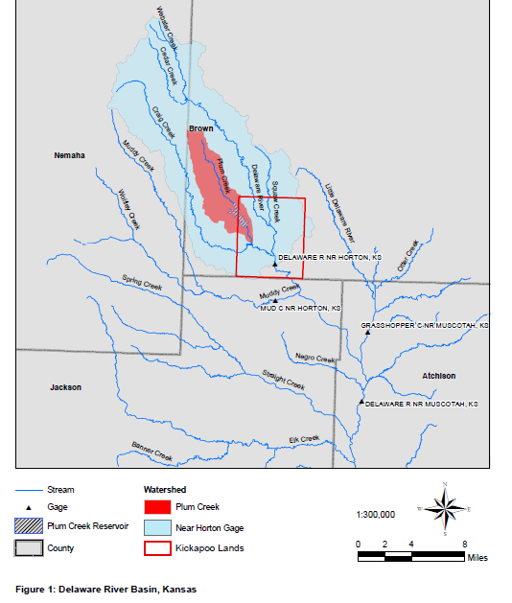
Background & History
Kansas, the Tribe, and the federal government planned a reservoir to satisfy the Tribe’s water rights, under the USDA’s Small Watershed Program (late 1990’s).
Cooperation broke down over securing land necessary for reservoir; the Tribe filed lawsuit in June 2006 asking Kansas to condemn land and recognize the Tribal Water Right.
The land issue was resolved by the Court in early 2014 against the Tribe; the suit then focuses exclusively on the Tribal Water Right.
Parties (Tribe, Kansas, USA) agreed to suspend active litigation to negotiate a resolution.

Slide 6
Basic Aspects of Settlement Agreement
Notes:
DAVID

Slide 7
Objectives of the Agreement
Establish the nature, extent and characteristics of the Tribal Water Right
Remove causes of future controversy among the Parties concerning water rights in the upper Delaware River Basin
Establish the respective rights, duties, and obligations of the Parties.
Maintain agreement on clear procedures for communication, monitoring, and protection of the Tribal Water Right.

Slide 8
Primary Technical issues negotiated
Agree on the ultimate “direct flow” needs of the Tribe
Agree on the amount of storage which could build to support direct flow needs
Agree on action by the State to protect the Tribal right
Agree on coordination and Tribal reporting.

Slide 9
Keys to success in this settlement
Preceding technical work done for litigation proved helpful background for settlement discussions.
Recognition by the State of the unique aspects of the Tribal water right.
Willingness of the Tribe to allow the use of state standards for determining most other aspects of the Tribe water right.
Willingness to look at new approaches (e.g. using an alternative to “practicable irrigable acres”)
Notes:
Priority with the date of the establishment of the Reservation; indefinite (unlimited) “Perfection period”; respect for Tribal Sovereignty in access to land and records; any beneficial use on Tribe

Slide 10
Agreeing on the ultimate “direct flow” needs of the Tribe
While two different practical irrigable acres (PIA) estimates were prepared, the use of the PIA standard was awkward as irrigation limited in the area.
The State proposed an alternate procedure to determine the Tribes needs based on a “municipal build out” principle.
Used population density of nearby urbanized areas and gallons per capita based on state experience to determine the Tribe’s ultimate annual need:
30 sq miles x 1000 persons per square mile x 140 gpcd => 4705 acre-feet/year.

Slide 11
Quantifying the amount of storage which could build to support direct flow needs
Used Kansas state-wide rules to determine allowable storage to support the Tribe’s direct use.
State rules allow storage of 3 years of direct use + 3 years of indirect use (evaporation and seepage) or 18,520 acre-feet based on assumed seepage rate.
As seepage not known until the dam sites are determined, the settlement allows for a larger storage value if seepage characteristics of the reservoir(s) require.

Slide 12
State commitments to protect the Tribal Water Right
Agree to recognize Tribal Water Right with priority date of October 24, 1832
Review applications of Kansas Water Rights to ensure prevention of injury to Tribal Water Right and provide notice of applications to Tribe
Monitor basin as prescribed in the attached Memorandum of Agreement (MOA) and prepare for necessary administration to protect the Tribal Water Right
Respond to notices of impairment through evaluation and administration, as needed
With the Tribe, annually review the MOA to insure its remains appropriate as the Tribe develop its demand and constructs storage.

Slide 13
Memorandum of Agreement
Agreement between the Tribe and State of Kansas (Chief Engineer)
Attached to the Proposed Settlement and part of it, but can and will be updated over time by the State and Tribe as time goes on, additional storage developed by the Tribes
Establishes communications, monitoring and action levels based on streamflows and storage levels in reservoirs to protect the Tribal Water Right
Annual reviews to insure it remains current, especially as the Tribe develops storage.

Slide 14
Water rights subject to administration
During times of shortage, when the Tribe is unable to meet it direct demands or when its storage is below target levels, the Tribe may request curtailment of upstream water rights.
Upstream water rights: 2 irrigation, 4 industrial, 2 recreational and 23 sediment control dams.
Watershed dams will be required to bypass inflows.
No administration of domestic use.
No administration if the chief engineer determines it would be “futile.”

Slide 15
Reporting / communication
Tribe to construct and maintain dams and other water structures and provide the Chief Engineer copies of inspection reports, notice of significant changes dam construction and operation, or evidence of problems with the dams
Tribe to meter all diversions and annual reporting of all of its use and provide additional data required by the Chief Engineer to administer water rights to protect the Tribal Water Right.
With KDA-DWR, the Tribe to annually review the MOA.

Slide 16
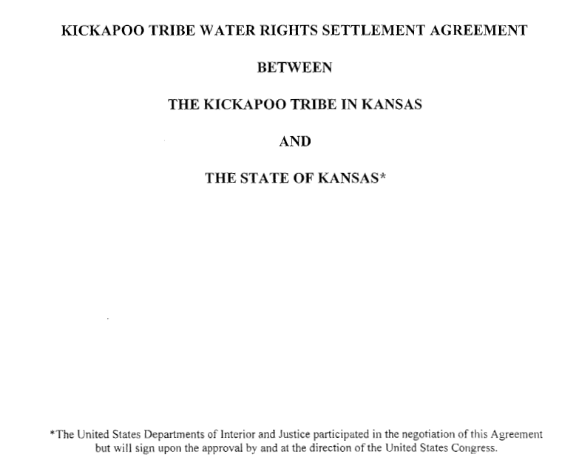

Slide 18
Questions & Discussion

Slide 19
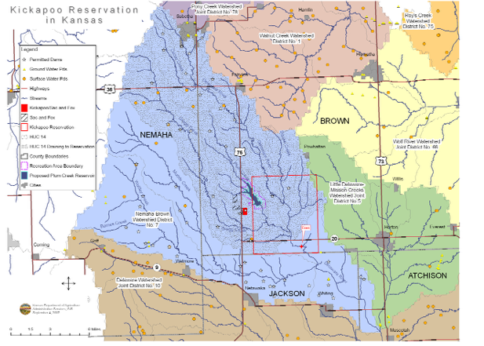
Background & History
Kickapoo Tribe of northeast Kansas is federally recognized Indian Tribe
Tribe’s government operates under Constitution of Kickapoo Tribe of Indians, as approved by the Secretary of Interior on February 16, 1937
Under the Winters doctrine, Tribe has a federal reserved water right with a priority date of October 24, 1832

Slide 20
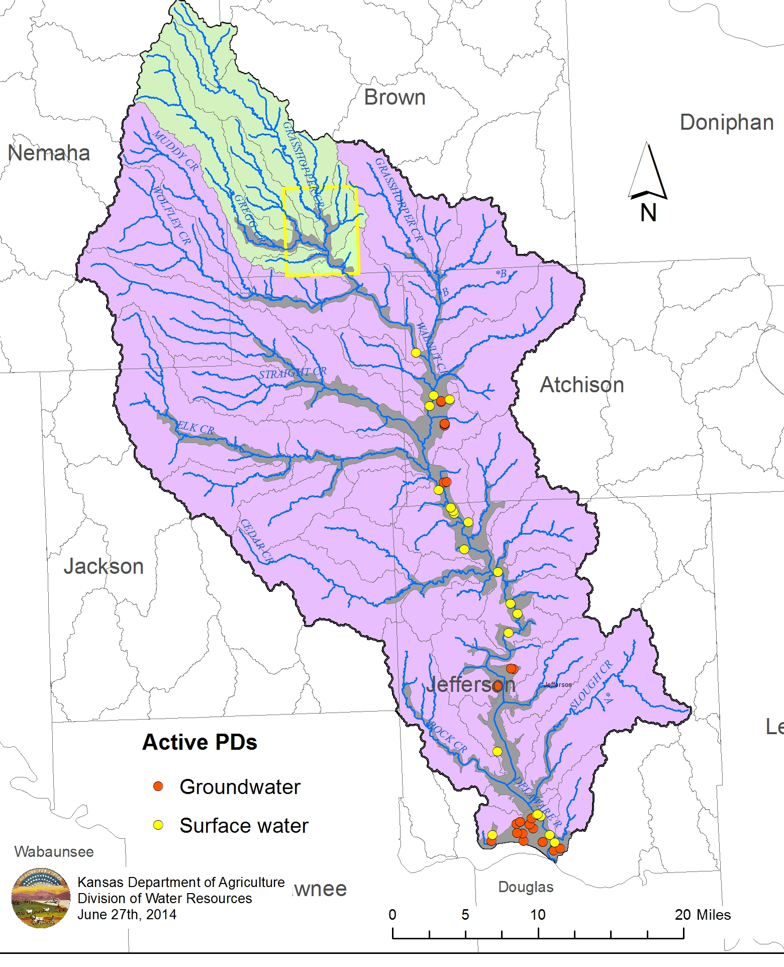
Downstream water rights potentially effected
As the Tribe develops its water right, it will use and store waters that formerly made its way downstream.
However, few downstream rights are immediately downstream of the Reservation.

