Slide 1
The Blackfeet Water Rights Settlement Act
Samuel D. Gollis
Indian Resources Section, ENRD
Department of Justice
August 9, 2017

Slide 2
Treaties and Agreements between the United States and the Blackfeet Tribe
Treaty with the Blackfeet, 1855, Oct. 17, 1855, 11 Stat., 657, Ratified Apr. 15, 1856, Proclaimed Apr. 25, 1856, Act of April 15, 1874 (18 Stat. 28, chapter 96) (Lame Bull Treaty)
Agreement of 1888, ratified by the Act approved May 1, 1888 (25 Stat. 113)
Agreement of 1895, dated September 26, 1895, ratified by the Act approved June 10, 1896 (29 Stat. 321, 353)

Slide 3
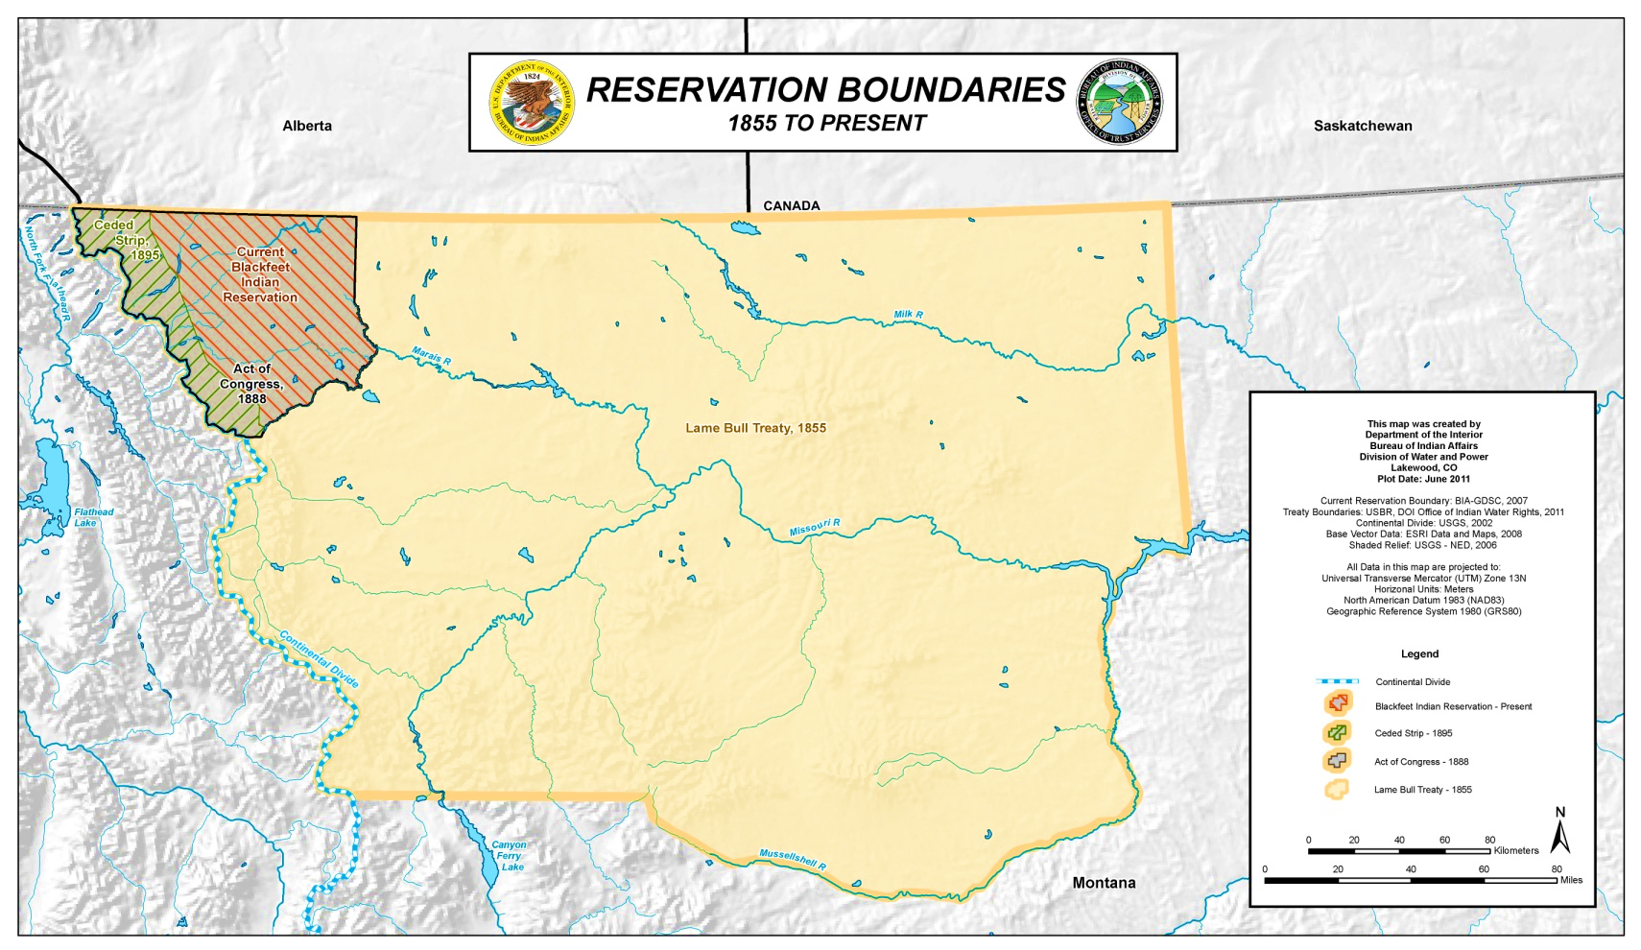
Treaties with the Blackfeet Nation
.

Slide 4
Blackfeet Water Rights - Adjudication
United States v. Aageson, No. CIV-79-21-GF (D. Mont. April 5, 1979) stayed since 1983 pending final adjudication in State court
In 1979, Senate Bill No. 76 (SB 76), amending the adjudication procedures originally established by the Montana Water Use Act in 1973, established a comprehensive general adjudication of the entire state.

Slide 5
Proper Forum To Adjudicate Indian
Reserved Water Rights
No. Cheyenne Tribe v. Tongue River Assoc., 484 F. Supp. 31 (1982)
No. Cheyenne Tribe v. Adsit, 668 F. 2d 1080 (1982)
Arizona v. San Carlos, 463 U.S. 845 (1983)

Slide 6
Blackfeet Water Rights Adjudication
1982 US files protective claims on behalf of the Blackfeet Tribe
DOJ/BIA conduct technical studies to support water rights claims
1991 In re the Adjudication of the Existing and Reserved Rights to the Use of Water, Both Surface and Underground, of the Blackfeet Tribe of the Blackfeet Reservation within the State of Montana, Civ. No. WC-91-1 (Mont. Water Ct. 1991)
1997 US files more definite statement of claim – includes tribal claims for off-reservation instream flow for Tribe in the Lewis and Clark National Forest and Glacier National Park
2017 Case stayed until January 31, 2018

Slide 7
Montana Compact Commission
5-2-702 (1) The reserved water rights compact commission . . . may negotiate with the Indian tribes or their authorized representatives jointly or severally to conclude compacts authorized under 85-2-701, “for the equitable division and apportionment of waters between the state and its people and the several Indian tribes claiming reserved water rights in the state.”
5-7-702(2) The compact is effective and binding upon all parties upon ratification by the legislature of Montana and any affected tribal governing body, and approval by the appropriate federal authority.

Slide 8
Blackfeet Compact Negotiations
Tribe initiates negotiations with State
Department appoints a Federal Negotiation Team
2007 State and the Tribe reach agreement
State Legislature approves Compact

Slide 9
Federal Legislation Blackfeet Water Rights Settlement Act
111th Congress - S. 3290 (2010)
112th Congress – S. 399 (2011)
113th Congress – S. 434 (2013)
114th Congress – S. 1125 (2015)

Slide 10
Federal Legislation Hearings
The Department testified on 3 occasions –
S. 399 – 10/20/2011 - Senate Comm. Indian Affairs
S. 434 – 05/08/2013 - Senate Comm. Indian Affairs
Draft – 05/24/2016 – House Natural Resources Subcommittee on Water, Power and Oceans

Slide 11
Federal Legislation Administration Concerns S. 399
Cost - $591 million plus additional sums as may be necessary
Inadequate State Cost Share
Lack of detail about water infrastructure projects and costs
Federal mitigation fund to benefit a non-tribal beneficiary
Lack of finality on contentious water management issues

Slide 12
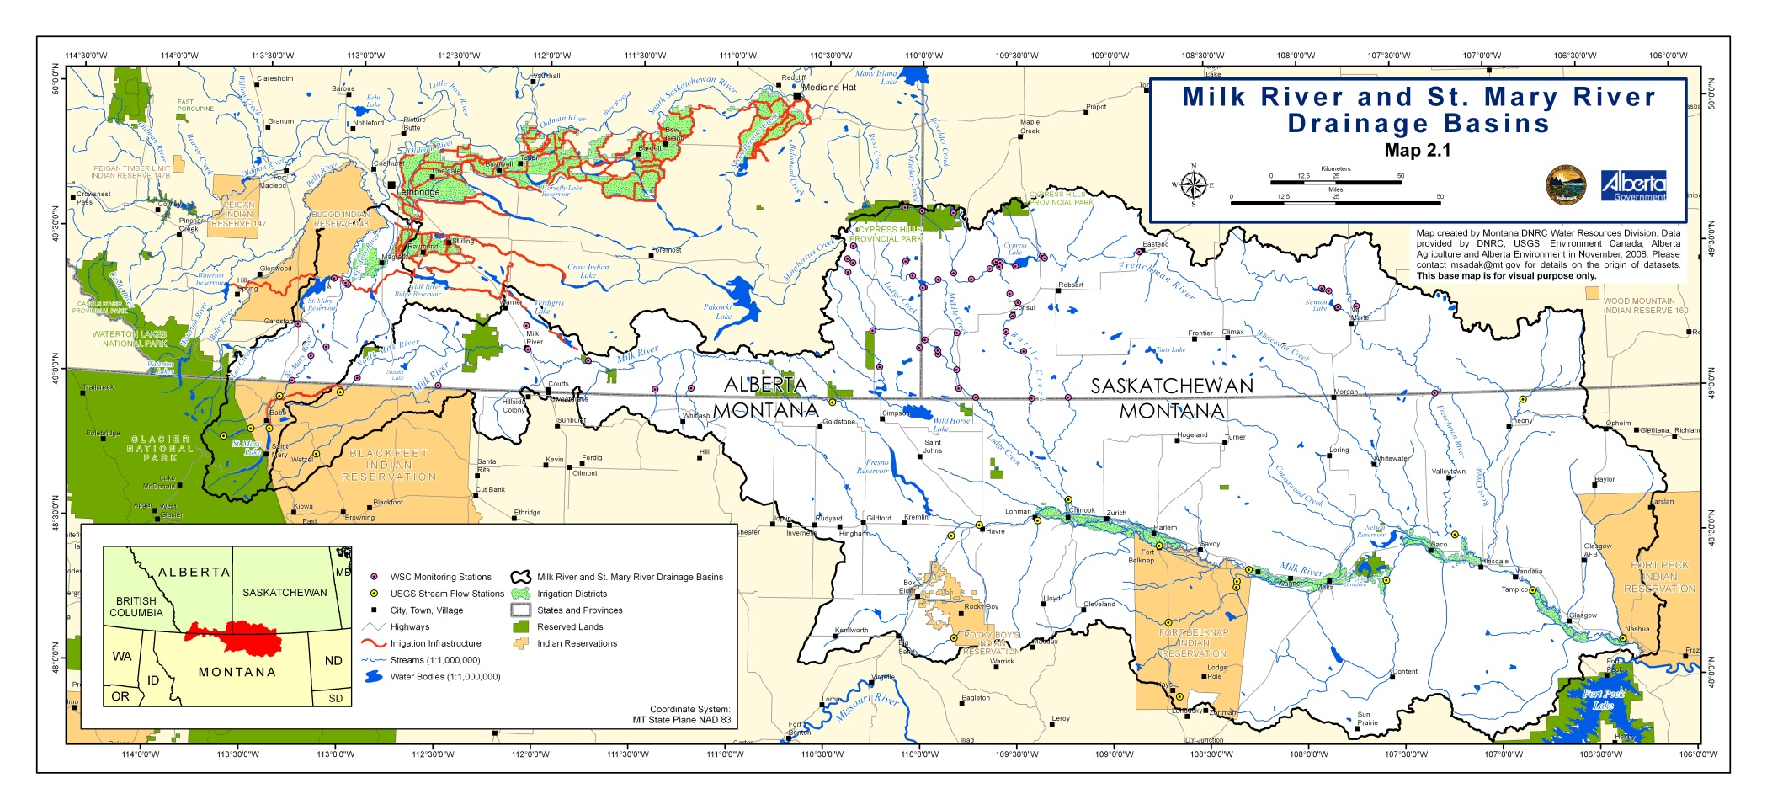

Slide 13
Federal Legislation Administration Concerns S. 434
Federal mitigation fund to benefit a non-tribal beneficiary
Lack of finality on contentious water management issues
Cost remains high
Other policy concerns

Slide 14
Resolution of Federal Concerns
Four Horns Project
Pipeline to deliver water off-Reservation to non-tribal water users
Department opposed because of cost and inadequate State cost share
Tribe and State redesign reduced Project costs by $70 Million.
$500,000 Design Work on Four Horns Project
$14,500,000 State Payment to Tribe
$14,000,000 State Mitigation Fund for Pondera Water Users
$20,000,000 State's infrastructure costs
$49,000,000 Total State Contribution

Slide 15
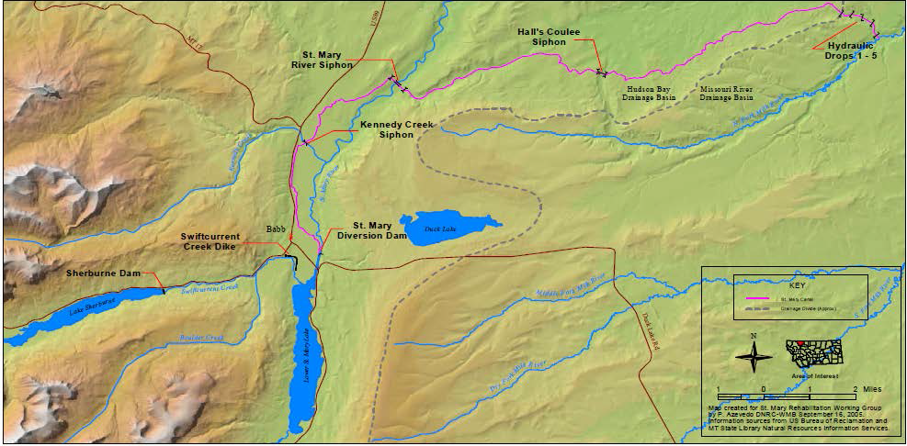
St. Mary Canal and Associated Features

Slide 16
Federal Legislation S. 1125 - Introduced April 28, 2015
Reported out of Committee February 3, 2016
Strong support of Montana Congressional Delegation
Negotiations with Federal Government continued
Subject to analysis under the new “Bishop Process”

Slide 17
Federal Legislation Securing Administration Support
5/16/16 - Support letter sent to Chairman Bishop, with consensus legislation (S. 1125 with amendments)
5/24/16 - Hearing on Blackfeet discussion draft before House Natural Resources Subcommittee
7/11/16 - HR 5633 introduced
7/22/16 - Letter confirming Blackfeet settlement conforms to Criteria and Procedures

Slide 18
Settlement Benefits
Safe and secure water supply
Tribal Water Resources and Energy Administration
Lake Recreation and Infrastructure Development
Fisheries Program Development
Hydropower Development
Irrigation and on farm development

Slide 19
Federal Infrastructure Funding
Construction and expansion of the Blackfeet MR&I System
Water storage in Milk River and Cut Bank Basins
On farm irrigation improvements on Tribal trust lands
Deferred maintenance of the Blackfeet Irrigation Project
Safety of Dams replacement of Four Horns Dam

Slide 20
Important Fiscal Measures
Cap on Federal expenditures
Projects may be modified within spending caps
Cost savings incentives for Tribe
Long term economic development opportunities for Tribe
Long term employment opportunities for tribal members
Limit on Federal obligations
Promotion of self-determination and economic self sufficiency
Fulfill Federal Trust Responsibility

Slide 21
Resolution of Federal Concerns
Agreement on St. Mary water rights
Waiver of claims against the United States
Tribe to withdraw objections against United States water rights claims
Process to resolve Ft. Belknap/Blackfeet water use conflict
Process to reestablish St. Mary Canal right of way
Agreement on Tribe’s instream flows in the Lewis and Clark National
Forest and Glacier National Park

Slide 22
