Slide 1
THE DEPARTMENT OF THE INTERIOR’S APPROACH TO INDIAN WATER SETTLEMENTS
Alan Mikkelsen
Acting Commissioner of the Bureau of Reclamation and the Chair of the Working Group on Indian Water Rights Settlements

Slide 2
Secretary Zinke Support for Indian Water Rights Settlements
“As Interior Secretary, I believe water is a vital resource for Indian Tribes. The Federal Government has a responsibility to uphold our trust responsibilities, which includes Tribal water rights. We are continuing to work on Indian Water Settlements with Tribes, States, and all water users to ensure there is certainty for all and an opportunity for economic development in local communities.”
Ryan Zinke, U.S. Department of the Interior Secretary, [date]

Slide 3
Interior Views
Indian water settlements:
Are a critical part of the United States Government’s trust responsibilities and we have a duty to collaborate on a government-to-government basis with Tribes.
We know that water is a key resource for the Tribes and the surrounding communities and settlement of claims brings certainty to all water users.
There is a critical need for a sustainable and reliable water supply for the West.

Slide 4
Interior Views (cont’d)
Economic development and infrastructure investments are important in revitalizing Native communities.
The Department will need to explore new settlement funding mechanisms.
Commitment to fund and implement existing settlements.
Continue working under the Bishop letter framework.

Slide 5
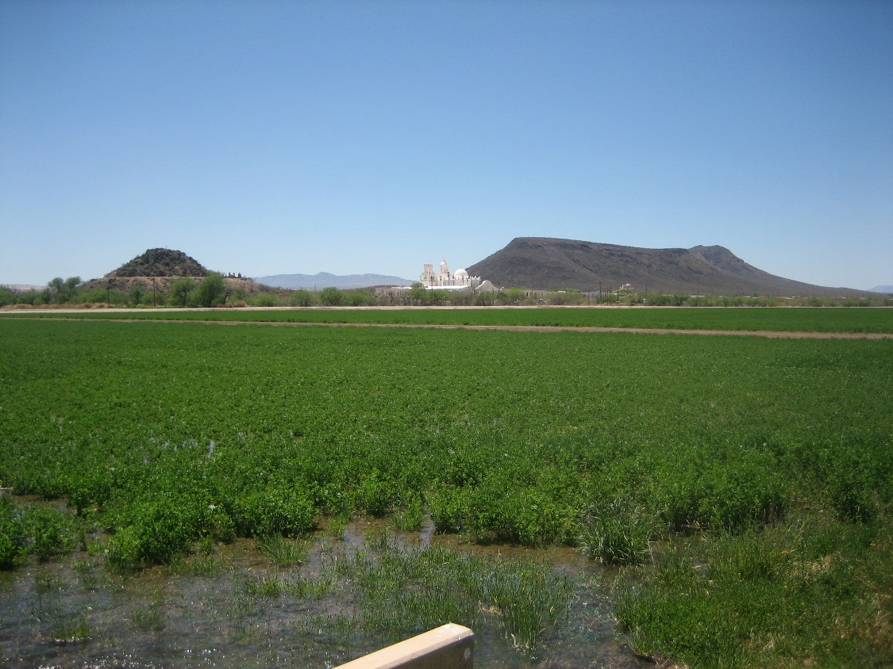
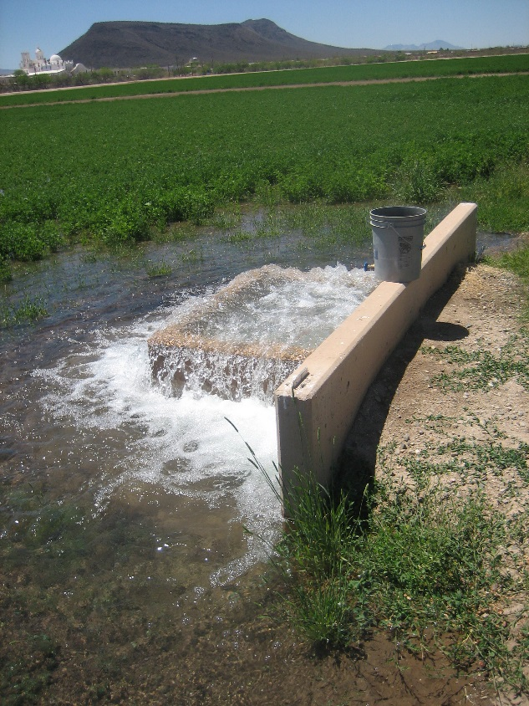
Southern Arizona Water Rights Settlement Act
Rehabilitated irrigation under the Tohono O’odham settlement

Slide 6
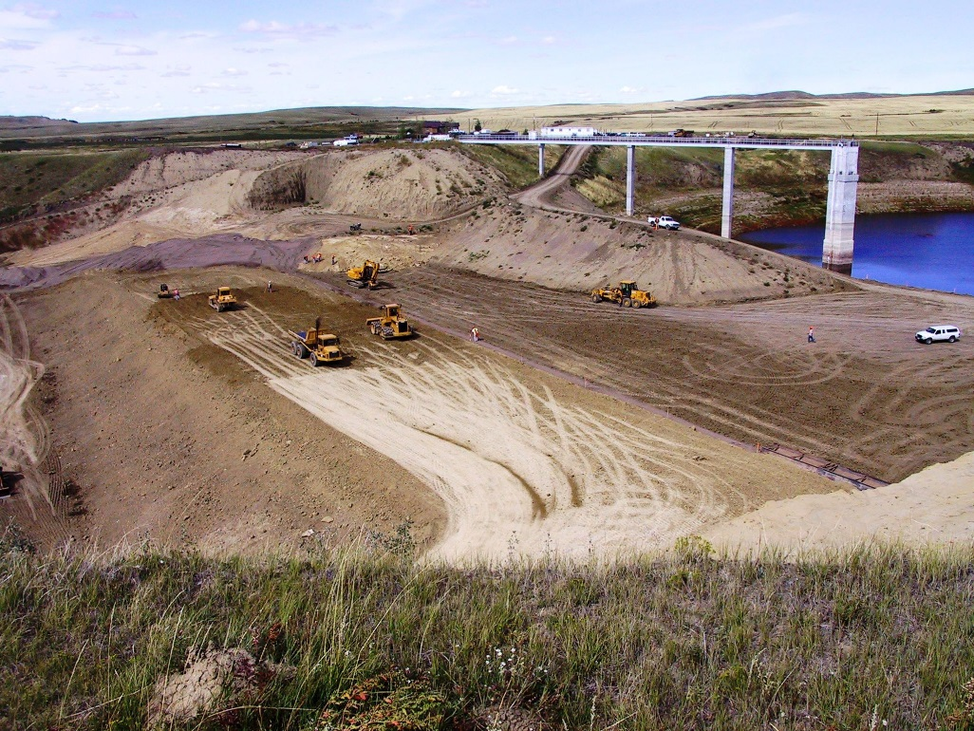
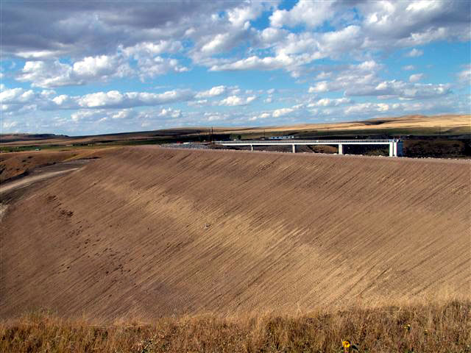
Chippewa Cree Tribe Water Rights Settlement Act
Enlargement of the Bonneau Dam to maximize the water supply on the Rocky Boys Reservation for irrigation
Notes:
Here are before and after pictures of Chippewa Cree Tribe's Water Settlement implementation of the Bonneau Dam enlargement project. The project was constructed by the Tribe's Chippewa Cree Construction Corporation (CCCC), under a Title IV (Self-Governance), Indian Self-Determination and Education Assistance Act, Pub. Law 93-638 (638) contract with Reclamation.
The pictures show the magnitude of the Bonneau Dam enlargement project. The first picture depicts the condition dam, after it was modified under a BIA Safety of Dam's Repair and Improvement Title IV 638 contract with CCCC for enlarging. Note the newly constructed larger outlet structure and the crest of the original dam, where a white pickup is parked directly above the grader.

Slide 7
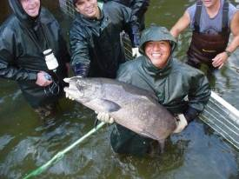
Snake River Water Rights Act
Nez Perce Tribal Fishery

Slide 8
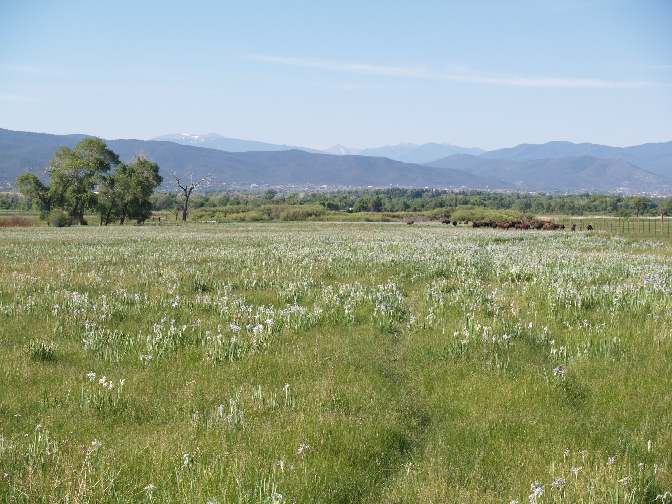
Taos Pueblo Indian Water Rights Settlement Act
Protecting habitat, natural and cultural resources at Buffalo Pasture at Taos Pueblo
Notes:
This is taken from within the Buffalo Pasture and show part of the operation that Taos has been able to undertake with settlement funds...they are routing water to the Buffalo Pasture by building new ditches (of which this is one) which are bringing water from sources previously unavailable to the Pasture. They are grass, and the non-pasture and mountains beyond. e also measuring water going into the Pasture (other pictures show a flume installed). This picture only shows the upper edge of the Pasture, with the green

Slide 9
Settlement Funding
Indian Water Settlements in 2016 Water Infrastructure Improvements for the Nation Act (P.L. 114-322)
Blackfeet Nation – ended litigation filed in 1979 (Federal cost approx. 422 million*)
Pechanga – ended litigation filed in 1951 (Federal cost approx. $28.5*)
Chickasaw and Choctaw – Litigation filed in 2011 (no Federal cost)
San Luis Rey Amendment – ended litigation filed almost 50 years ago (no new federal funding authorized)
*not including indexing

Slide 10
Settlement Funding (cont’d)
Funding of Indian Water Rights Settlements come out of the budgets of both the Bureau of Indian Affairs and the Bureau of Reclamation.
Provides funding for BOR and BIA to provide important technical assistance to Tribes
Supports funding for SIWRO

Slide 11
Settlement Funding (cont’d)
Omnibus Public Land Management Act (P.L. 111-11) Established Reclamation Water Settlement Fund
$120 million for each of 10 years beginning in 2020 (total of $1.2 billion)
Funding is allocated based on priorities within the Act: Navajo-Gallup Water Supply Project; other NM Settlements; Montana Settlements; Arizona Settlement (Navajo Nation’s claims in the Lower CO River Basin)
A good start but not enough and highlights the need to look for new mechanisms to fund settlements.

Slide 12
DOI Funding
FY 2016 FY 2017 FY 2018 (requested)
SIWRO $1,219,000 $1,370,000 $1,370,000
Reclamation $5,949,000 $6,499,000 $5,999,000
BIA $11,071,000 $18,010,000 $12,266,000
TOTAL* $18,997,000 $26,574,000 $20,304,000
*includes funding provided by other DOI Bureaus

Slide 13
Future Challenges
With over 200 Tribes in the West who need access to clean, reliable water and with extreme drought conditions in those States with these Tribes, it is inevitable that the Department will continue to see a growth in the number of Tribes who will assert their rights to the water on their reservations. Settlement requests will continue.

Slide 14
Future Challenges (cont’d)
Currently pending litigation relates to water rights of about 65 Indian tribes in 12 states.
Many more requests for federal litigation assistance are pending.

