Slide 1
NEGOTIATING INDIAN WATER RIGHTS SETTLEMENTS
Identifying Parties and Issues and
How Negotiations Bind Larger Groups
NATIVE AMERICAN RIGHTS FUND AND WESTERN STATES WATER COUNCIL
Fifteenth Biennial Symposium on the
SETTLEMENT OF INDIAN RESERVED WATER RIGHTS CLAIMS
August 7-10, 2017
Great Falls, Montana
Maria O’Brien
Modrall Sperling
Albuquerque, NM

Slide 2
IDENTIFYING ISSUES AND PARTIES
WHAT IS NECESSARY FOR A SUCCESSFUL SETTLEMENT?
Each settlement presents unique issues - there is no exact blueprint for how to structure a settlement
Critical to success:
  Mutual desire for a negotiated resolution
  Clarity regarding respective goals
  Flexibility and willingness to compromise
  Innovative approaches to supply, jurisdiction and funding
  Fortitude and patience to stay the course

Slide 3
IDENTIFYING ISSUES:
The issues behind the issues
Technical (beware the information battle – you will never have enough information)
Legal
Political

Slide 4
IDENTIFYING ISSUES:
Scope of claims to be resolved:
  Geographic
  Nature of the resource (surface; ground; reliability; desired end uses)
  Allottees?
  Other affected parties

Slide 6
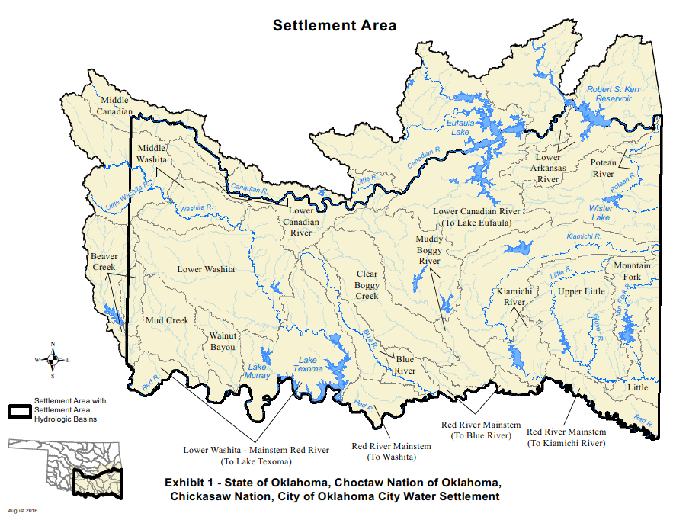

Slide 7
IDENTIFYING ISSUES:
What judicial determinations or legal precedent do you have?
  Choctaw/Chickasaw Settlement – no clear precedent for claims relating to proprietary and regulatory control of non-reservation water
  Aamodt Settlement – decades of litigation provided a starting point for characterization and quantification
What is your legal context for resolution?
  General stream adjudication
  Litigation (absent a general stream adjudication)
  Voluntary negotiations absent litigation

Slide 8
IDENTIFYING PARTIES AND
BINDING LARGER GROUPS:
  Who do you need at the table?
  How do you bind those at the table and what about those not at the table?
  Examples:
  Aamodt Settlement – eight governmental entities four Pueblos, State, County, City, United States, representatives for hundreds of non-Indian users.
  Choctaw/Chickasaw Settlement –two Nations, State, City of Oklahoma City, United States

Slide 9
IDENTIFYING PARTIES AND
BINDING LARGER GROUPS:
Who do you need at the table?
  Driven in large part by the issues to be resolved
  Legal and political question
  Answer will depend in part on your starting point (ongoing adjudication or other litigation; specific circumstances of basin or watershed)
  What waivers and releases do you need and from whom to provide certainty in perpetuity?
  May change over time

Slide 10
IDENTIFYING OF PARTIES AND
BINDING LARGER GROUPS:
How do you bind those at and not at the table?
  Question is procedural in nature (both legal and political)
    Federal legislation/congressional approval
    State (or federal) court McCarran amendment judgments and decrees binding larger groups of claimants

