Slide 1

INDIAN WATER RIGHTS SETTLEMENTS
WSWC/NARF Symposium
August 14, 2019
Pamela Williams, Director
Secretary’s Indian Water Rights Office

Slide 2
Indian Water Settlements
History and legal underpinnings
Existing Indian water settlements
Settlement elements and benefits
The Federal settlement process
Federal legislation

Slide 3
Historic Background
Basis of Indian water rights is the Federal reserved water rights doctrine established in United States v. Winters in 1908
    establishment of a reservation impliedly reserves the amount of water necessary to accomplish the purposes of the reservation (homeland purpose)
    past, present, and future uses included
    rights are not lost by non-use
    governed by Federal and not state law
    held in trust by the Federal Government

Slide 4
Historic Background (cont’d)
Despite the Winters decision, Indian water rights were largely left undeveloped and unprotected in the decades after 1908
By contrast, Federal policy and expenditures supported extensive development of water resources to benefit non-Indian communities across the West

Slide 5
Early Efforts to
Establish Indian Water Rights
Winters rights were a cloud over western non-Indian water rights
    The push to quantify Winters rights began in the 1960s
Disputes over the applicability of the McCarran Act to Indian reserved water rights created a rush to litigate but the results were disappointing

Slide 6
Settlement Era Begins
In the 1970s, tribes, states, local parties, and the Federal Government began questioning the utility of litigation as the way to resolve Indian water rights disputes
Negotiated settlements, rather than protracted litigation, became the preferred approach to resolving Indian water rights conflicts

Slide 7
Completed Settlements
Department of the Interior (DOI) has completed 36 Indian water rights settlements since 1978
    Congressionally Approved → 32
    Administratively Approved by DOI & Department of Justice (DOJ) → 4

Slide 8
Indian Water Rights Settlements with Federal Legislation, by State

Slide 9
Number of Indian Water Rights
Settlements by Year of Federal Legislation

Slide 10
Active Indian Water Rights
Settlement Negotiations by State

Slide 11
Settlement Negotiations
Settlement negotiations frequently evolve from litigation but can also occur without litigation
DOI provides technical and other assistance to the tribes
Settlement agreements vary from multi-party agreements to compacts among the state, tribe, and Federal Government
When agreement is reached, parties typically seek Federal approval in the form of Federal legislation

Slide 12
Benefits of Settlements
Wet Water
  Provide “wet water” to tribes; litigation provides “paper water”
Win-Win
  Provide water to tribes while protecting existing non-Indian water users
Local Solutions
  Allow parties to develop and implement creative solutions to water use problems based on local knowledge and values

Slide 13
Benefits of Settlements (cont’d)
Certainty and Economic Development
    Provide certainty to tribes and neighboring communities, support economic development for tribes, and replace historic tension with cooperation
Trust Responsibility
    Consistent with the Federal trust responsibility and Federal policy of promoting Indian self-determination and economic self-sufficiency

Slide 14
Federal Settlement Process
  The Working Group on Indian Water Settlements
  Established by the Department of the Interior in 1989
  Comprised of all Assistant Secretaries and the Solicitor
  Responsible for making recommendations to the Secretary of the Interior regarding water settlements and settlement policies

Slide 15
Federal Settlement Process (cont’d)
  Presided over by a Chairman who is selected by the Secretary. Currently the Chair is Alan Mikkelsen, Senior Advisor to the Secretary on Water and Western Resource Issues
  Secretary’s Indian Water Rights Office (SIWRO), under the direction of the Chairman of the Working Group, coordinates and assists with Indian water rights settlements and interfaces with settlement teams in the field
  Upon direction from the Working Group, SIWRO establishes Federal teams to lead settlement negotiations and implementation

Slide 16
Federal Settlement Process (cont’d)
Teams are comprised of representatives from:
    Bureau of Indian Affairs
    Bureau of Reclamation
    Solicitor’s Office
    Fish and Wildlife Service
    Department of Justice
    Other Federal agencies (within or outside the DOI) with significant interests in the settlement
  Currently the DOI has 46 teams in the field:
    21 Negotiation Teams , 23 Implementation Teams, and 2 Assessment Teams

Slide 17
Criteria and Procedures
The Criteria & Procedures for Participation of Federal Government in Negotiations for the Settlement of Indian Water Rights Claims, 55 Fed. Reg. 9223-9225,
Mar. 12, 1990
    Provide guidelines for Administration’s participation in settlements
    Include factors to be considered in deciding Federal contribution to settlement cost share
    Require non-Federal cost sharing

Slide 18
Criteria and Procedures (cont’d)
Four-Phase Settlement Procedure
    Phase I – Fact Finding
    Phase II – Assessments and Recommendations
    Phase III – Briefings and Negotiating Position
    Phase IV – Negotiations Towards Settlement
Notes:
On Phase IV changed it from “Negotiation” to “Negotiation Towards Settlement”

Slide 19
Criteria and Procedures (cont’d)
  Phase I – Fact Finding
    Develop information necessary to support settlement; identify parties and their positions; evaluate claims; describe geography of the reservation and drainage basin; and analyze contracts, statutes, regulations, legal precedent, and history of reservation water use
  Phase II – Assessments and Recommendations
    Assess costs presuming settlement and cost of settlement to all the parties; analyze value of tribal water claim; and recommend a negotiating position

Slide 20
Criteria and Procedures (cont’d)
  Phase III – Briefings and Negotiating Position
    Working Group establishes Federal negotiating position, including Federal funding strategy and positions on major issues
  Phase IV – Negotiations Towards Settlement
    Negotiations commence; Office of Management & Budget (OMB) and DOJ are briefed periodically; negotiating position revised if appropriate
Notes:
On Phase IV changed it from “Negotiation” to “Negotiation Towards Settlement”

Slide 21
Federal Settlement Legislation
Basic parameters of the settlement and legislation approved by Working Group and OMB
Legislation drafted and introduced
Hearings scheduled
DOI prepares initial draft testimony which is then reviewed and revised through the OMB clearance process before being submitted to Congress

Slide 22
Recent Settlements
Amendment to the White Mountain Apache Tribe Water Rights Quantification Act of 2010 (P.L. 115-227)
Amendment to the Blackfeet Water Rights Settlement Act of 2016 (P.L. 115-270)

Slide 23
Pending Legislation
Settlements introduced in 116th Congress:
  RWSF Extension – S. 886/H.R. 1904 introduced in March 2019. Hearing held in April 2019.
  Navajo Utah - S. 1207/H.R. 644 introduced in January and April 2019. Hearing held in June 2019.
  Aamodt Amendment - S. 1875/H.R. 3292 introduced in June 2019. Hearing held in June 2019.
  Hualapai- S. 1277/H.R. 2459 introduced in May 2019. Hearing held in June 2019.
  Kickapoo- H.R. 3491 introduced in June 2019
Legislation not yet introduced in Congress but expected:
  Confederated Salish and Kootenai Tribes

Slide 24
ADMINISTRATION’S SETTLEMENT POLICY
Alan Mikkelsen
Senior Advisor to the Secretary-Water and Western Resource Issues
&
Chair of the Working Group on Indian Water Rights Settlements

Slide 25
Message from Secretary Bernhardt
"For over two and a half decades, I have been a believer in the merit of resolving our longstanding water rights issues; Alan and Pam have my support in the Indian Water Rights Office."

Slide 26
Interior Views
Indian water settlements:
  Are a critical part of the United States Government’s trust responsibilities and we have a duty to collaborate on a government-to-government basis with Tribes.
  We know that water is a key resource for the Tribes and the surrounding communities and settlement of claims brings certainty to all water users.
  There is a critical need for a sustainable and reliable water supply for the West.

Slide 27
Interior Views (cont’d)
  Economic development and infrastructure investments are important in revitalizing Native communities.
  The Department will need to explore new settlement funding mechanisms.
  Commitment to fund and implement existing settlements.

Slide 28
Failure Is Not An Option:
The Aamodt Settlement Case Study
The 2010 Aamodt Litigation Settlement Act resolved over 50 years of litigation by settling the claims of 4 Pueblos in NM (Nambe, Pojoaque, San Ildefonso and Tesuque).
The centerpiece of the settlement is a Regional Water System.
This settlement has teetered on the edge of failure for years.
But the Settlement parties have persevered to overcome each seemingly insurmountable obstacle.

Slide 29
Failure Is Not An Option:
The Aamodt Settlement Case Study

Slide 30
Failure Is Not An Option:
The Aamodt Settlement Case Study
County Roads Trespass
  After years of roads trespasses on Pueblo land, BIA sent Santa Fe County a show cause letter or face ejectment.
    Title insurers stopped issuing policies.
  The County responded by requiring ROWs on all 4 Pueblos’ land or it wouldn’t enter into funding agreement with BOR, which would kill the settlement because BOR couldn’t start construction without it.
  In 2018, with the Department’s help, County settled with each Pueblo and purchased 200-year term ROWs.

Slide 31
Failure Is Not An Option:
The Aamodt Settlement Case Study
Funding Shortfall
  Funding for Regional Water System was $208M short due primarily to a low estimate based on appraisal study
  611(g) of the Act provides that the Secretary will enter agreement w/the parties if funding shortfall exists
  The parties recently completed 611(g) negotiations:
    $15M in savings from revised project design
    Approximately $56M in additional non-Federal contribution
    $137M in additional Federal contribution
  The legislation to amend the Act awaits a floor vote
  Construction will begin winter 2020

Slide 32
Fund Based Settlements
Settlements based on Appraisal Level costs are problematic
  Neither the Administration nor Congress are likely to approve open-ended settlements or repeated amendments to raise cost ceilings
Fund Based Settlements
  Allow tribes to determine the timing and size of infrastructure over time
  Promotes self determination and sovereignty

Slide 33
Having Realistic Expectations
Often tribes, states and local users negotiate a settlement that works for them without regard to Federal costs
These expectations cause great disappointment when the Department weighs in on Federal costs
This Administration is striving to give tribes and other settlement parties realistic expectations on what can Federal costs can supported
While the message may not be what tribes and parties want to hear, it is important to hear and understand

Slide 34
Settlement Funding
Funding of Indian Water Rights Settlements come out of the budgets of both the Bureau of Indian Affairs and the Bureau of Reclamation.
Both BOR and BIA provide technical and other assistance to tribes in negotiation and implementation

Slide 35
DOI Funding
FY 2018 FY 2019 FY 2020 (request)
SIWRO $1,490,000 $1,380,000 $1,370,000
Reclamation $6,019,000 $7,330,000 $5,992,000
BIA $18,061,000 $18,084,000 $16,571,000
TOTAL* $27,228,000 $27,209,000 $24,958,000
*includes funding provided by other DOI Bureaus

Slide 36
Federal Costs of Settlements
Federal funding required by Indian water settlements has significantly increased over time
Roughly a billion dollars expended between mid 1980s and 2002 but more than $2 billion authorized between 2009-2016
Pending settlements approaching $3 billion

Slide 37
Settlement Funding (cont’d)
Omnibus Public Land Management Act (P.L. 111-11) Established Reclamation Water Settlement Fund
  $120 million for each of 10 years beginning in 2020 (total of $1.2 billion)
  Funding is allocated based on priorities within the Act: Navajo-Gallup Water Supply Project; other NM Settlements; Montana Settlements; Arizona Settlement (Navajo Nation’s claims in the Lower CO River Basin)
  A good start but not enough and highlights the need to look for new mechanisms to fund settlements.

Slide 38
S.866 Indian Water Rights Extension Act
Original bill introduced on March 27, 2019 and would have permanently authorized the Reclamation Water Settlement Fund.
A substitute amendment was introduced, marked-up and reported out of the Senate Committee on Indian Affairs on July 17, 2019.
The Amendment has three main proposes:
    Makes a number of changes to the Reclamation Water Settlement Fund including extending it to 2039 and specifying that it is only for Indian water right settlments;
    Includes the Aamodt Litigation Settlement Completion Act of 2019 (S. 1875), which will increase the authorization ceiling to $137M, extend completion dates, and conforms to the 611(g) Agreement, among other things and;
    Includes a provision directing USDA’s Natural Resources Conservation Service, in consultation with the Department of the Interior, to conduct a study of the Upper Delaware and Tributaries Watershed Plan no later than two years after the date of enactment, in order to facilitate future Congressional consideration of the Kickapoo Tribe Water Rights Settlement Agreement.

Slide 39
Future Challenges
Currently pending litigation relates to water rights of about 65 Indian tribes in 12 states.
Many more requests for federal litigation assistance are pending.

Slide 40
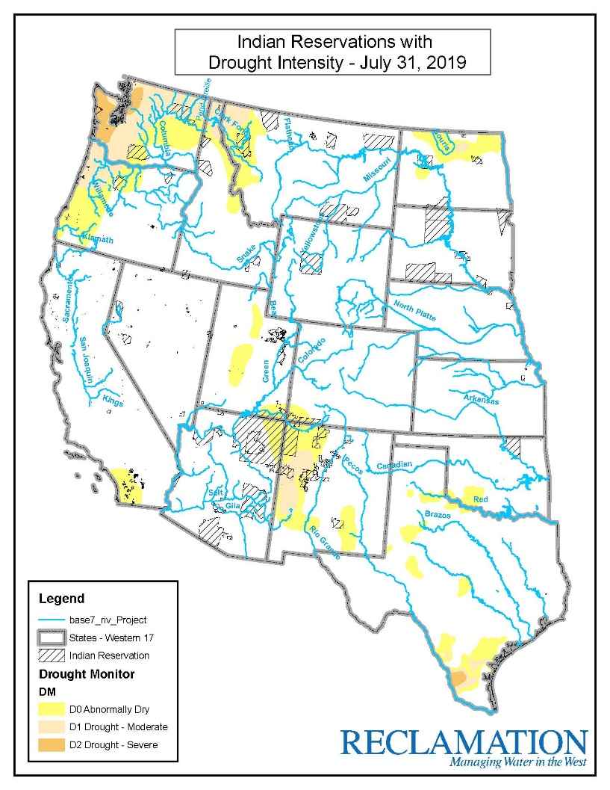

Slide 41
Conclusion
With over 200 Tribes in the West who need access to clean, reliable water and with extreme drought conditions in those States with these Tribes, it is inevitable that the Department will continue to see a growth in the number of Tribes who will assert their rights to the water on their reservations. Settlement requests will continue.

