Slide 1
Gerald (Jerry ) Lunak
Born and raised on the Blackfeet Indian reservation. Grandfathers were Mountain Chief and Sits in the Middle, both signers of the Lame Bull Treaty of 1855. Attended Bureau of Indian Affairs boarding schools from age 7 to 19 years old on the Blackfeet Reservation, in South Dakota, and in Kansas. Attended college in Billings and Missoula, Montana. Over the last 17 years worked as a Blackfeet Tribal Director for Agriculture, Farm Leasing, Water Resources, Water Rights and most recently the Water Compact Implementation. Other work …. Intertribal Agriculture Council, USDA-NRCS, and USDA Agricultural Statistics.
Notes:
This is me….

Slide 2
Negotiation of Indian Water Rights Claims…The Basics
Native American Rights Fund and Western States Water Council Conference August 13 2019
Notes:
Honored to be here

Slide 3
Blackfeet Water Compact and Settlement Act
Gathering Background Information and the Role of Technicians for the Blackfeet Compact and Settlement Act cannot be defined without addressing the story of who we are and where we reside.

Slide 4
A Blackfeet Perspective………Historical
The Blackfeet have existed for millennia on the lands where they currently reside. According to Darrell Kipp, tribal historian, carbon dating has proven we have been here for 5000 years ……….our Blackfeet tribal stories say we have always been here.
First contact or interruption with Blackfeet occurred in 1700s. “Contact history is a sliver to the overall historical record of the Blackfeet.”
(Darrell Kipp – Blackfeet Tribal Historian ”)
Compare this to the currently used “1855 priority date” that exists in current water law.
Recent archeological activities on the Blackfeet Nation detect Blackfeet presence at 13,000 years
Notes:
Darrel Kipp a champion for revitalization of the Blackfeet Language

Slide 5
Blackfeet Country 1856
Notes:
Blackfeet Homeland 1856 Niitsitapi (The People)or ( Real People) Currently 1.5 million acres in Northwest Montana

Slide 6
Mythology of the Blackfeet “Tales of the Old Man” By Wisner/Duvall Vol 2,1908 pg.19
“During the flood, Old Man was sitting on the highest mountain with all the beasts. The flood was caused by the Above People, because the baby (Dusty Star –a mushroom) of the woman who married a star was needlessly torn in pieces by an Indian child. The Old Man sent the otter down to get some earth. For a long time he waited, then the otter came up dead. Old Man examined its feet but found nothing on them. Next he sent beaver down, but after a long time he came up drowned. Again nothing was on his feet. He sent Muskrat to dive next. Muskrat also drowned. At length he sent the Duck (?), it was drowned, but its paws held some earth. Old Man saw it, putting it in his hand feigned putting it on the water three times and at last dropped it. Then the Above People sent rain and everything grew on the earth.”
The loon is the most powerful water bird spirit according to Blackfeet belief. (John Murray –Tribal Historic Preservation Office
Notes:
Water is part of our oral history..

Slide 7
Blackfeet Tribe “Lame Bull Treaty“ October 17th 1855
Notes:
This treaty defines the Blackfeet “priority date”

Slide 8
The Blackfeet have endured many “tragedies and challenges” leading up to the present day
Bear River Massacre (1870)
Starvation Winter (1883)
Dawes Act (1887)
Boarding School Era
Relocation Era (1952)
These are some of the many…
Water maintained its purpose
throughout our journey
Notes:
The issue of water maintained its purpose throughout our journey

Slide 9
Blackfeet Perspective ….contemp0rary
With the signing of the 1855 Treaty, the Blackfeet have been part of the water use/water rights landscape. The philosophical and legal changes that have come to Blackfeet Country regarding how water is viewed, have challenged the tribe in various aspect of their lives.
Looking out from beyond the trust responsibility of the federal government (though not dismissing it) has allowed the tribe to step forward and proactively address issues regarding water. These issues vary from on the reservation, from a basin wide, statewide, and national perspective and have become part of the tribal conversation.
Notes:
The Blackfeet Tribe had to adjust to the way water was viewed going forward in time.

Slide 10
basic issues that define the Blackfeet compact ?
Water
How much is there?
Lakes
Streams
Groundwater
How much water is needed to fulfill the purposes of the reservation (future)
Land
What is the land base for the claim?
Land Use-Irrigated, dryland crop, range, etc.
Other Purposes: stock, fisheries, habitat, recreation, municipal, rural, industrial, etc.
Notes:
The process of gathering this information has come from various sources

Slide 11
Historical Timeline…
1855 -Blackfeet Treaty of 1855 (priority date)
1908 -Winter Doctrine 1908 (established water right)
1954 -McCarren Amendment 1954 (state input)
1975 -1986 Litigation (Arizona v. San Carlos; Blackfeet v. Hodel)
1979 -Montana Reserved Water Rights Commission established
1986 -Blackfeet Tribe began negotiations
2007 -Compact passed by Blackfeet Tribal Council
2009 -Blackfeet Compact passed by State of Montana
2016 -Blackfeet Compact passed by Congress
2016 -Blackfeet Compact signed by then President Obama
2017 -Blackfeet people approve Compact by referendum vote
2017 -Implementation Phase of Compact begins.
2019 -State Water Court Decree process proceeds
2019 -The pursuit of Compact Implementation continues
Notes:
At every step there were any number of people involved in defining this infromation

Slide 12
Who and what defines the Blackfeet Water Compact and Settlement Act?
Tribal Community
Tribal Leadership
Tribal Departments
Tribal Legal Team
Tribal Engineering Consultants
Other Tribal Entities –Community College etc.
Other Resources
Studies by Groups
Historical Documents
Federal and State Agencies
The Blackfeet Water Compact processes have been an ongoing effort since 1986.
Notes:
For the Blackfeet water changes from a mythical counterpart to a natural resource.

Slide 13
With the completion of the negotiation phase of the Blackfeet Compact and Settlement act, the tribe has moved to the Implementation Phase of the Compact
There are still technical issues that need to be completed in order to totally move to the Implementation phase of the Compact

Slide 14
Technical Issues ?
State Water Court -Final approval of Blackfeet Water Decree
Waiver of claims –Tribe must sign waivers
Funding –Must be appropriated
Agreements –Must be finalized
Ft.Belknap –Agreement must be entered into
Milk River Right of Way –Agreement must be finalized
St.Mary Canal Water –Tribe must enter into contract
Lake Elwell Water –Tribe must enter into allocation agreement
Water Code –Tribe must amend water code
Implementation Activities –Reservation wide plan to be developed
Other outstanding issues

Slide 15
Two Medicine Dam …Blackfeet Country
Notes:
Two Medicine Watershed

Slide 16
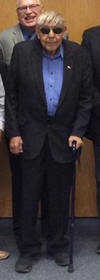
Blackfeet Perspective ….. Future
“I used to interpret for our Blackfeet elders, they would always say the water is ours, it will always be ours.” Then it began to change ….the laws began to move in on us…. now we have to negotiate to hold on to our water. We have to become educated about the laws, so we have our water in the future.” (Chief Earl Old Person, Blackfeet Tribal elder, past Blackfeet Tribal Chairman, Blackfeet Tribal Council, 1952-2016) .…90 years old and his work continues..
Notes:
Information and technology are driving this effort

Slide 17
On April 20,2017 the Blackfeet Nation decided by referendum vote to accept the Blackfeet Tribe Water Compact and Settlement Act
An extensive education program was provided to the membership of the Blackfeet Nation prior to the vote, among the education processes offered were:
Establishment of a website blackfeetnation.com
Nationwide mailings to all 17,000 members
Education meetings throughout the reservation
Mailings to Montana residence (tribal) 18 years and older
Outreach to voting age high school seniors
Outreach to Senior citizens and their families
Radio and newspaper informational ads
Interaction with leadership and others on local radio
Interaction with social media, facebook etc.

Slide 18
Selection of the projects for the Implementation of the compact have come from: The existing Water Compact and Settlement Act Community led meetings throughout the reservation Tribal Leadership and staff Consultation with agencies and partnerships
The end result must be a combined community effort
Notes:
Again the issue of data gathering and technical assistance looms before us…

Slide 19
St Mary’s Watershed…..to the Blackfeet “The Lakes Inside”
St. Mary’s Watershed to the Blackfeet “The Lakes Inside”
Notes:
This watershed proceeds to Canada and Northcentral Montana

Slide 20
2019 - Montana State Water Court facilitated meetings throughout the Upper Missouri watershed, addressing objections to Blackfeet Compact…ultimate goal? Water Decree
Notes:
DNRC,DOJ,BIA,State Att.G, (Judge Brown,Blackfeet Tribe,Water Master…cooperation at its finest ,ultimately a water decree

Slide 21
Benefits of the Blackfeet Water Compact
Negotiated water decree will provide current and future uses for the Blackfeet people.
The projects and funding for the compact will provide jobs, training and education for Blackfeet people.
The water compact will provide opportunities in agricultural development for the Blackfeet membership. (shifting from landlord to agricultural producer will shift the tribal economy upward)
Municipal water for tribal members, upgrades in infrastructure, recreation and fisheries development, development of tribal and allotted irrigated lands and land purchase are some of the benefits of the negotiated Blackfeet compact
Other benefits…
Notes:
It will have been the work of the various technical teams the provides a path to success for these components

Slide 22
Blackfeet Compact projects
Notes:
472 million dollars and 750,000 acre feet of water for present and future uses

Slide 23
What are the parameters?
Funding ($422 million) must be secured by 2025 (federal)
Blackfeet plan will address timeline for projects
Some early projects have begun (Four Horns Dam, Heart Butte Water Supply)Water Measurement Program
Notes:
28 million in State of Montana funding contrubutions

Slide 24
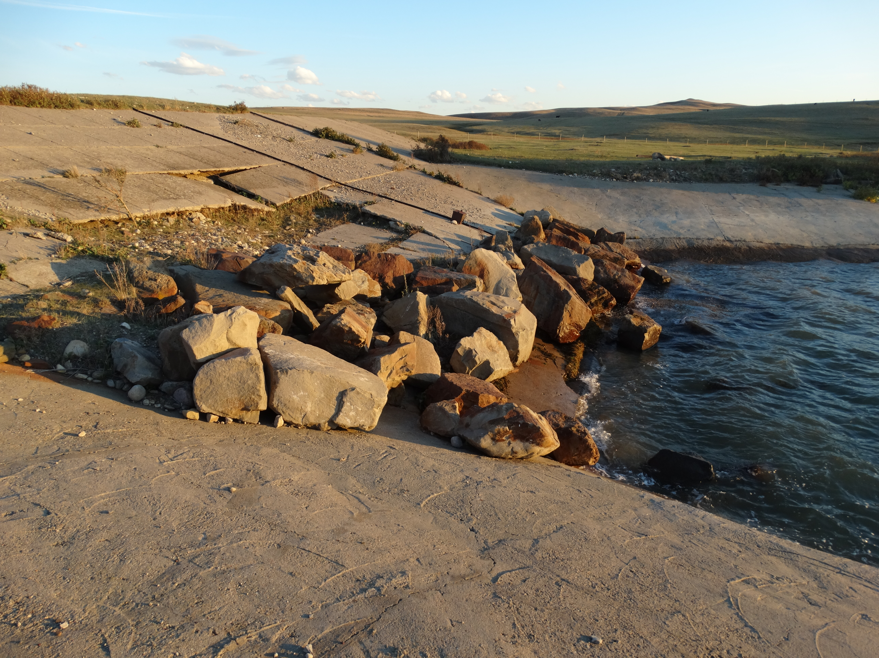
Ongoing projects
The Four Horns Dam improvement has already begun with Safety of Dams funds. (Birch Creek Agreement)

Slide 25
Blackfeet Footprint
It is critical that the Tribe keep a Blackfeet footprint on the compact.
The tribe’s Implementation team must be able to articulate political, governmental, personnel, community, and financial issues relevant to the Blackfeet Water Compact
The Blackfeet people have spoken through a referendum vote and by a majority have approved the Blackfeet Water Compact and Settlement Act (April 20.2017)
The critical work of Implementation of the Blackfeet Compact and Settlement Act has begun

Slide 26
A Celebration of historic proportions February 27,2017
Notes:
A sharing of success for everyone who has participated in this effort…there are so many

Slide 27
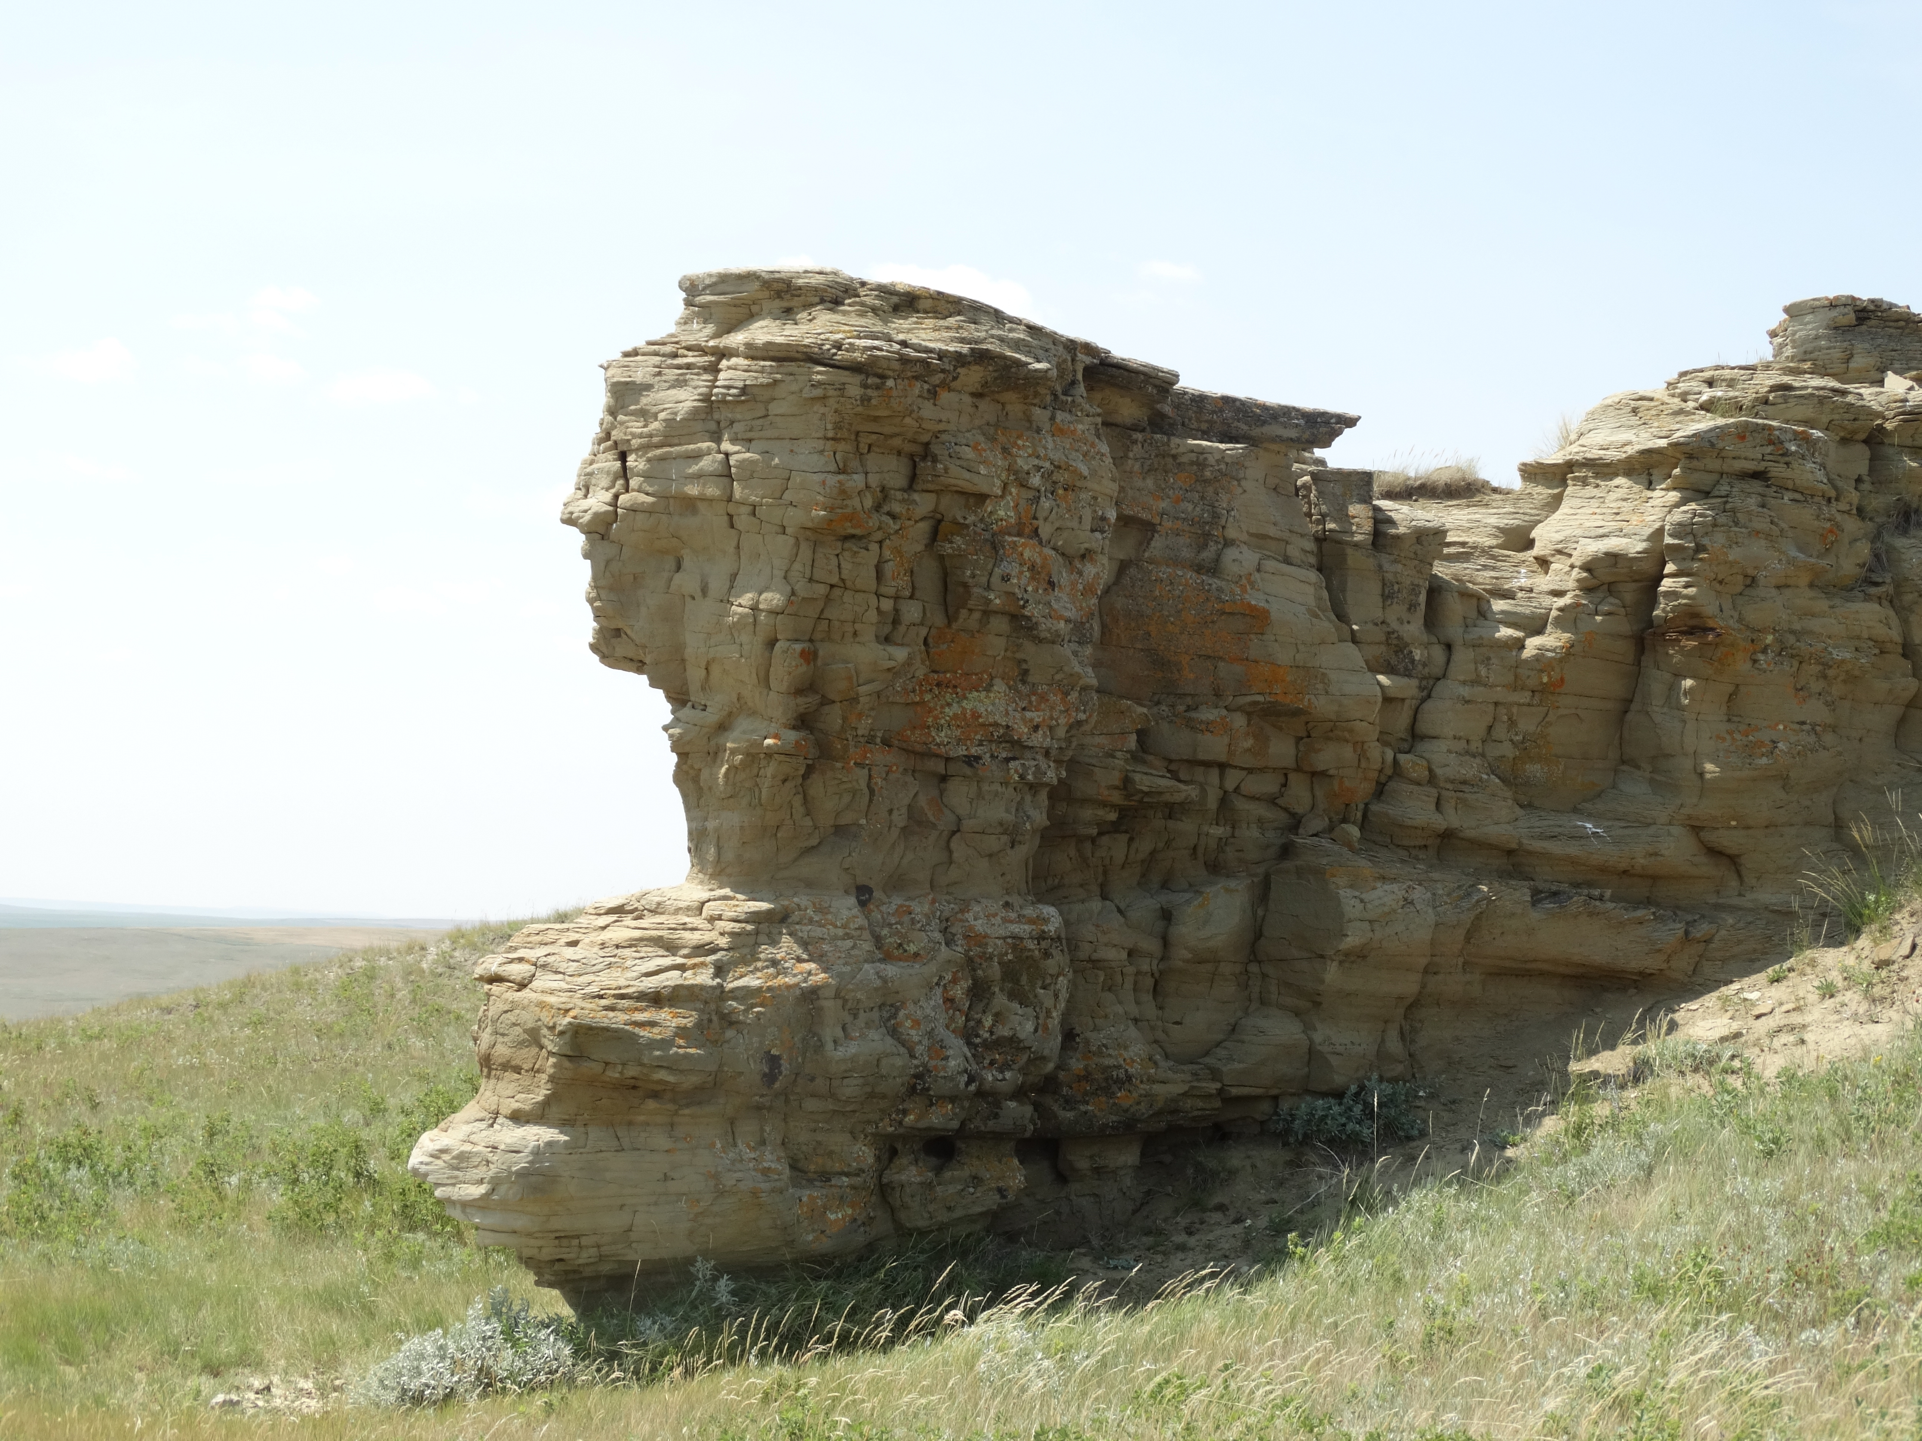
Go To www.blackfeetnation.com
Questionss?

