Slide 1
Western Water Law and Indian Reserved Water Rights: A Premier
Norman K. Johnson
Symposium on the Settlement of
Indian Reserved Water Right Claims
August 13-15, 2019
Funner, California
Notes:
1 – My opinions are my own and should not be attributed to my employer, clients or anyone else.
2 – I think to understand the negotiation of reserved water right in Utah we need to begin by understanding the doctrine itself and how it relates to the doctrine of prior appropriation, which we do by starting with the basics.
3 – We need a history lesson today.

Slide 2
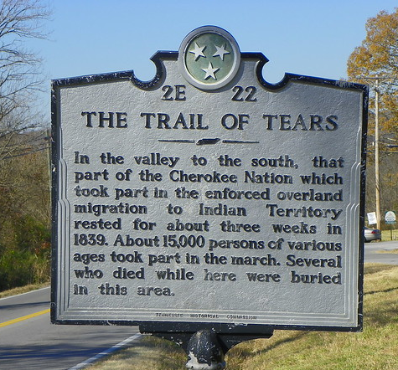
Reserved Rights — Origin and History
Historical context helps
understand the relationship
between Western law and
reserved water rights
Long before explorers,
pilgrims or puritans came to
the Americas indigenous
people inhabited the land.

Slide 3
Reserved Rights — Origin and History
The Indian Removal Act of 1830 and the forced resettlement of Native American populations led to the “Trail of Tears”
Creation of Native American reservations followed, first in the eastern United States and later in the West
At the same time non-Native American settlers were moving westward

Slide 4
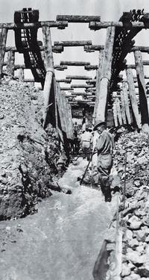
Western Water Law — Origin and History
In the arid West areas of water use were often located far from sources of supply
Miners and irrigators built diversions
and moved water to areas of need
The “first in time/first in right”
mining principles carried over to
water rights
The doctrine of “prior appropriation” of water was born (mid to late 1800s)

Slide 5
Western Water Law — Origin and History
Appropriative water rights are given a priority based on their date of creation
In times of shortage, earlier priority rights are filled first to the limit of the right
No sharing of shortages means some uses will be met
The intent was to maximize public benefit
Continued beneficial use required

Slide 6
Western Water Law — Origin and History
Appropriative water rights are constitutionally protected property rights
Their basis is the beneficial use of water
They are defined by quantity, time, and nature of use
Priority date is when beneficial use began or when an application was filed to use them
They can be lost by non-use
Notes:
The need for beneficial use is so important because it pays back the public for allowing a person to privatize water use and because it “keeps the system real” in terms of requiring actual use instead of simply doing paperwork.
We are moving away from bedrock principle in some ways and we will pay a price for doing so, I’m afraid.

Slide 7
Western Water Law — Origin and History
The federal government supported growth and development of this “new” water law
1866 Mining Act and 1877 Desert Land Act required state law created water rights
The U.S. Supreme Court said these acts severed the land and water estates and directed that water rights be obtained under the laws of the territories and states

Slide 8
Western Water Law — Origin and History
Lawmakers and farmers believed that either rain would follow the plow or irrigation would compensate
The appropriation doctrine flourished
Notes:
The desire to irrigate arid land prompted the spread of the appropriation doctrine.
“Modern irrigators” could subscribe to this magazine—published monthly. In this October, 1894 issue you could read articles on:
“The Progress of Western America, ” “The Mighty Colorado,” “The Art of Irrigation,” and “Talks with Practical Irrigators.”
[The temporary chairman of the “Third National Irrigation Congress” at this time was George Q. Cannon and John Henry Smith was a delegate to the National Irrigation Congress. The mantra of the National Irrigation Congress was “Store the Floods,” “Save the Forests,” and “Reclaim the Land.”]

Slide 9
Western Water Law – Origin and History
Notes:
In many places those who came before us have done such a good job of planning for the future, that we forget about our desert environment.
Much of what appears on this map in yellow is depicted on other early maps as “the Great American Desert.”
It was considered a desert area by cartographers in 1890 because of lack of rainfall.

Slide 10
Western Water Law — Origin and History
2014 U.S. Department of Energy: “The Water-Energy Nexus: Challenges and Opportunities” Overview and Summary, Figure 5.
Notes:
You can see on this map how closely the water laws of the Western States correlate with the amount of water available.

Slide 11
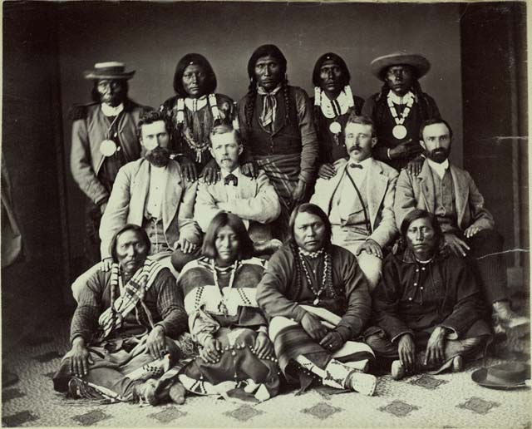
Reserved Rights — Origin and History
At the same time the appropriation doctrine was developing with federal approval, federal reservations of land were being made in the West
Congress and the President set aside public lands
for a particular purposes,
such as Indian
reservations, but did not
create accompanying
water rights
Notes:
At the same time the appropriation doctrine was developing a parallel history played itself out in the West--this complex history involved the creation of federal reservations, particularly Indian reservations, in many western areas.
There are a tremendous number of developments involved here, particularly regarding Native Americans, which we don’t have time to describe in detail. Suffice it to say that the indigenous people who were parties to the treaties that created the Indian reservations had every reason to believe the promises made to them in the treaties would be honored. The problem was that, when it came to the water for the federal reservations, the treaties were silent. This was bound to create controversy, and it did.

Slide 12
Reserved Rights — Origin and History
In 1906 the U. S. sued on behalf of the Ft. Belknap Reservation Indians to secure water rights for them on the Milk River
Defendant farmers/ranchers protested, saying they had valid water rights created under Montana law
The suit created a genuine dilemma
Notes:
It is important to note here the dilemma was real—neither party had acted in any direct way to harm the other, but now their needs were in conflict

Slide 13
Reserved Rights — Origin and History
In 1908 the Supreme Court issued its Winters decision
It said Congress, when it set aside the reservation, impliedly intended to reserve water for the Indians
The “reserved rights” doctrine was born as an equitable, judicial response to a real and difficult controversy
Notes:
A principal reason for pointing this out is – there are no “good guys” and “bad guys” when it comes to reserved water rights
- The point is that in some areas the federal government essentially gave away the same water twice or at least it gave the opportunity to obtain the rights to the same water twice, leaving to western interests, Indian and non-Indian, the challenge and opportunity to resolve the resulting controversies.

Slide 14
Reserved Rights — Origin and History
In Arizona v. California (1963) the U. S. Supreme Court said the reserved rights doctrine applies to federal reservations other than Indian reservations
For Indian Reservations it said the number of practicably irrigable acres on the reservation (PIA) is used to quantify the right
Notes:
The judicially – created reserved rights doctrine developed slowly in the Courts.

Slide 15
Reserved Rights — Origin and History
Subsequent case law further defined the reserved rights doctrine
Cappaert v. U.S. (1976) – the
amount of water reserved is the
minimum amount necessary to
fulfill reservation purposes
U.S. v. New Mexico (1978) –
primary purposes only get
reserved water rights

Slide 16
Reserved Rights vs. Appropriative Water Rights
Courts have required sensitivity in how the reserved rights doctrine impacts those who have obtained water rights under state law – U.S. v. New Mexico
And, the PIA standard for Indian reservations is complicated and can be difficult to prove—no similar standard applies to obtain a state water right

Slide 17
Reserved Rights vs. Appropriative Water Rights
The Gila V decision indicates that the reserved water right is for the amount sufficient to make a reservation a permanent home land
Gila V also says the right should tailored to the reservation’s minimal need.

Slide 18
Reserved Rights vs. Appropriative Water Rights
Reserved water rights are important sovereign and property interests
Their basis is the creation of reservations
The purpose of the reservation defines their quantity (PIA for Indian reservations)
Priority date is creation of the reservation
They are not lost by non-use
Notes:
Now, look at how these principals compare with appropriation doctrine principles.
Appropriative rights are not typically considered sovereign interest.
The basis of appropriative rights and their quantity is defined by beneficial use.
The priority date of appropriative rights is when use began (or when an application was filed)
Appropriative rights can be foresighted
**NOTE—Because the priority date of reserved water rights is the creation of a reservation, appropriative rights apply only to the unappropriated water available at that time.

Slide 19
Reserved Rights vs. Appropriative Water Rights
In addition to having characteristics that conflict with appropriative water rights, the more pressing problem is that reserved water rights are un-quantified when created
Given their early priority dates, they compete with and can displace State-created water rights

Slide 20
Western Water Law — Origin and History
Hypothetical
Mill Valley Water System
1863 – 100 ac/ft
1890 – 100 ac/ft –0 use
1900 – 100 ac/ft
1901 – 100 ac/ft
1915 – 50 ac/ft
1917 – 100 ac/ft
1930 – 100 af/ct
1931 – 100 ac/ft
1935 – 100 ac/ft—10 use
This small surface water system produces +/- 300 ac/ft/yr
The rights in blue are used every year
The right in pink has not been used for decades
The rights in yellow have become supplemental to other rights and are rarely used
The rights in light green are used every year when water is available
Only 10 ac/ft of the right in dark green has been used for decades
Notes:
(Go through the description point-by-point.)
If we had time, there are all sorts of issues we could discuss here.
- forfeiture
- partial forfeiture
- supplemental rights
- and more
But, we don’t have time and the point is that we should look at what happens when we add a reserved water right of significant size relative to the other rights in the system.

Slide 21
Reserved Rights vs. Appropriate Water Rights
1860 – 100 ac/ft
1863 – 100 ac/ft
1890 – 100 ac/ft –0 use
1900 – 100 ac/ft
1901 – 100 ac/ft
1915 – 50 ac/ft
1917 – 100 ac/ft
1930 – 100 af/ct
1931 – 100 ac/ft
1935 – 100 ac/ft—10 use
Reserved Right reorganized for 100 ac/ft/yr, with 1860 priority date
Becomes the earliest right on the system
All other rights move down in priority
Notes:
Adding the reserved rights will cause displacement and challenge in patterns of use.
So, our task is how to quantify the rights in the least disruptive way possible.

Slide 22
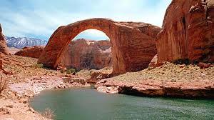
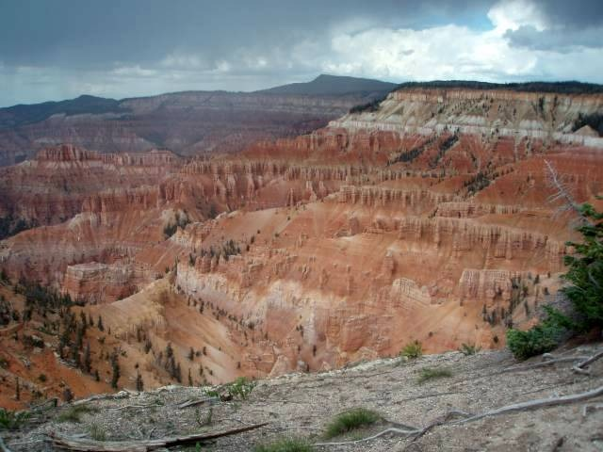
Reserved Rights vs. Appropriative Water Rights
Utah, an arid state, has many federal reservations — federal lands set aside for specific purposes, like Indian reservations, national parks and monuments, military bases, etc.
How should these rights be quantified?
Notes:
Let’s talk about whey this matters.
- using a sample illustrative example.

Slide 23
Reserved Rights vs. Appropriative Water Rights
States have taken different approaches:
Pretend reserved rights don’t exist (mostly in times past)
Litigate about reserved rights
Negotiate such rights on a case-by-case basis
Utah has chosen to negotiate because it provides the best opportunity for a win/win result
Notes:
The Legislature and Governor, by a joint resolution, have endorsed this approach.

Slide 24
Utah/Navajo Reserved Water Right Negotiations
Navajo has substantial Winters rights
Navajo’s water rights for the portion of the reservation in Utah must come from Utah’s share of the Colorado River
Utah and Navajo have worked together to resolve reserved water right issues for more than a decade seeking “win-win” solutions

Slide 25
POTENTIAL LIABILITY
PIA = abt. 160,000 AF
of Water Depletion
Expensive, Unpredict-
able Litigation
Non-Indian Priority
Conflicts
SETTLEMENT PROPOSAL NAVAJO NATION
81,500 AF of Water Depletion
About $200 Million in Projects
Emphasis on Drinking Water Projects
Subordination to Existing Rights
About 5% of cost ($8M) = State Share

Slide 26
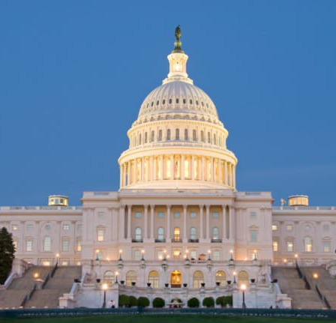
Pending Legislation H.R. 644 / S. 1702
Navajo/Utah legislation was introduced and almost passed in the last session of Congress
H.R. 644/S. 1702 have been introduced this year
The Nation, State, and the Administration supports these bills
House Water, Oceans and Wildlife Subcommittee held a hearing on June 26

Slide 27
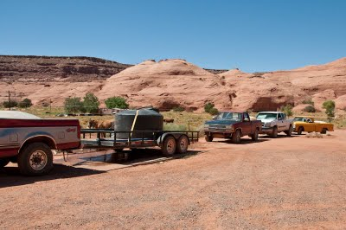
Benefits of a Navajo-Utah Settlement Agreement
Quantify a Significant Reserved Water Right
Improve Quality of Life for Utah Navajo People
Avoid Costly Litigation and Uncertain Outcomes
Provide Certainty for Water Users
Navajo Nation
CUP/Wasatch Front
Uintah Basin & San Juan County
Price River, Carbon, Emery &
Grand Counties
Lake Powell Pipeline
Solve a Colorado River Issue

Slide 28
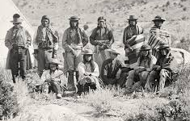
Settlement of Reserved Water Rights
We have learned negotiators must:
Protect all Tribal/federal/non-federal interests;
Realize that settlements must work for all;
Communicate and educate;
Focus on what matters;
Use technicians;
Build trust;
Be patient;
Put things in context; and
Acknowledge finality.

Slide 29
QUESTIONS?
~ The End ~

