Slide 1

Settlement Implementation
Impacts of Policy Change
Rocky Boy Montana

Slide 2



Rocky Boy (Montana)
Chippewa Cree Construction Corp
  Shalee Russette, Project Manager
Advanced Engineering & Environmental Services, Inc
  Deon Stockert, PE

Slide 3
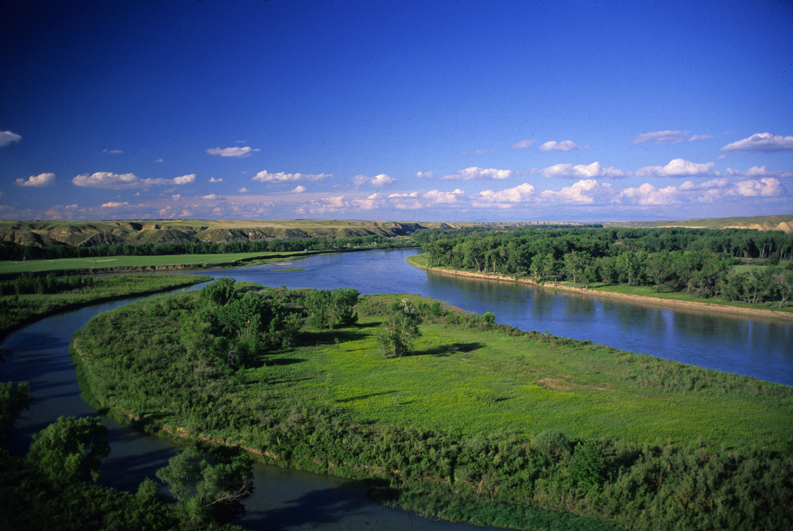
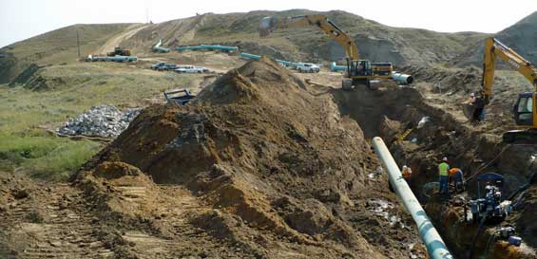
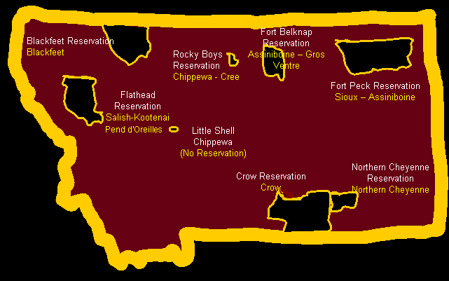
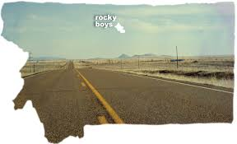
Location

Slide 4
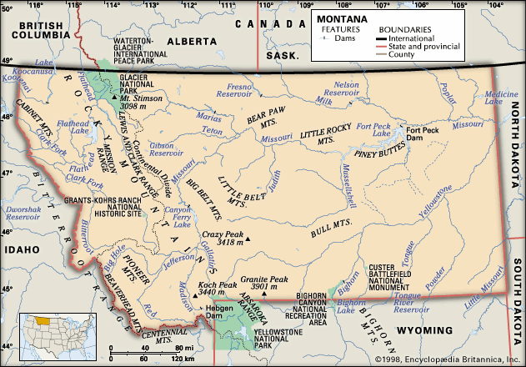
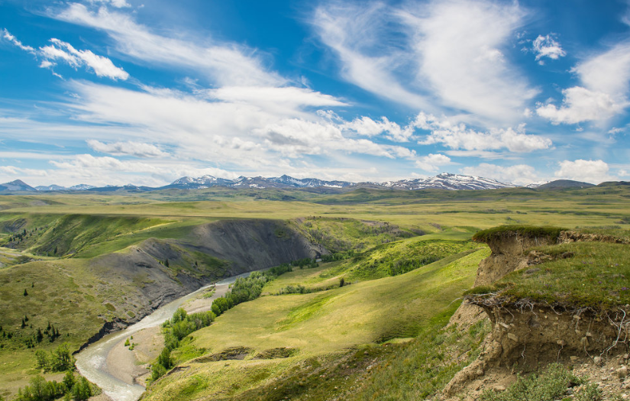
Marias River

Slide 5
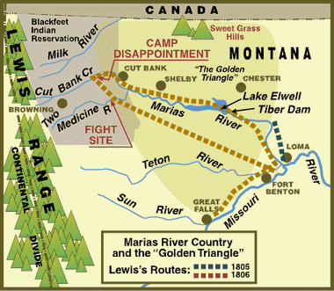
History of Marias River
Marias River, river in Glacier county, northwestern Montana, U.S. It is formed by the confluence of Cut Bank, Dupuyer, and Birch creeks and Two Medicine River and flows generally southeastward. The river is impounded by the Tiber Dam to form Lake Elwell, a reservoir used for irrigation and recreation. Beyond the dam it flows for 50 miles (80 km) to enter the Missouri River at Loma. Used by pioneer and trading expeditions, the Marias was named in 1804 by the explorer Meriwether Lewis for his cousin Maria Wood. In 1806 Lewis proceeded up the river to a point near the site of Cut Bank, where Fort Piegan, an American Fur Company trading post, was established in 1831. The river was the site of one of the bloodiest incidents of the Indian Wars when, on January 23, 1870, U.S. soldiers killed 173 Piegan, Blackfoot, and Blood Indians, mostly elderly men, women, and children, in an event that came to be known as the Marias Massacre. The Marias River receives its principal tributary, the Teton River, at Loma, near its junction with the Missouri.
Formed by confluence of the following rivers
  Cut Bank
  Dupuyer
  Birch Creek
  Two Medicine
Impounded by Tiber Dam (Lake Elwell)
Named by Meriwether Lewis for his cousin Maria Wood

Slide 6

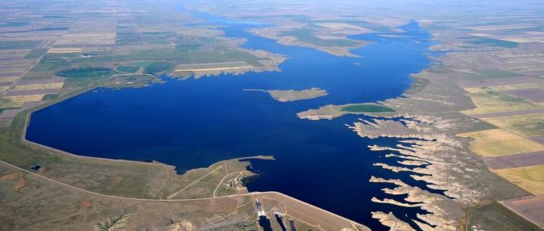
Tiber Dam

Slide 7
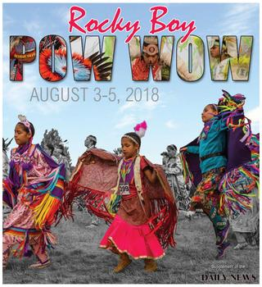
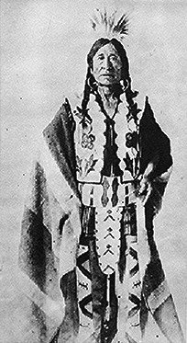
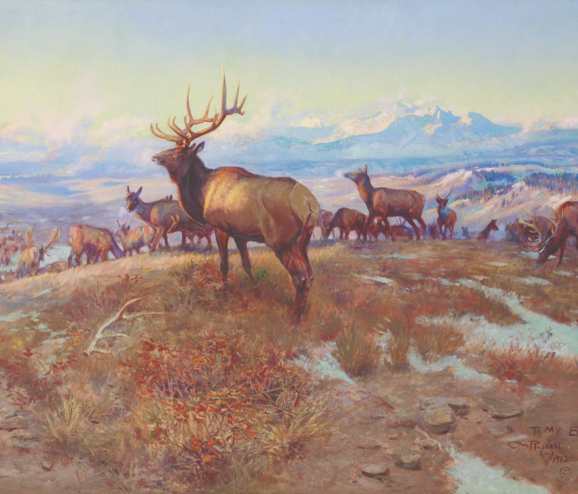
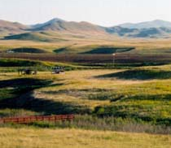
Chippewa Cree Tribe
Reservation Established by Act of Congress in 1916
110,000 Acres in Hill and Chouteau Counties
1 of 7 Reservations in Montana
Bears Paw Mountains
Population = Approx 4,000 (Fastest Growing MT Reservation in 2010 Census)

Slide 8
Settlement History
The Chippewa Cree Tribe of the Rocky Boy's Reservation passed a resolution approving the water rights compact between the Tribe and the State of Montana.
Water right settlement negotiations began w/ Montana adjudication of water rights.
PL106-163: Federal Water Rights Settlement
On-reservation Water
Off-Reservation (10,000 Acre-Ft)
On-Reservation Projects Bonneau, Towe, East Fork
1992
1997
1999
2002
2004
2005

Slide 9
Settlement History – Off-Reservation
The Chippewa Cree Tribe of the Rocky Boy's Reservation passed a resolution approving the water rights compact between the Tribe and the State of Montana.
TriPartite OM&R Agreement
Water right settlement negotiations began w/ Montana adjudication of water rights.
PL106-163: Federal Water Rights Settlement
On-reservation Water
Off-Reservation (10,000 Acre-Ft)
PL107-331: Rocky Boy’s/NCMRWS Project
Final Engineering Report
1992
1997
1999
2002
2004
2005

Slide 10
Settlement History – Off-Reservation
20-Years and not a drop of water On-Reservation.
2002
2019

Slide 11

Tribal Vision
5.5 MGD to Rocky Boy
  Population
  Removing Water Restrictions
  Improve Water Quantity/Quality
Jobs (PL93-638)
Water Sales (10,000 acre-ft)
Correlate Technical w/ Vision
  Alignment
  Political Buy-In
  Lead Agency Buy-In

Slide 12
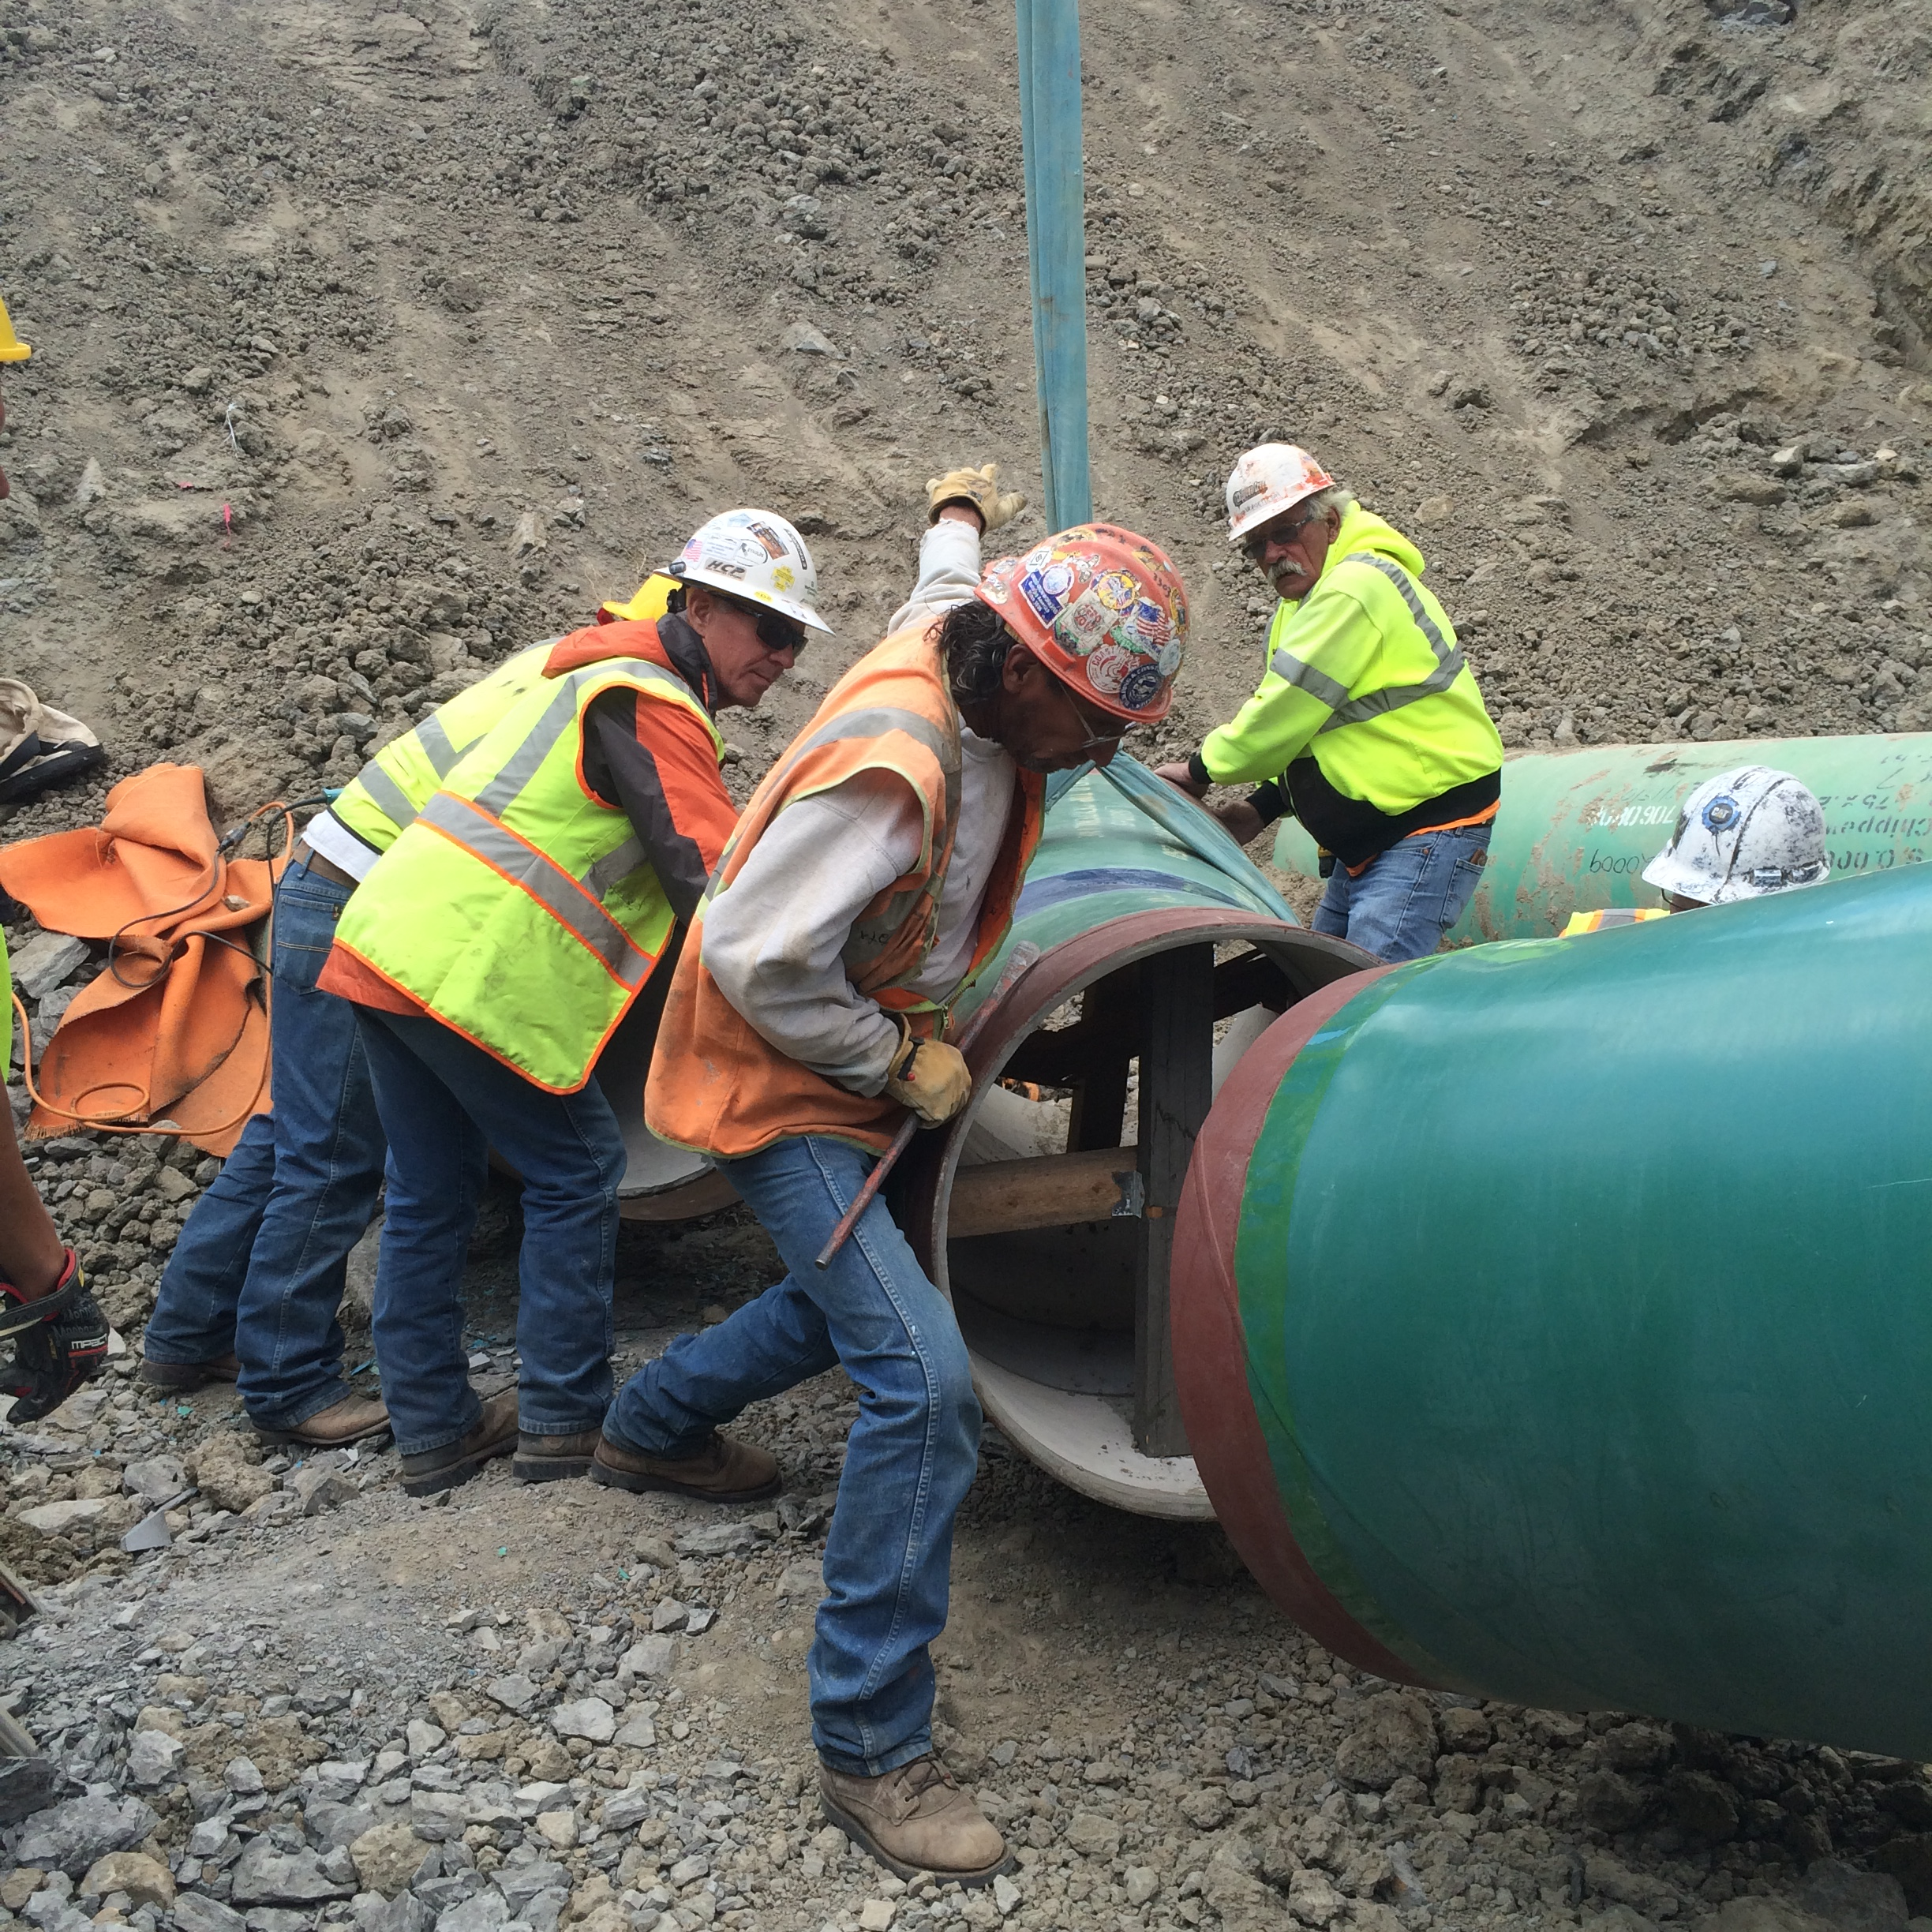
Lead Agency
Project Team
Chippewa Cree Construction Corporation (CCCC) = Owner/Builder
Bureau of Reclamation = Lead Agency for Construction
Bureau of Indian Affairs = Lead Agency for OM&R
AE2S = Engineer

Slide 13
Federal Funding Structure
Tribal
100% Federal
Core
Authority
80% Federal
10% State Match
10% Local Match
Federal Appropriations
Non-Core
Authority
80% Federal
10% State Match
10% Local Match

Slide 14
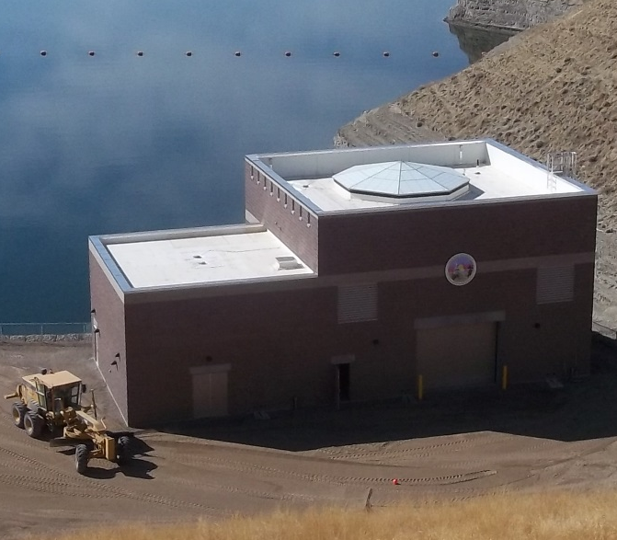
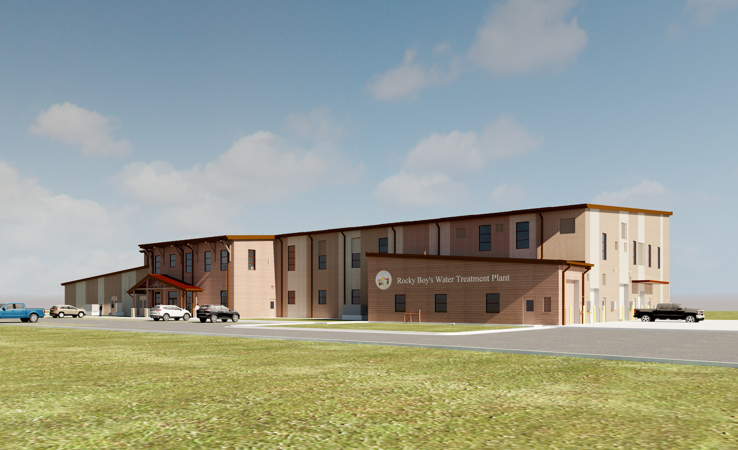
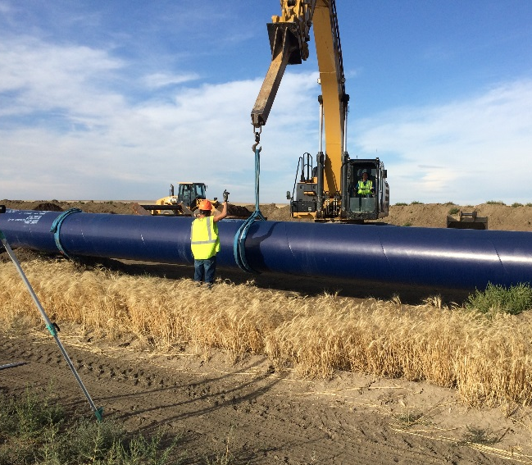
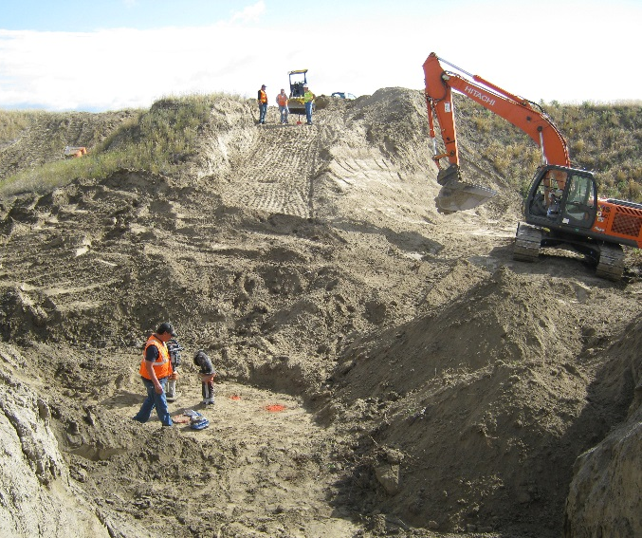
4 Components
Intake Structure
50% Complete
Water Treatment Plant
Bidding Phase
Core Pipeline
30% Complete
On-Reservation
15% Complete

Slide 15
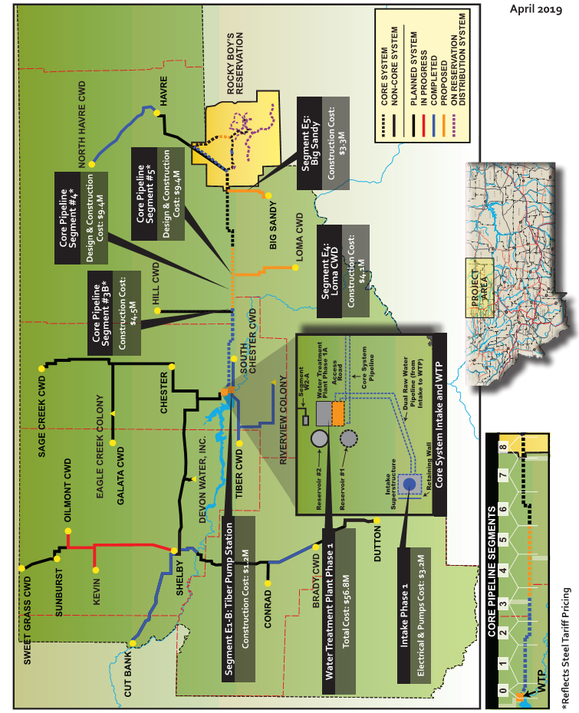

Slide 16
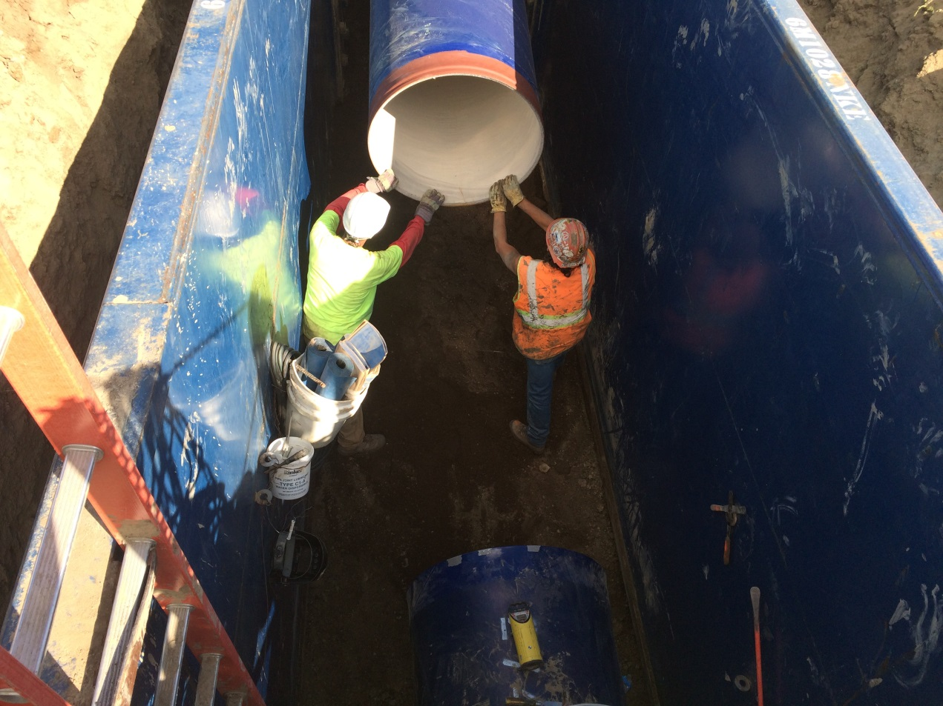
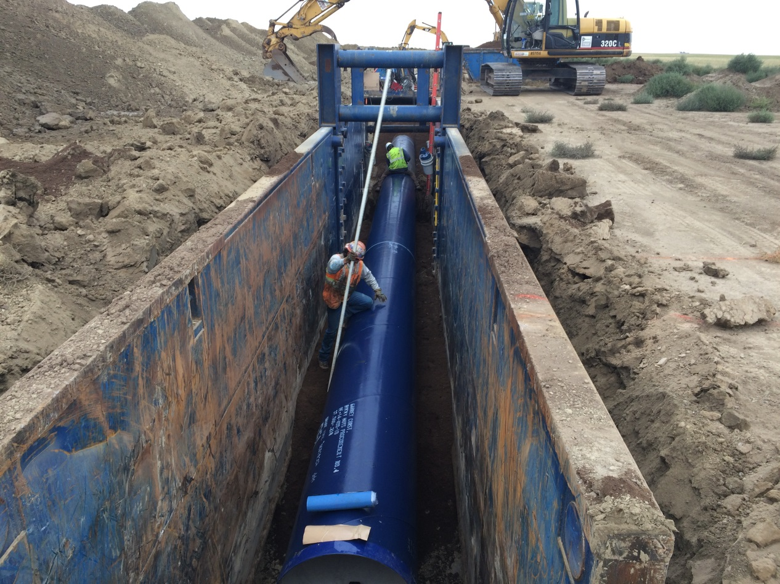
Core Pipeline (CCCC)

Slide 17
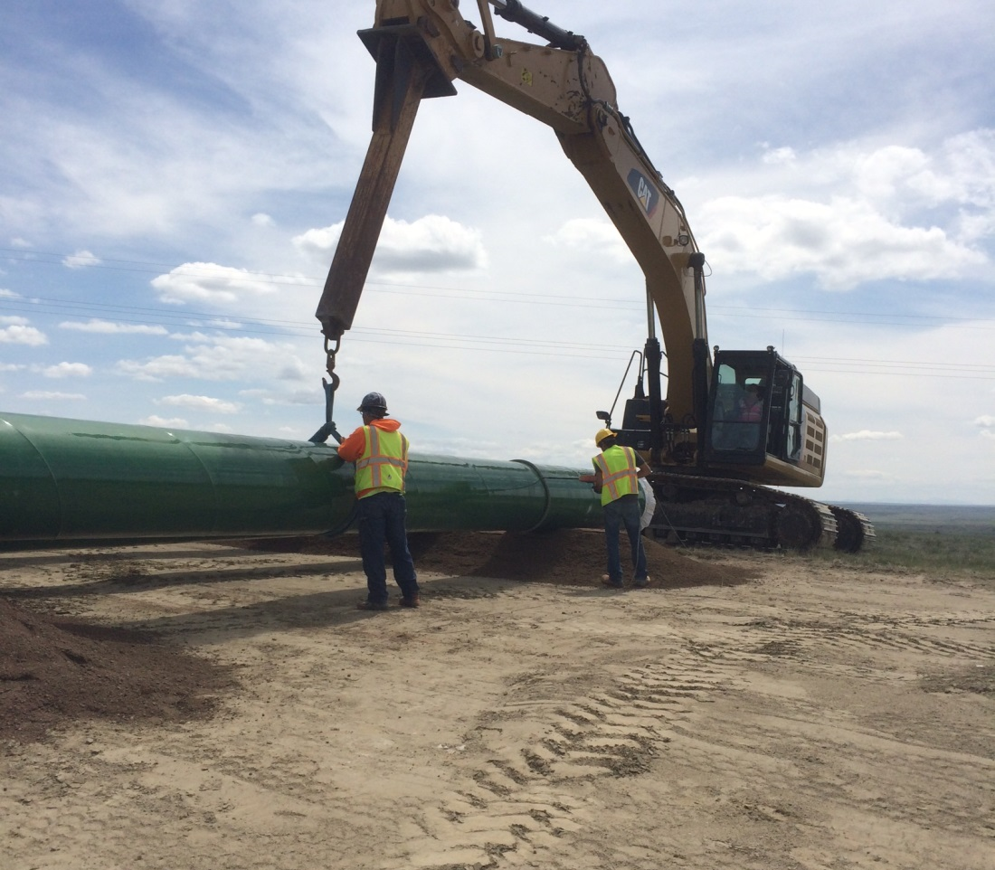
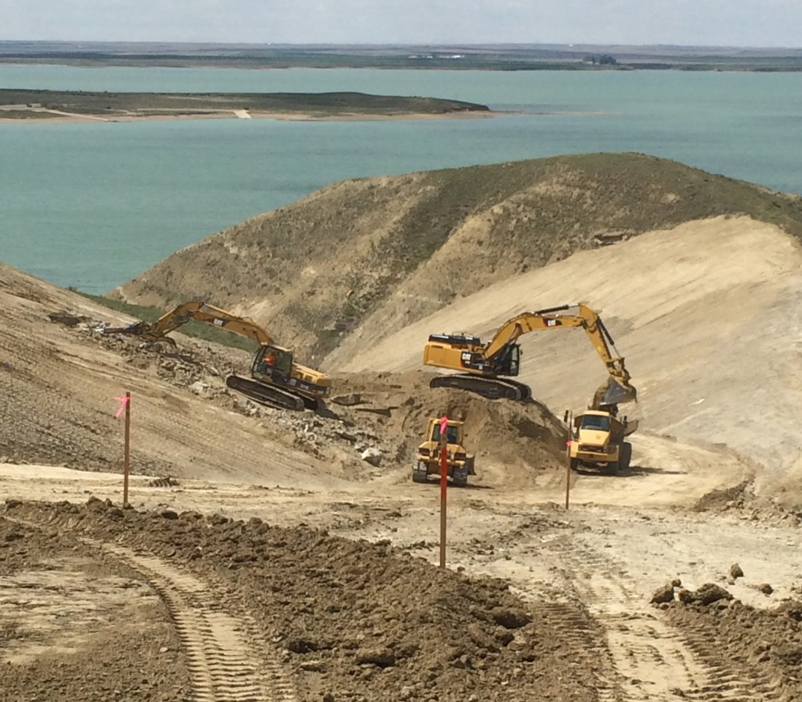
Tiber Raw Water Pipelines

Slide 18
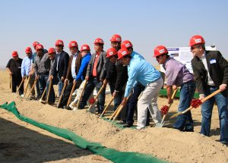
Water Treatment Plant
QR Code

Slide 19
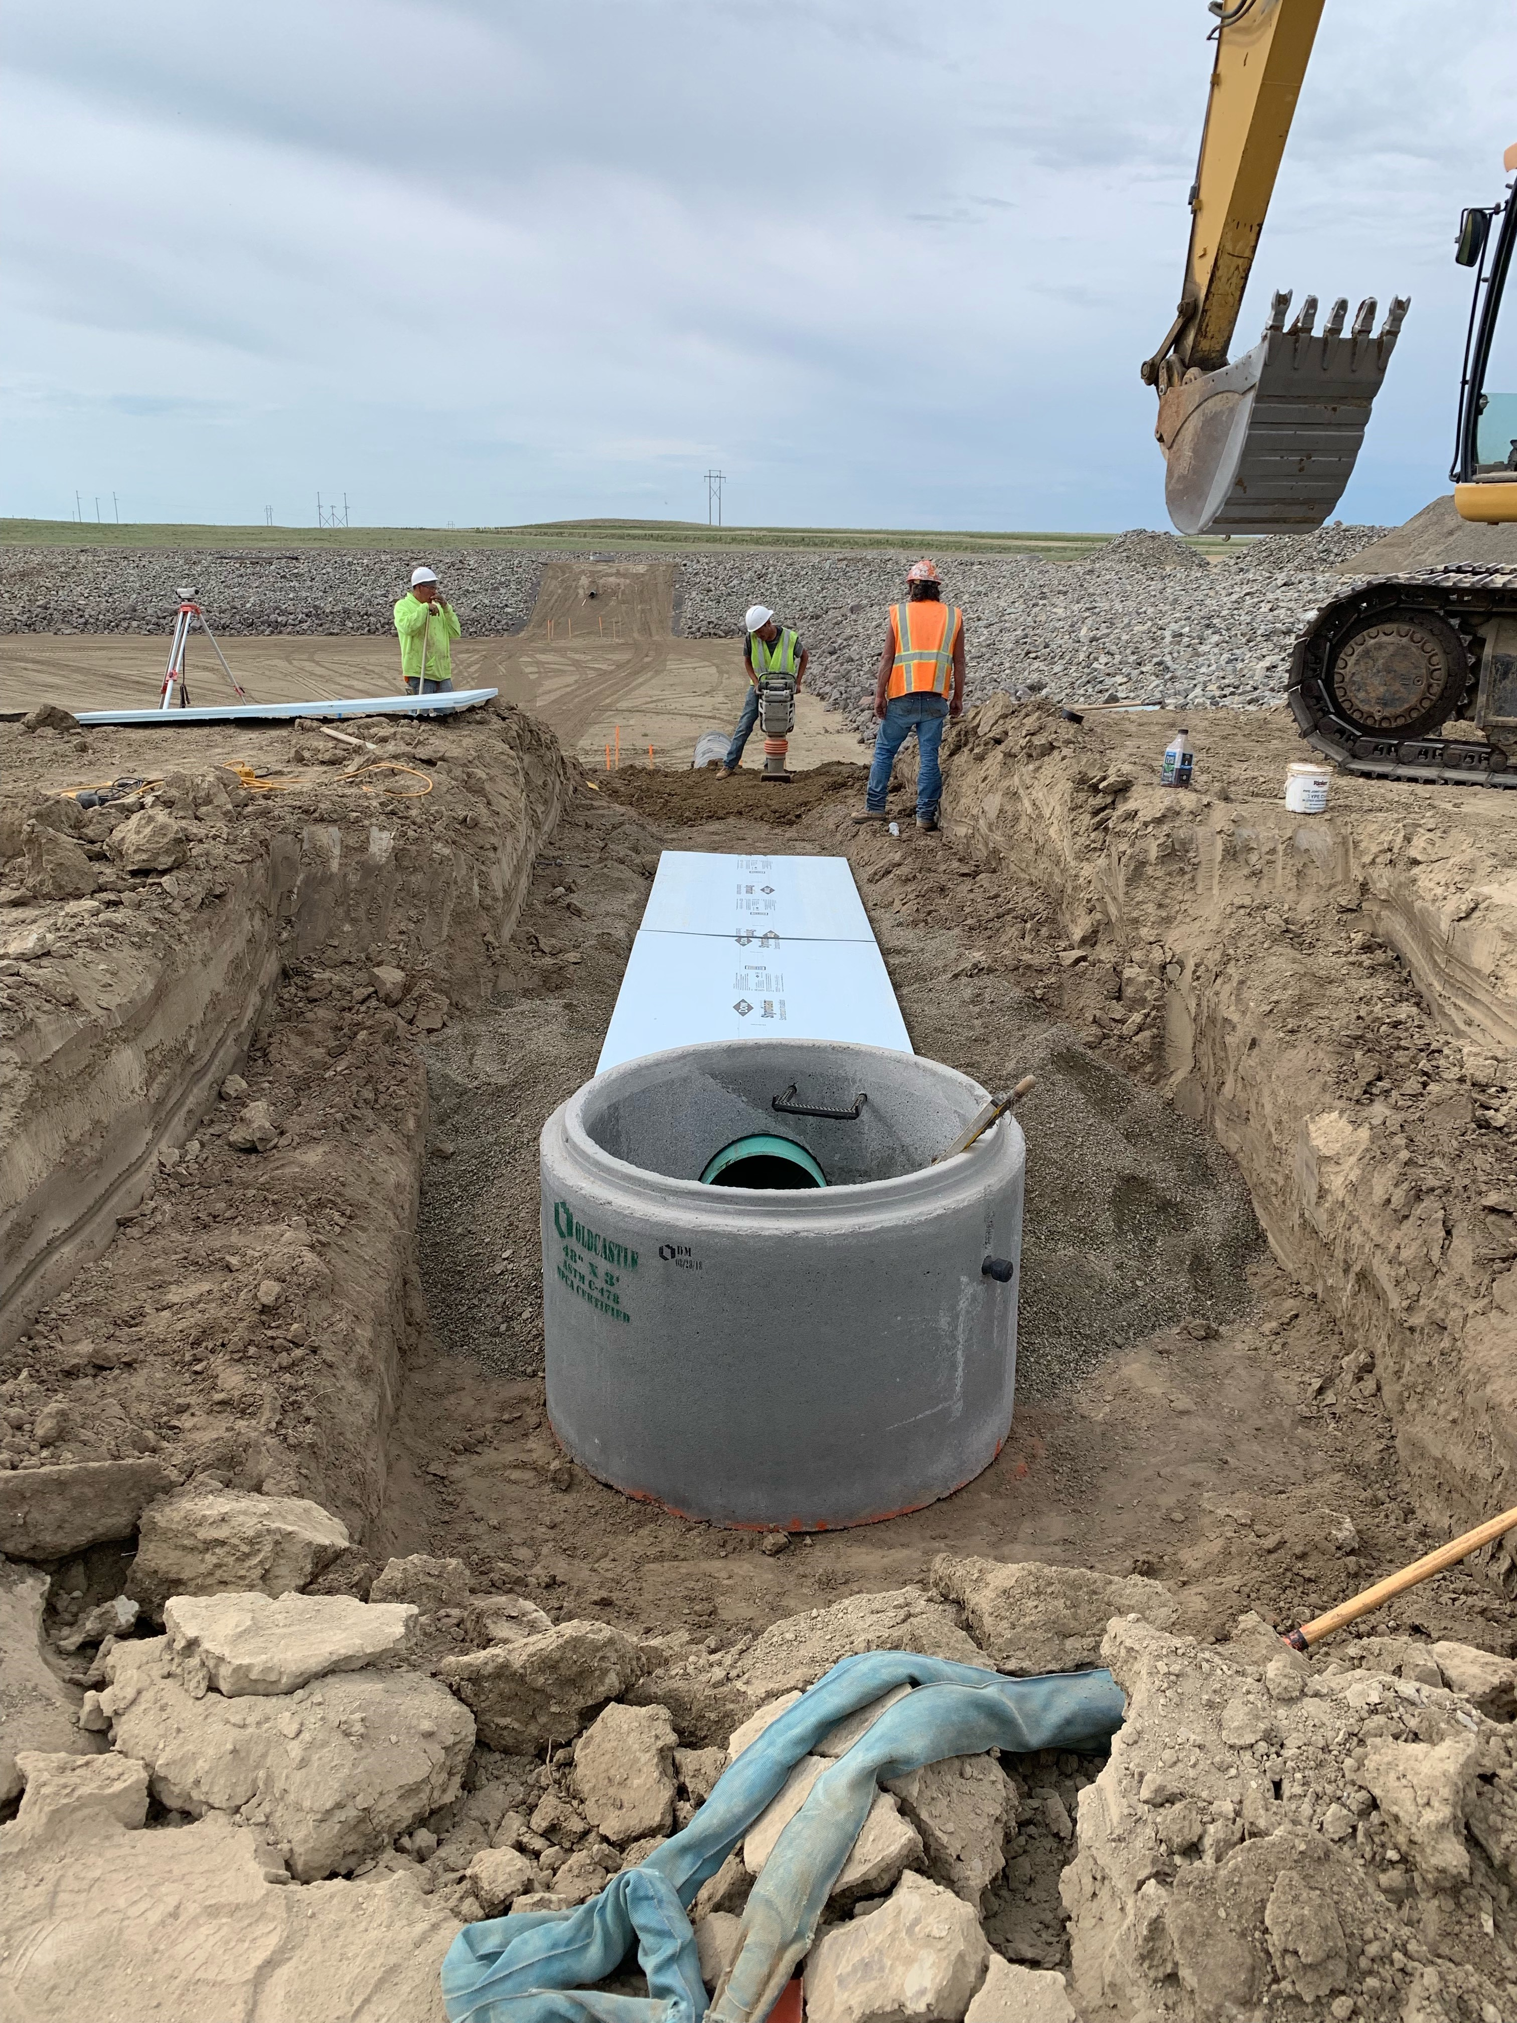
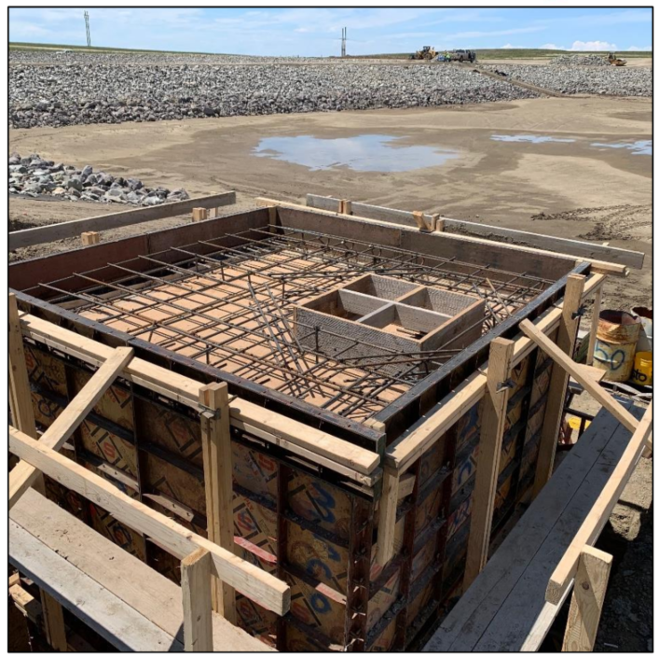
Water Treatment Plant - Construction

Slide 20
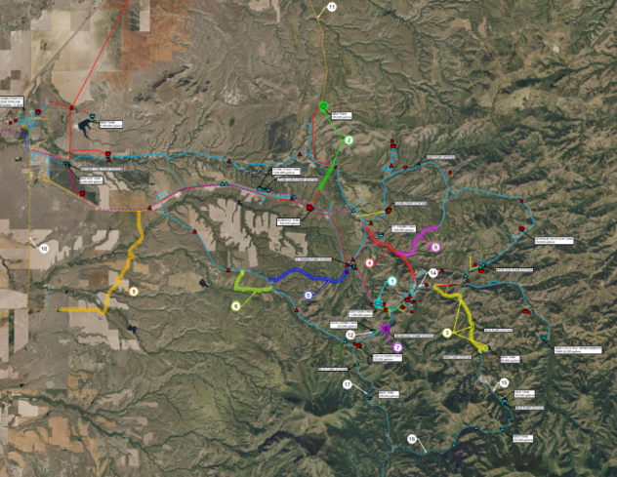
On-Reservation Water System
Existing Rural Water System = Extremely Supply Limited
Permanent Water Restrictions
Limits Economic Development
Significant Scope changes throughout the changes in DC Administrations

Slide 21
Administration Changes
Clinton (D) Era – Water Compact 1992-2000 (D/D)
  Baucus (D), Burns(R), Hill (R)
  BOR – Bruce Babbit
Bush (R) – Authorized - 2000-2008 (D/R)
  Baucus (D), Tester (D), Reiberg (R)
  BOR - Gale Norton, Dirk Kempthorne, John Keys
  BIA = Bruce Ward
Obama (D) – Stimulus 2008-2016 (D/D)
  Tester (D), Daines (R), Zinke (R)
  BOR – Ken Salazar, Sally Jewell, Hellekson/Stremcha, Lenny D, Mike Connor
  BIA - Mike Black, Irvin Bekis, Emerson Eskeets
Trump (R) – No ReAuthorization 2016 to Present (R/R)
  Tester (D), Daines (R), Gianforte (R)
  BOR=Ryan Zinke, David Bernhardt, Kruzich, Davies, Black, Mikkelsen
  BIA = Susan Messerly

Slide 22
FER
Basis for Congress/PL
Lead Agency Follow Explicitly
Underestimated/Overestimated
Basis for Funding Ceiling
Is this Budget Really Sufficient?
Budget Impacts for Future Scope Revisions

Slide 23
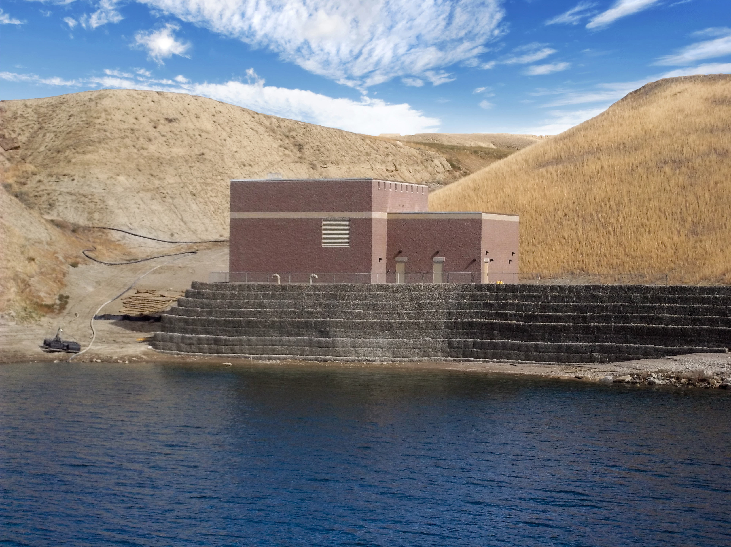
Original Plan (FER)
Intake/WTP
  22 MGD
Core Pipeline
  24-inch (10 MGD max)
On-Reservation Improvements

Slide 24

2008 Plan
Revised FER/Scope for More Users
  22 MGD to 36.5 MGD
  Havre, Chester, Brady, Cutbank, etc.
Plans for ReAuthorization
Gravity (to avoid pumping OM&R)
WTP Siting
Hydraulic Modeling Core Pipe
On-Reservation: State/Federal Funds
Intake Superstructure
Core Pipe Procure/Install
CCCC Employee Roster Grows

Slide 25

2018 Plan
Don’t Bet on Re-Authorization
Do not Exceed Federal Cap
  Different than Mni Wiconi (OST in SD)
Redesign(s)
  Reevaluate Water Demands for all Users
  Downsize Core Pipe (36 to 30”)
  Downsize WTP Capacity (36.5 mgd to 11 mgd)
  On-Reservation Budget Concerns ($60M to $20M)

Slide 26

Handling Change
Federal Relationship
  Be Ready
  Design Readiness
Local Relationship
Improvements/Ideas/Modeling
Technical Planning/Flushing
Effective Program Mgt Team

Slide 27
Program Management
Process of managing Tribe's portfolio of projects to improve program performance:
  Economies of Scale
  Reduced Risk
  Reduced Cost
  Better Communication
  Faster Response Time
  Better Services to Tribal Members
Manages
  Planning
  Funding
  Material
  Labor
  Contractors
  Engineering
  Change
  Management
  Costs
  Acquisitions
  Environmental,
  Regulatory
  Resources

Slide 28
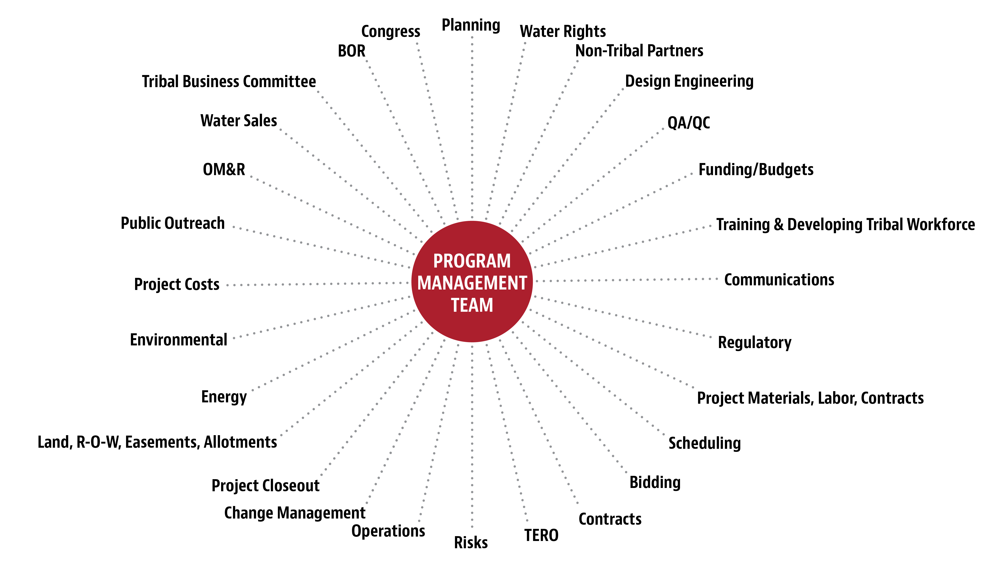

Slide 29
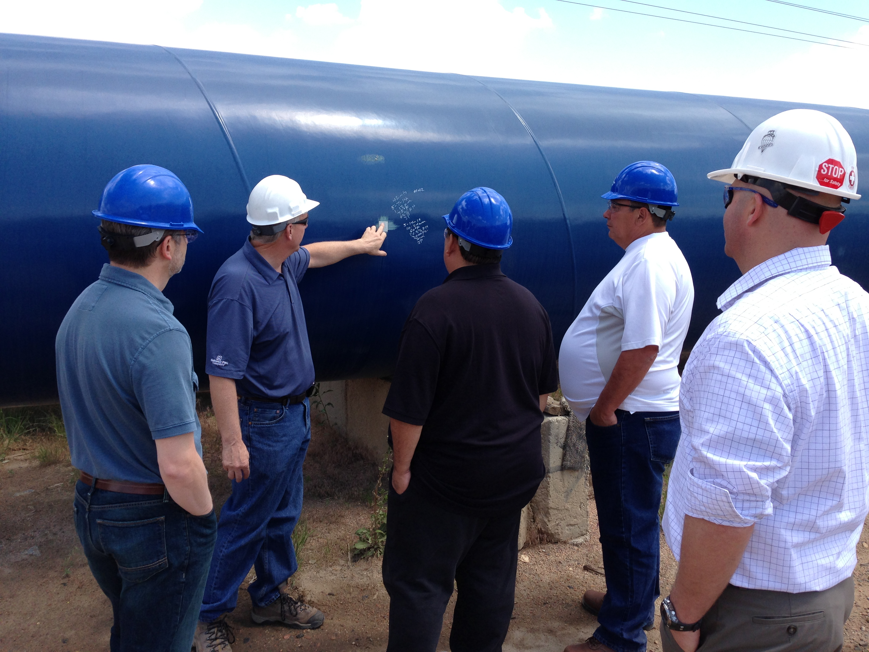
Program Management
Managing Outside Forces and Change Case Studies
  Steel Pipe
  Steel Tariffs
  OM&R
  Master Plan & Tribal Vision
Fight or Adapt
  Is Vision the Same or Revised?

Slide 30
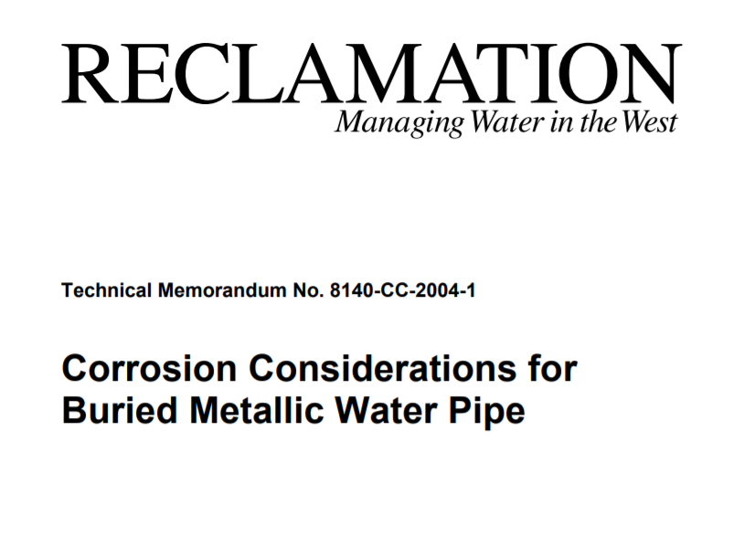
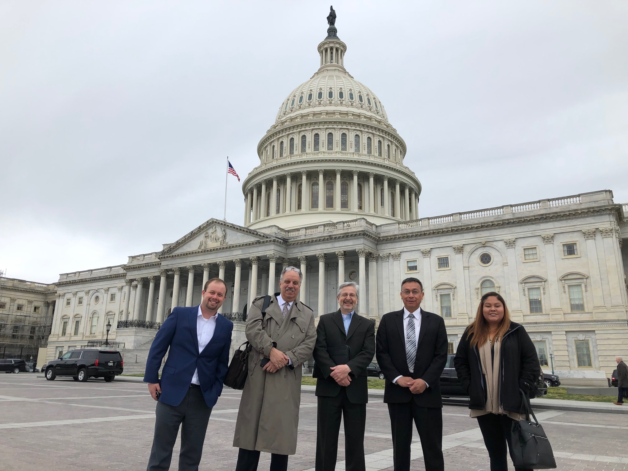
Case Study – Steel Pipe
Reclamation Design Standards
54 Miles Of Pipe
  DIP ($2.55/gal)
  PVC ($2.94/gal)
  Steel ($3.21/gal)
Technical Memo 8140-CC-2004-1
Steel Decision Added $8M+/-

Slide 31
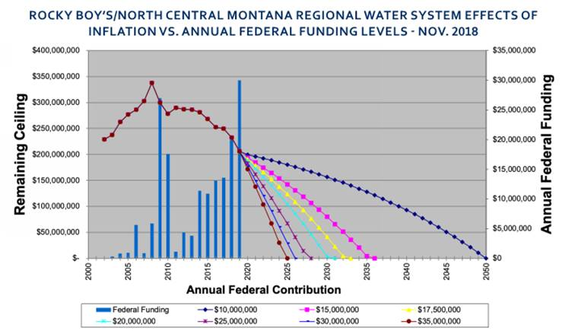
Case Study: Project Delivery = Funding
Limited Funding and Project Success, Increasing Ceiling
Increased Funding and Project Success, Paydown of Ceiling

Slide 32
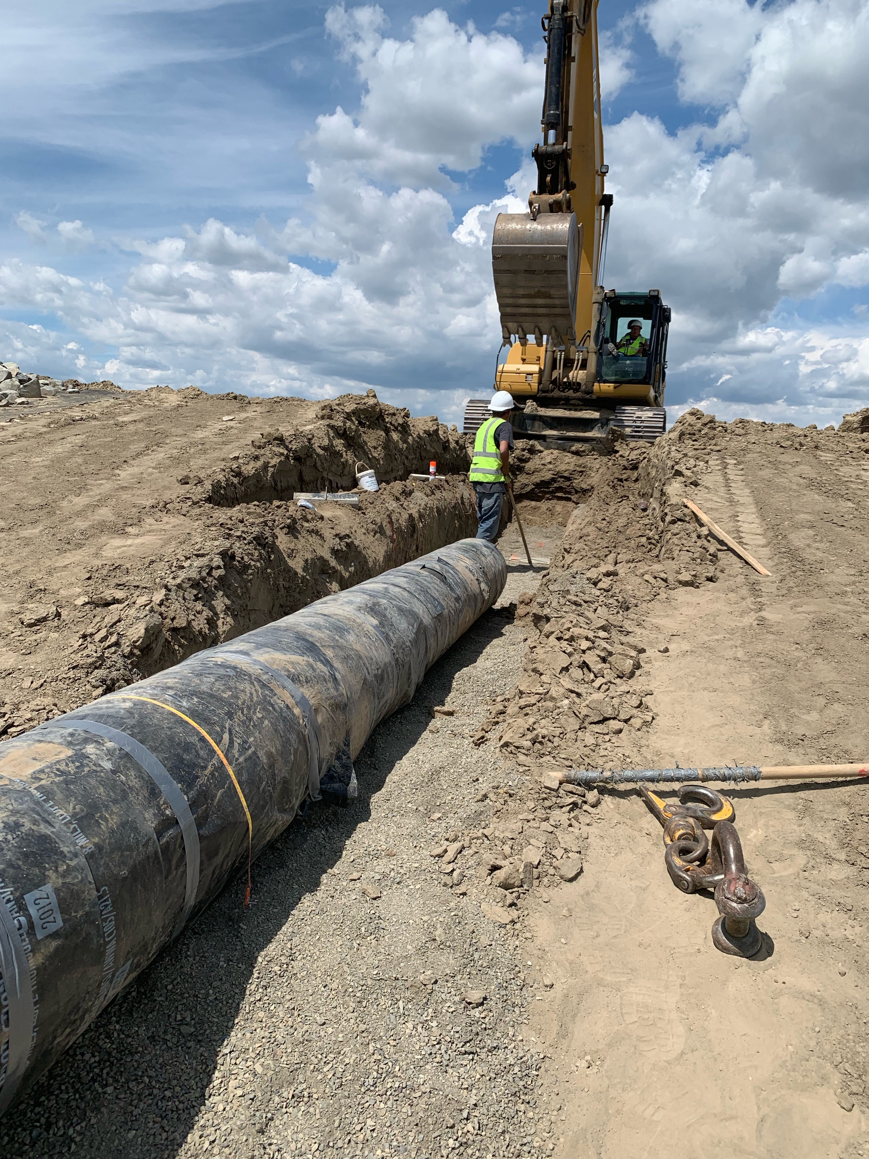
Effective Implementation
Leads to Funding
Lessons
  Authorization Doesn't Mean Appropriation
  Capability to Complete
  Self Perform (638) or Bid
  Labor Pool Skills, Remote Site, etc.
ARRA
  $24M
Negotiations
  Revised Plan in Exchange for Funding Support

Slide 33

Case Study - OM&R Importance
2002 Trust Fund = $20M
  $15M Tribal & $5M Federal
2010 Trust Fund Needs - $139M
  Federal Contribution via BIA??
2019 - To be Revised
  Alternative Funding = BIA?
Program Mgt Team has been critical to managing this Team

Slide 34
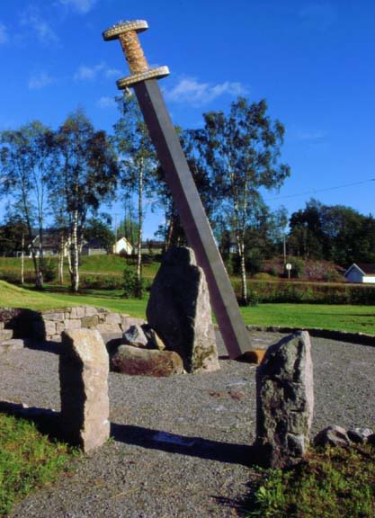
Weathering the Storm of Change

Slide 35
Case Study = Master Plan
Tribal Vision = Renewed
5.5 MGD to Rocky Boy
  Population
  Removing Water Restrictions
  Improve Water Quantity/Quality
Jobs (PL93-638)
Water Sales (10,000 acre ft)
Corelate Technical w/ that Vision
Alignment
Political Buy-In
Lead Agency Buy-In
COMPROMISES
Bid WTP
Downsizing Pipe
Phasing WTP
Capacity Reductions (Non-Core)
LEMONADE
Tero Employment at WTP
Continue Service to NonCore/Havre
Alternative Funding in Future
Peak Supplementation

Slide 36
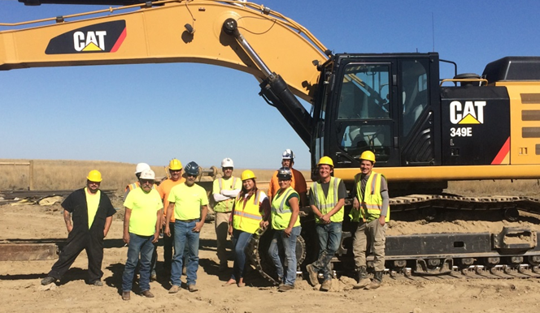
Case Study - Bidding
CCCC Labor Pool
Successful Organization
Production and Professionalism

Slide 37






Recommendations for Coping With Change
PERFORM
HAVE A CONSISTENT MESSAGE
PLAN
BE
PERSISTENT
OVERCOME HURDLES
BE
FLEXIBLE

Slide 38
Questions?
  Shalee Russette, CCCC
  406-352-8000
  Deon Stockert, AE2S
  701-690-3693

Slide 39

  Shalee Russette, CCCC
  406-352-8000
  Deon Stockert, AE2S
  701-690-3693

